Slide 1
NW Gas Market Outlook:
Winds of Change
Northwest Power Conservation Council
Natural Gas Advisory Committee
June 16, 2011

Slide 2

1914 Willamette Falls Dr., #255
West Linn, OR 97068
(503) 344-6637
www.nwga.org
NWGA Members:
Avista Corporation
Cascade Natural Gas Co.
Intermountain Gas Co.
NW Natural
Puget Sound Energy
Spectra Energy Transmission
FortisBC Energy, Inc.
TransCanada’s GTN System
Williams NW Pipeline

Slide 3
Recent Gas Demand

Slide 4
2008 Energy By Source
89%
94%
48%
108%
109%
Source: NPCC

Slide 5
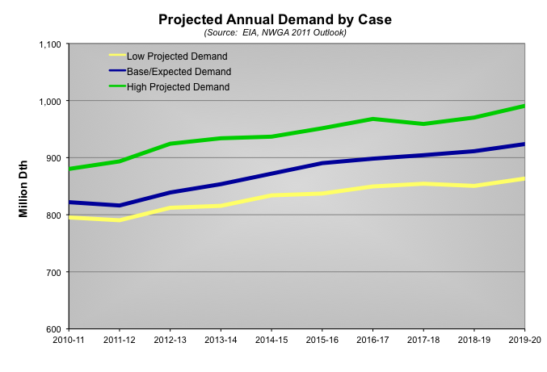
Demand Forecast

Slide 6
Base Case Forecast by Sector

Slide 7
Three Year Forecast Comparison

Slide 8
Decline in Projected Industrial Use

Slide 9
Demand Composition: 1996

Slide 10
Demand Composition 2019-20

Slide 11
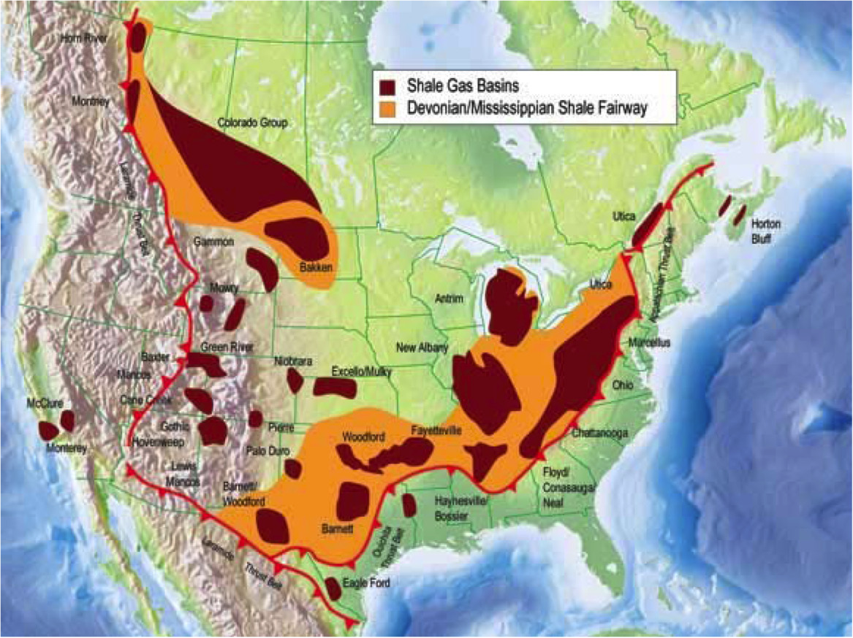
Shale Gas A Game Changer

Slide 12
Productivity Dramatically Improved
Southwest Energy
Fayetteville Shale
+341%
80,930
Source: Southwestern Energy Financials
+142%
+114%
+83%
2,439
4,503
33
+8%
-45%
1,006
$2.8
20
18
2,104
18,360
$2.6
11
Time To Drill
(Days)
Wells Per Yr
Per Rig
Average
Lateral Length
(Feet)
30 Day Ave.
Prod Rate
(Mcf/d)
Init Prod
Additions
Per Rig Per Yr
(Mcf/d)
Drill &
Complete
Costs ($MM)
Notes:
TECHNOLOGY IS REDEFINING DRILLING RIG PRODUCTIVITY.
The magnitude of technology change that is impacting the gas industry is evident when one looks at the time to drill statistics offered by many producers.
Slide 7 shows the numbers for Southwest Energy an independent company that operates primarily in the Fayetteville, E TX, and Marcellus.
Between Q1-2007 and Q4 – 2009 the time it took them to drill a well decreased by 45%. What makes this more remarkable is that they length of the horizontal lateral they drilled increased by nearly 100%. So they drilled wells that were twice as long, twice as fast. During the period their 30 day production rates rose dramatically and their production additions per year per rig increased by nearly 350%. All this happened while total cost per rig increased only 8% and if looked at on a $/MMBtu produced in the first year basis fell significantly.
This is but one company’s example, but producer analyst presentations are full of similar information. For example, in the Pinedale area of the Green River/Overthrust Ultra Petroleum dropped its average drilling time from nearly 80 days in 2006 to 25 in 2010. In their case average depth remained flat, but D& C costs fell from $7.0 to $4.8 Million. These types of efficiency gains are evident to varying degrees in all shales and to lesser even among conventional producers in the Anadarko and Permian.

Slide 13
Price Affect

Slide 14
2007 WCSB Production Forecast

Slide 15
WCSB Production Forecast

Slide 16
BC Propping Up WCSB
Bcfd
Data Source: Navigant
Notes:
--

Slide 17
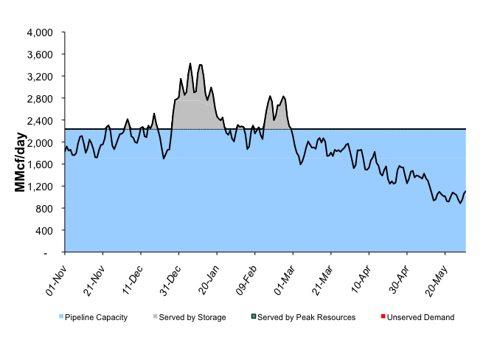
Winter-long Capacity
CTN: 2019-20, Expected Demand

Slide 18
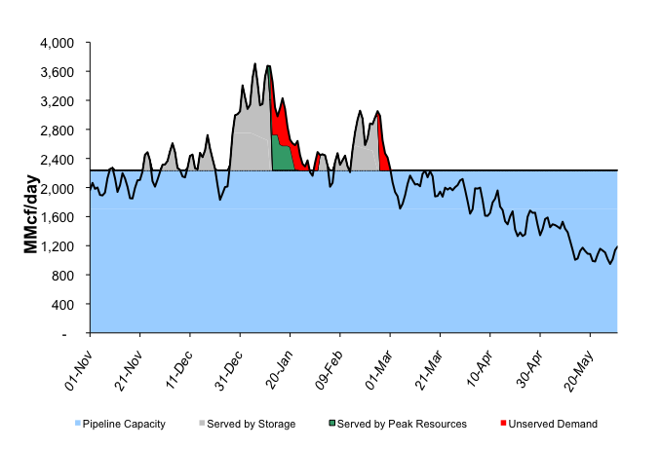
Winter-long Capacity
CTN: 2019-20, High Demand

Slide 19
2008 Peak Capacity I-5 Corridor

Slide 20
Current Peak Capacity I-5 Corridor

Slide 21
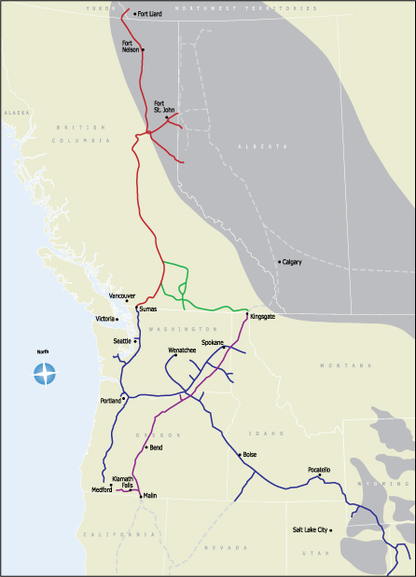
Capacity Projects
Pipelines
Southern Crossing Expansion
Palomar
Sunstone
Blue Bridge (reconfigured)
Ruby
Pacific Connector
Pacific Trail
Oregon LNG
LNG Terminals
  Kitimat LNG (export)
  Bradwood Landing
  Oregon LNG
  Jordan Cove LNG
Storage Facilities
Mist
Jackson Prairie
Kitimat LNG
Oregon LNG
Bradwood Landing LNG
Jordan Cove LNG

Slide 22
1914 Willamette Falls Dr., #255
West Linn, OR 97068
(503) 344-6637
www.nwga.org
NWGA Members:
Avista Corporation
Cascade Natural Gas Co.
Intermountain Gas Co.
NW Natural
Puget Sound Energy
Spectra Energy Transmission
FortisBC Energy, Inc.
TransCanada’s GTN System
Williams NW Pipeline

