Slide 1

The Coded-Wire Tag Program:
A Conservation Perspective
May 10, 2012
Presented by Micki Varney
Oregon Department of Fish and Wildlife

Slide 2
Monitoring and Evaluation (M & E) are essential components of ESA Recovery Plans and Artificial Production Programs
Evaluate Performance objectives
Gauge effectiveness of recovery measures
Measure progress toward recovery and mitigation goals
Maintain accountability
Provide basis for adaptive management
Notes:
What does Monitoring and Evaluation mean?
to observe and Examine, then assess or measure.
Why link ESA recovery and conservation with AP programs?
There is a movement toward Hatchery Reform--a systematic, science-driven redesign of our hatchery systems to achieve two new goals:
Conserve naturally spawning populations
Support sustainable fisheries
Leading the charge was Washington U.S. Rep. Norm Dicks, who steered the “Mitchell Act 2010 Expansion To Implement Hatchery Reform” through a House appropriations committee in the summer of 2009. The bill language required salmon management activities that “begin implementation of reforms developed by the Hatchery Scientific Review Group to operate these [Mitchell Act] facilities in a manner more conducive to salmon recovery.’’
The Hatchery Scientific Review Group (HSRG), experts from the fields of fish biology, science, hatchery operations, and fish management, are tasked with independently reviewing hatcheries and providing recommendations with clearly identified goals and objectives. They formalized the hatchery reform process and raised the bar for the use of scientific rigor in hatchery operations.
Monitoring and Evaluation are essential components of ESA Recovery and Hatchery Management Plans
Evaluation of performance objectives
Gauge effectiveness of recovery measures
Measure progress toward recovery and project goals
Maintain accountability
Provide basis for adaptive management
Hatcheries are tools that should be used when they represent the best strategies for meeting clear and measurable goals for salmonid stocks.

Slide 3
Coded-Wire Tags are Essential
M & E Tools
  Hatchery Evaluation/Management
      Evaluate hatchery rearing and release strategies
      Estimate Contributions to fisheries
      Brood stock management
          Smolt-to-Adult Return Rates (SAR’s)
    Wild/Hatchery proportions, pHOS
    Run size and composition
  Distribution and abundance (fisheries and on spawning grounds)
Notes:
Outside of Fishery management, What are CWT’s Used for
pHOS is proportion of fish spawning in wild consisting of hatchery-origin fish

Slide 4
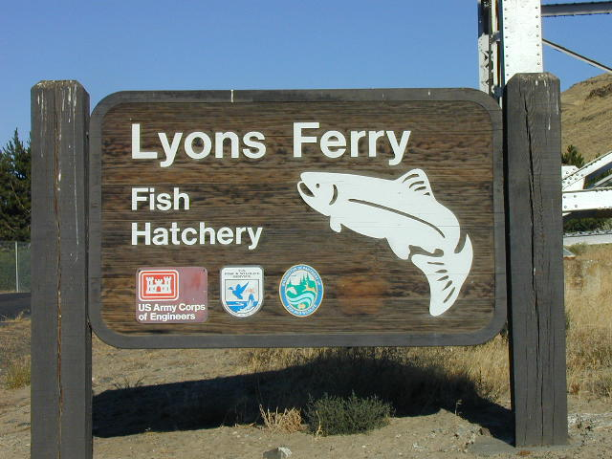
The Snake River Fall Chinook Salmon Program—A Case In Point
Notes:
Snake River Fall Chinook Salmon Program:
An example of a long-standing integrated Hatchery program that used CWT’s to make adaptive management decisions in order to maintain the genetic integrity and viability of Snake River Fall Chinook Stock.
CWT’s were the tools that provided and continue to provide the best science available to monitor and assess progress toward program and conservation objectives.
From APRE review: The goal for the stock is to maintain biological significance and improve viability over time. The program has primary mitigation goals of (1) recovery/supplementation and conservation of Snake River fall chinook and (2) harvest supplementation of fall chinook for fisheries in the lower/mid Snake River, Columbia River/Estuary, and Pacific Ocean.
The program is consistent and compatible with management, conservation, and research goals of the stock and other stocks within the Snake River Basin

Slide 5
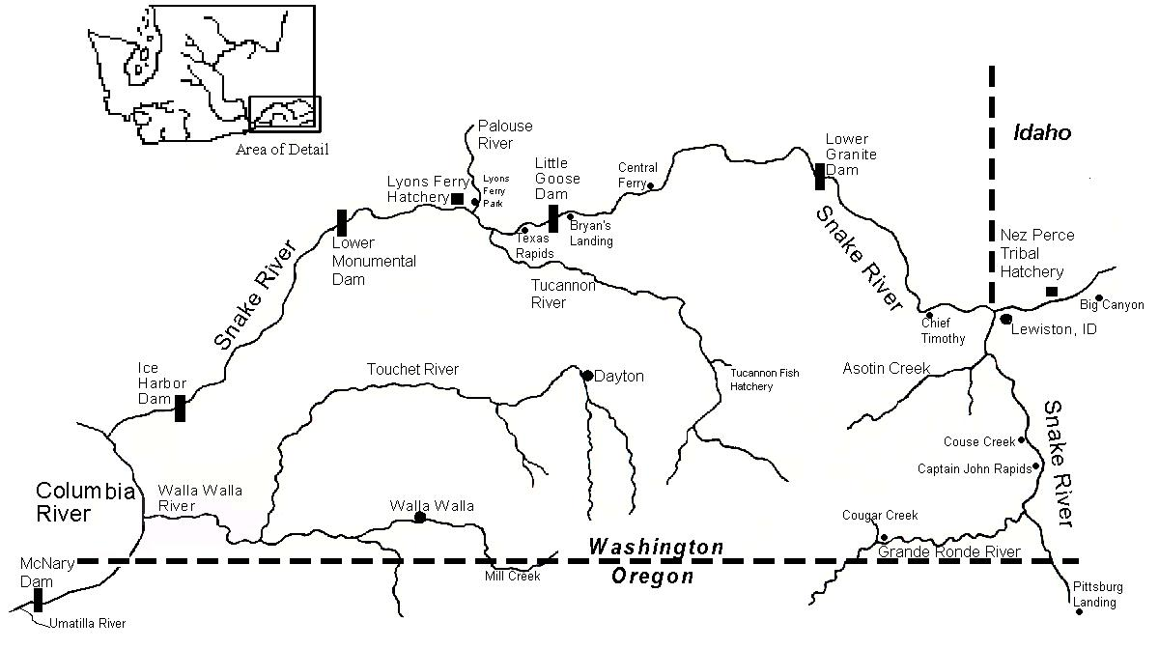
Snake River Area Map
Rkm 173
Rkm 95
Mouth of Snake River
(Col Rkm 522)
Rkm 346
Hells Canyon Dam
Rkm 397.4
Notes:
For perspective,
Snake River mouth Columbia River Mile 324
Walla Walla
Dayton
Lyons Ferry Hatchery
Hells Canyon Complex 1958 - 1967
Hells Canyon, Oxbow, Brownlee
Lower Snake River Dams 1961 - 1975
Ice Harbor, Lower Monumental, Little Goose, Lower Granite.
Hells Canyon Complex—no fish passage
Construction of these 7 main-stem dams over 20 years eliminated or severely degraded 530 miles of spawning habitat.
5

Slide 6
Historical Fall Chinook Returns to the Snake Basin and timing of Lower Snake Dam Construction
1962-1985 (Ice Harbor Dam Window Counts)
Ice Harbor
Lower
Monumental
Little Goose
Lower Granite
Notes:
IHR 1962
LMO 1969
LGO 1970
LGR 1975
Hells Canyon Complex 1958 - 1967
Hells Canyon, Oxbow, Brownlee
Lower Snake River Dams 1961 - 1975
Ice Harbor, Lower Monumental, Little Goose, Lower Granite.
Hells Canyon Complex—no fish passage

Slide 7
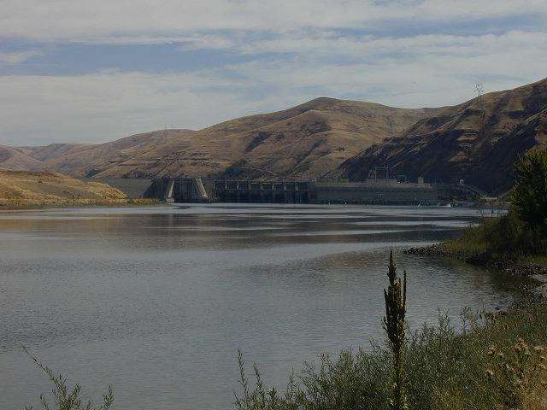
Lower Snake River Fish and Wildlife Compensation Plan (LSRCP) - 1976
Mitigate for juvenile passage mortality and direct loss of spawning area for 5,000 fall Chinook
Return 18,300 adults/year to the Snake River Basin
In-place and in-kind (maintain genetic integrity)
Notes:
LSRCP Mandated by Congress
Funded by the USFWS through the LSRCP Office (Boise) with power production revenues provided by the Bonneville Power Administration.
Included Spring Chinook and Steelhead too.
Hatchery compensation / mitigation for:
Juvenile passage mortality caused by the four Lower Snake River Dams
Direct loss of spawning area for 5,000 fall Chinook
Return 18,300 adults/year to the Snake River Basin
In-place and in-kind (maintain genetic integrity)
Escapement 18,300
Commercial Harvest 54,900
Recreational Harvest 18,300
91,500 Total

Slide 8
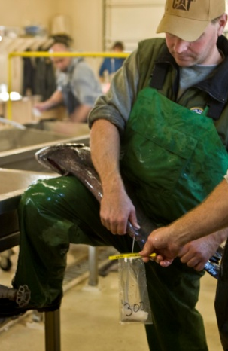
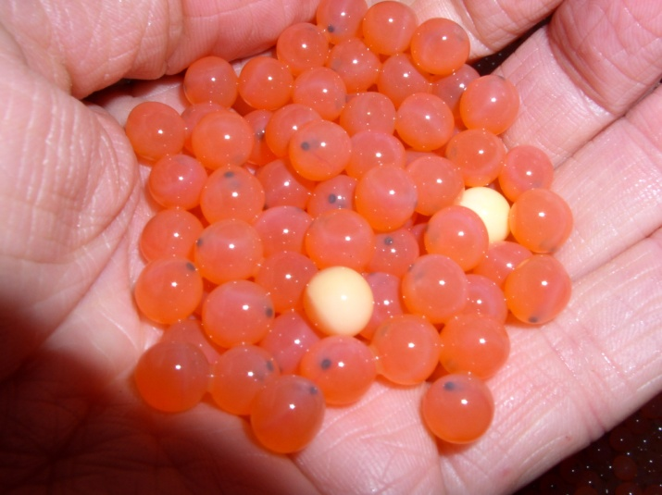
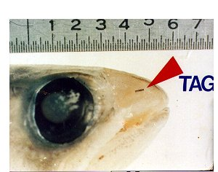
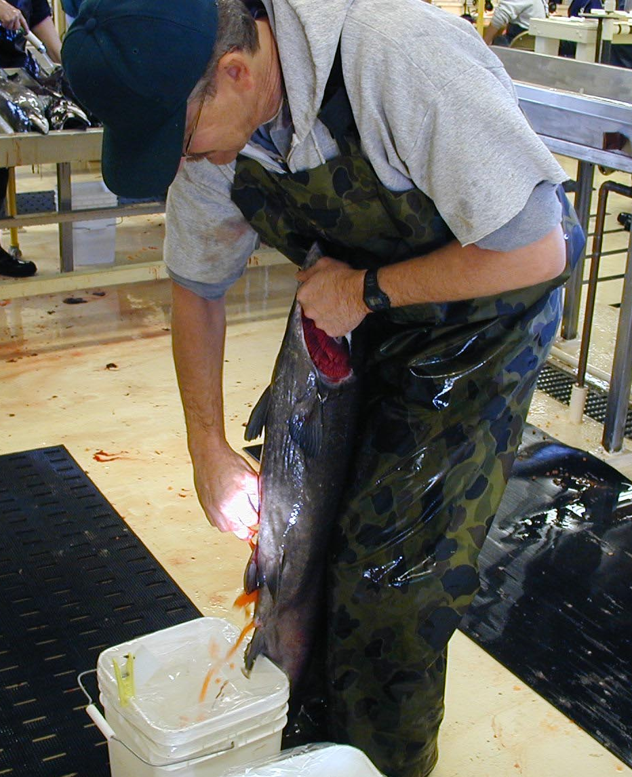
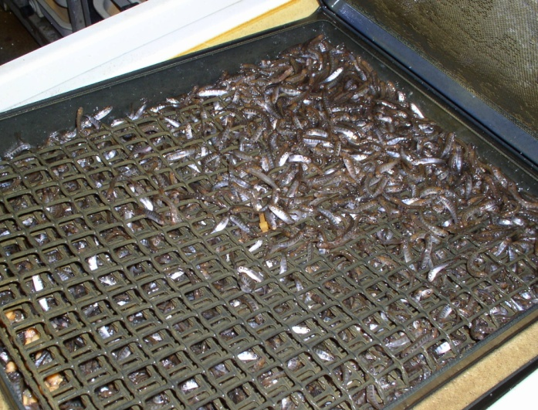
Egg Bank Program
1976
Notes:
1976-1986
the Fall Chinook Egg Bank Program Goals:
To maintain the population through artificial propagation at hatcheries until Lyons Ferry Hatchery could become operational by trapping in the Snake R. and rearing at existing hatcheries.
Trap and haul from Snake River.
Rear and release from Kalama Falls Hatchery.
Trap and spawn at KFH, provide eggs to LFH.
To maintain the genetic integrity of the stock.
To Accelerate LFH startup by having multiple broodstock sources

Slide 9

Roles of Players in the Egg Bank Program
1976
Hagerman Hatchery
Mid-Snake Juvenile
releases
Kalama Falls Hatchery
Lower Columbia River Juvenile releases and collection of Returning Adults
Little Goose Dam
Ice Harbor Dam
Lower Snake River
Adult Collection
Lyons Ferry Hatchery
Lower Snake River Juvenile releases and Adult collection
1986
Notes:
Adult Fall Chinook trapped primarily at IHR Dam (closest Dam to mouth of Snake River)
Genetic monitoring ---adults trapped at IHR for the Egg Bank Program were genetically sampled (baseline data).
Smolts (juveniles) were initially released into the middle Snake (Asotin, 10-mile, LGR) (by Hagerman hatchery) and Lower Columbia River (Kalama Falls Hatchery)--to avoid passage related mortality
By 1984 all juveniles were being released into the Snake River
Broodstock collection continued at Ice Harbor but was supplemented by the Marked Snake-Origin Adults that returned to Kalama Falls Hatchery to spawn.
The Egg Bank Program was considered a substantial success.

Slide 10
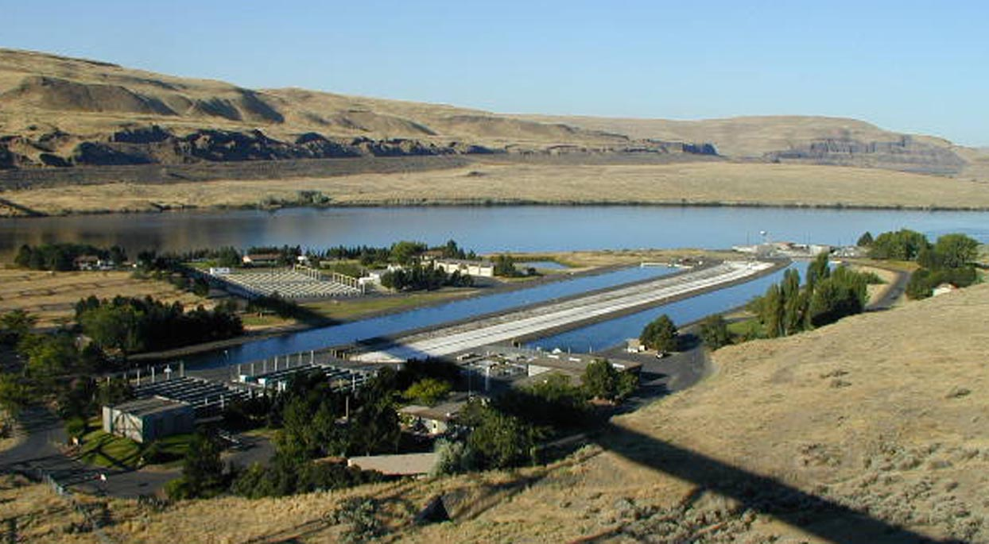
Lyons Ferry Hatchery 1980-1984
Notes:
Construction occurred 1980-1984
Rkm 95
Located between Lower Monumental and Little Goose Dams
1984 LFH on line,
First adult returns to LFH in 1986 added to available broodstock, and the Egg Bank (Kalama Falls Hatchery portion) program was phased out by 1987.

Slide 11
Early Lyons Ferry Hatchery Fall Chinook Production Goals
(to return 18,300 adults to Snake River Basin)
9.16 million subyearling smolts (101,880 lbs)
  at 90 fpp (80 mm)
  expected smolt-to-adult return (SAR) of 0.2%
Idaho Power Co. mitigation for Hells Canyon Complex
  for 1.3 million eyed eggs
  due after LFH reached 80% of capacity
Notes:
The LF Hatchery was sized to meet goal based on subyearling production
Release size and stage was to mimic wild emigrating fall Chinook.
Additional hatchery size paid for by IPC would eventually provide eggs for Hells Canyon Mitigation.

Slide 12
Stock Composition at Lyons Ferry based on CWT expansions
Very high stray rate—could jeopardize the SRF stock integrity
Notes:
Stray Umatilla and Columbia River hatchery fish became alarmingly prevalent by 1989 and 1990.
The Majority were Dip-in’s to IHR that were being trapped and hauled to Lyons Ferry.
This was a significant threat to the programs’ primary goal of maintaining genetic integrity

Slide 13
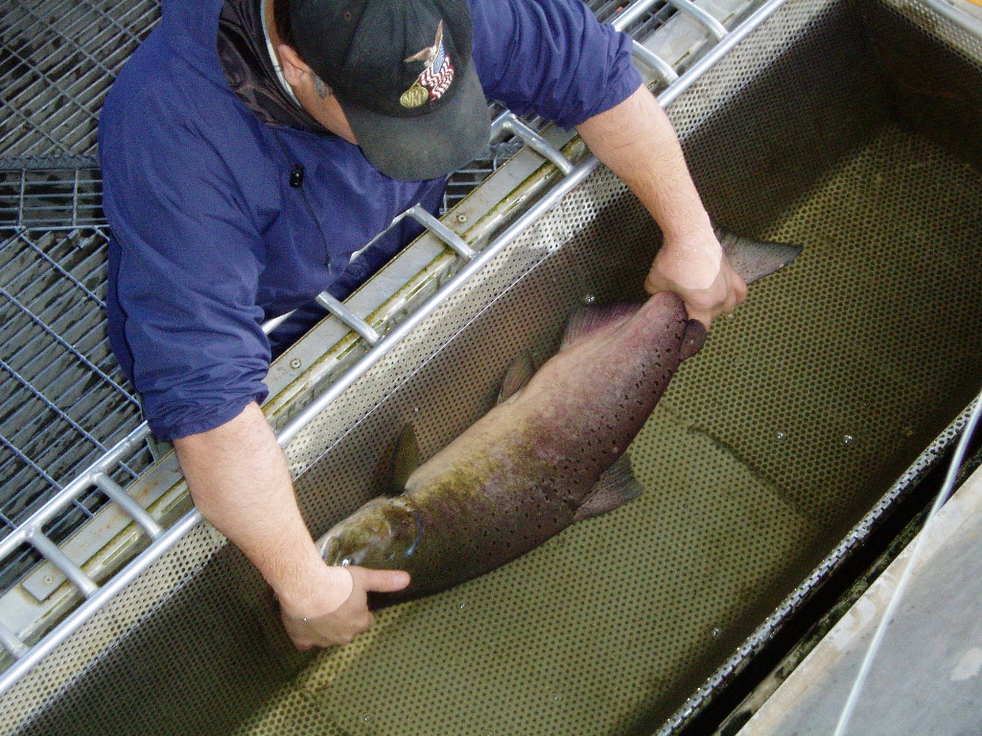
Program Adjustments to Maintain Genetic Integrity:
1989 Brood Progeny
  Initiated 100% wire-tagging
Modified broodstock collection protocol
  LGR trapping
  Unmarked fish
Beginning in 1990, CWT’s were read prior to combining the gametes
Fall Chinook trapped at Lower Granite Dam
Notes:
A series of action were taken at this time to rectify the problem:
1989 Brood Progeny
100% wire-tagged with either a CWT or BWT and would not be used for broodstock when they returned as adults.
Changed broodstock collection protocol
In 1990, initiated supplemental trapping at Lower Granite Dam (1988 LGR Trap started operation, 1995 )
reduce strays spawning naturally.
estimate stray rate at LGR.
supplement broodstock for LFH, fewer strays arriving at LGR than at IHR or LFH.
No more unmarked fish in broodstock
During spawning, CWT’s were read prior to combining the gametes
All subsequent broods 100% marked w/ CWTs
Adoption of full yearling program to maximize SAR

Slide 14
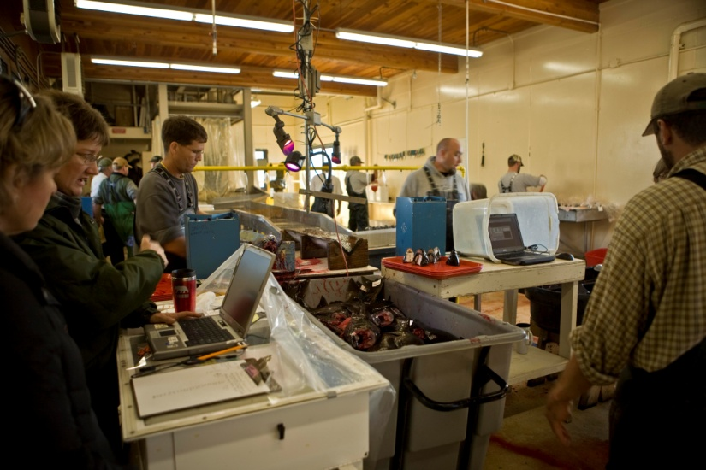
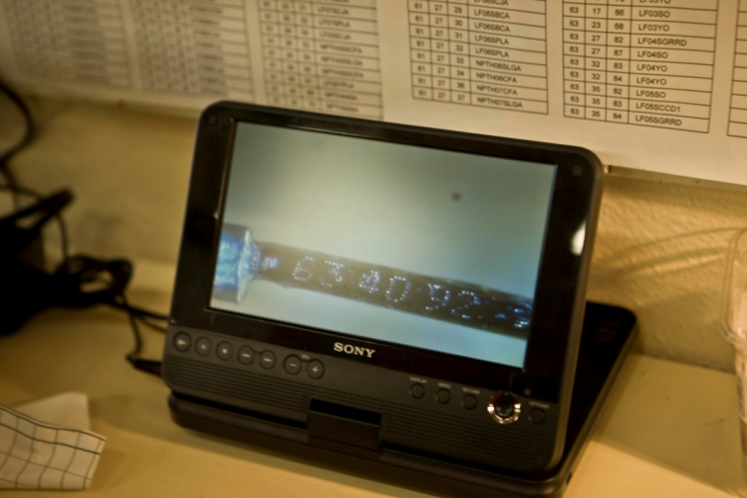
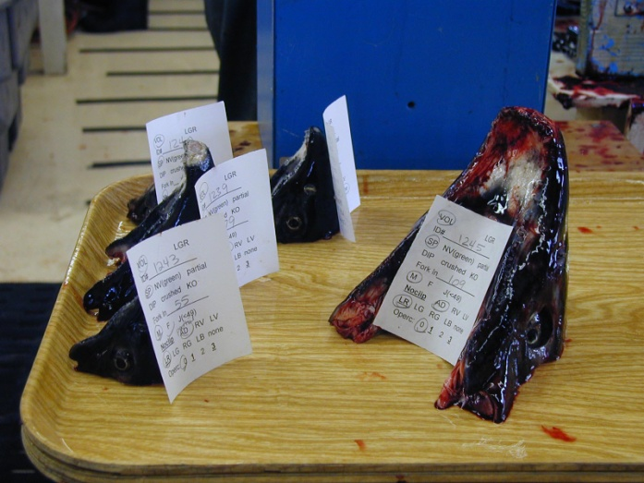
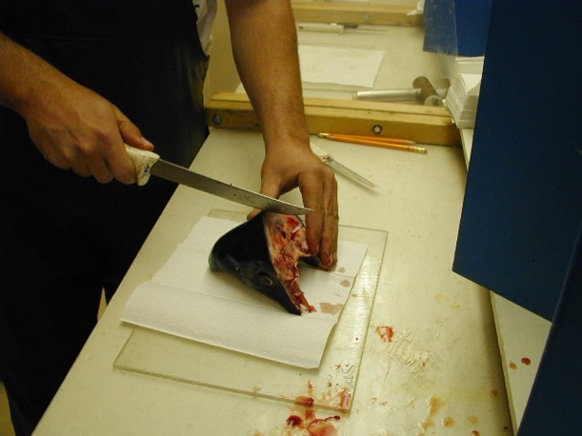
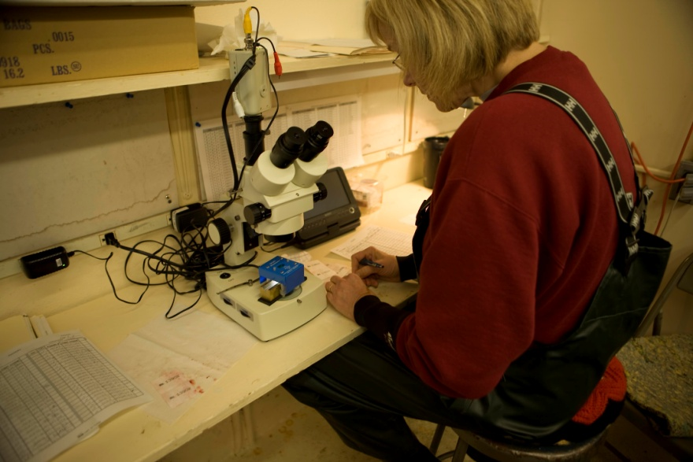
Notes:
Began reading the wires on all CWT fish prior to spawning.

Slide 15
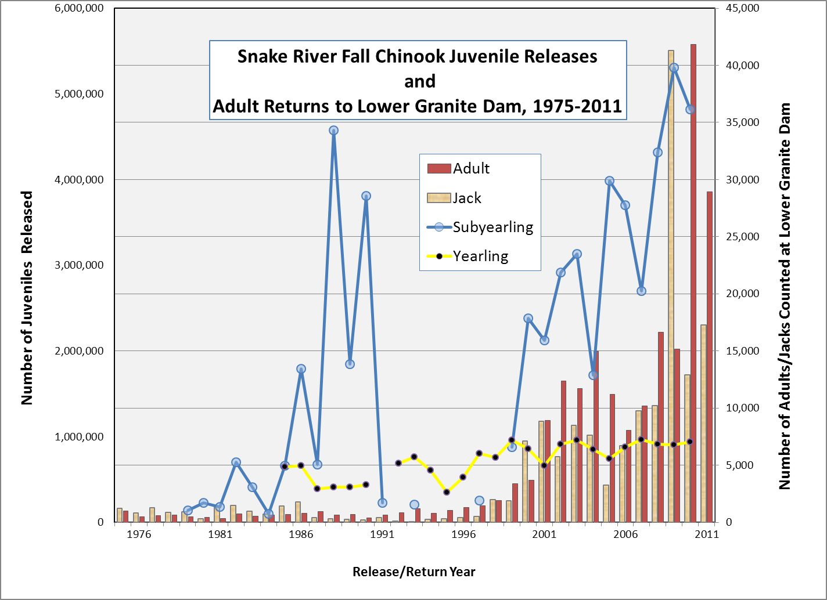

Slide 16
CWT’s continued to play an Integral role in Providing the Data Necessary to Guide Management Decisions
  Yearling/Subyearling Comparative Survival Study (1985-1990)
  Snake River Fall Chinook ESA Listed as threatened in 1992
  Fall Chinook Acclimation Program (FCAP)-1996
Notes:
Yearling/Subyearling Comparative Survival Study (1985-1990) Used CWT recoveries to calculate SAR’s.
evaluate rearing strategies to maximize SAR’s
Snake River Fall Chinook Salmon were listed for protection under ESA with a proposed recovery goal of 2,500 spawners to the Snake River spawning grounds (NMFS 1992, 1995).
The 1992 ESA Listing included both the Snake River Wild and Lyons Ferry Hatchery Stock in the same ESU
Decreased the allowable harvest downriver and in the Ocean Fisheries
CWT’s would be necessary to determine the hatchery/wild composition in the return
Fall Chinook Acclimation Program (FCAP) facilities above LGR begin operation in 1996 with juveniles reared at LFH.
Evaluation of Subyearling and yearling releases from 3 different Acclimation sites required CWT’s
The 1997-2001 geometric mean natural-origin count over Lower Granite Dam was 871 fish, approximately 35% of the delisting abundance criteria proposed for this run (2,500 natural-origin spawners averaged over an 8 year period)

Slide 17
Lyons Ferry Fall Chinook Survival Rate Comparisons from CWT recoveries
(On-Station Releases Only)
Subyearling Mean = 0.05
Yearling Mean = 0.59
Notes:
Estimates from CWT recoveries of Yearling vs subyearling SAR’s showed clear 11-fold advantage to yearling production.
Subyearling survival only one-fourth the initial program goal of 0.2.
New Production Goals:
Continue to Maintain genetic integrity of LFH / Snake River stock
Produce 900,000 yearling smolts annually at 10 fpp
-450 k for on-station release
-450 k for release at 3 acclimation sites above LGR
Subyearling production dependent on total eggtake
release primarily above LGR
- up to 4 million subyearlings@ 50 fpp
Provide eggs for IPC / Hells Canyon Production (First Release was BY 2000) 200K first 4 years, after that 900K+

Slide 18
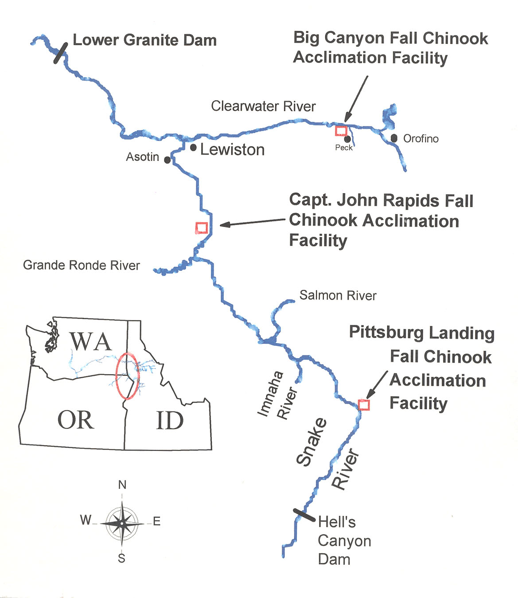
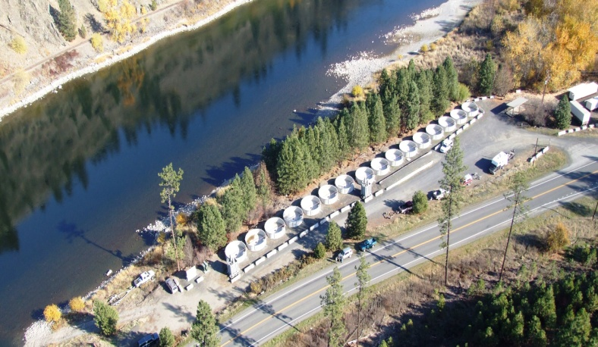
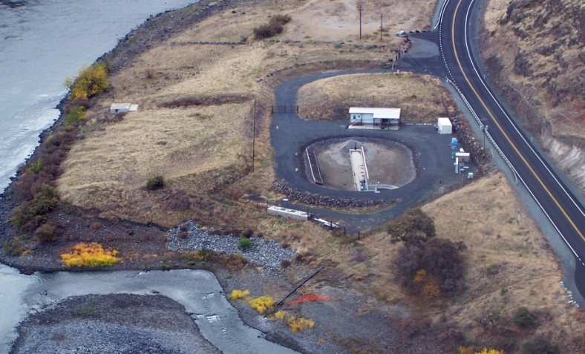
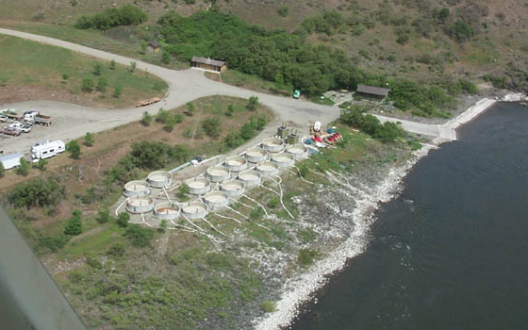
1997
1998
1996
Notes:
After the 1992 ESA Listing– Federal co-managers promoted supplemental programs to increase natural production above LGR.
Fall Chinook Acclimation Program (FCAP) facilities above LGR begin operation in 1996 with juveniles reared at LFH.
Bold Red years indicate first Yearling Releases at each acclimation facility. Yearling releases are 100% CWT.
Note to self===Nez Perce Tribal Hatchery 1996

Slide 19
Natural Production
2008 Total: 3,055
Notes:
A Redd is a fall Chinook nest.
Red counts in 2008—3,055
2009—3,716 (Snake above LGR + CLW)
2010—4,989 (Snake above LGR + CLW)
2011—4,686 (Snake above LGR + CLW)

Slide 20
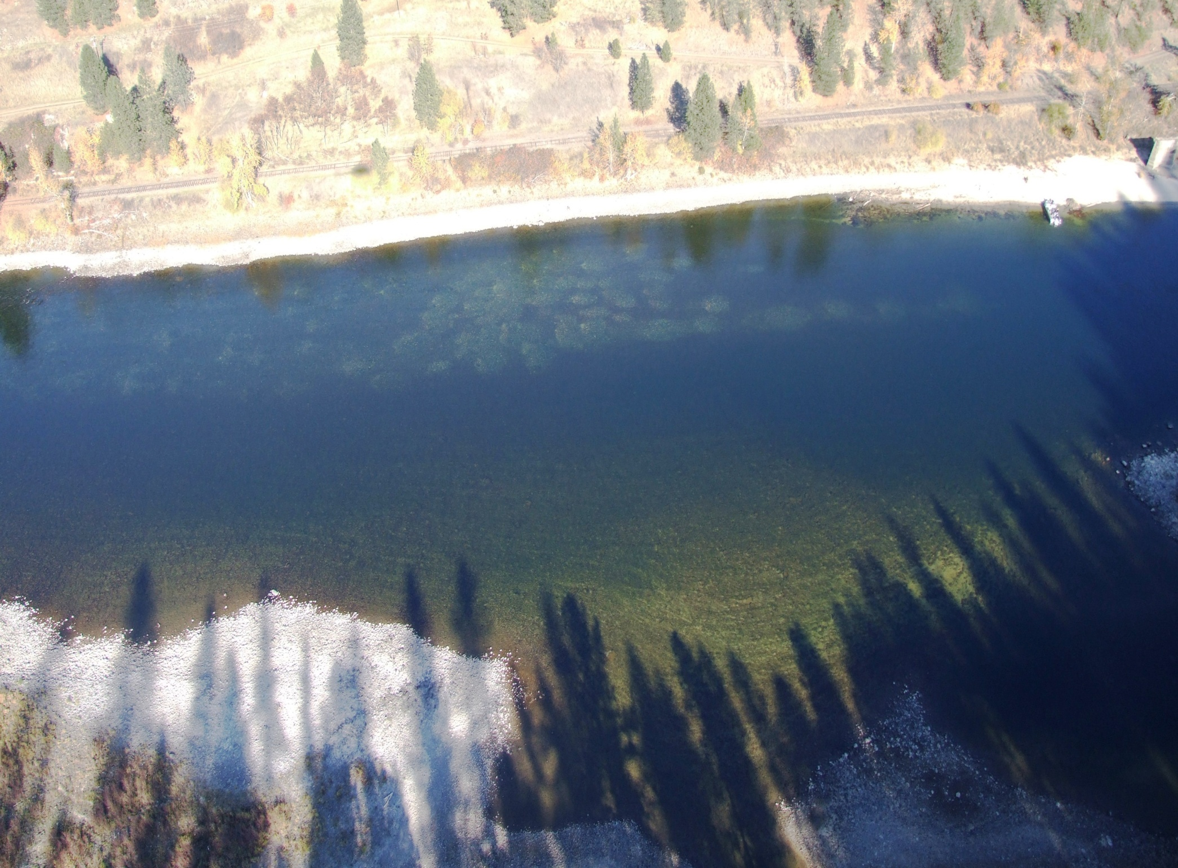
120 Fall Chinook Redds located in the Clearwater River near Big Canyon Creek 2007.
Notes:
Effect of Supplementation on Redd Counts (continued)
Photo by Mike Key NPTH

Slide 21
ESA Listed
Notes:
ESA Listing
Changes in Harvest regulations
Court-ordered Spill at the hydro projects
El Nino, Ocean Conditions
Wild Percentages—
2006—22.5%
2007—26.0%
2008—8.3% because of the proportional increase in hatchery fish returning (4,000)
2009—
2010—25% (10,000)
2011--14,900 wilds (new methodology) and same number forecast for 2012
The 1997-2001 geometric mean natural-origin count over Lower Granite Dam was 871 fish, approximately 35% of the delisting abundance criteria proposed for this run (2,500 natural-origin spawners averaged over an 8 year period)

Slide 22
Proportionate Natural Influence (PNI)
pNOB
PNI
=
pNOB
+
pHOS
pNOB = proportion of broodstock consisting of natural-origin fish
pNOB
Hatchery
Spawners
Natural
Spawners
pHOS
pHOS = proportion of fish spawning in wild consisting of hatchery-origin fish
Notes:
proportionate natural influence (PNI)
PNI is a Function of the Gene Flow Rates Between the Two Environments
pNOB = proportion of broodstock consisting of natural-origin fish
pHOS = proportion of fish spawning naturally consisting of
hatchery-origin fish
Putting natural origin fish into the hatchery retards domestication because the hatchery environment can’t effect natural-origin fish as effectively as hatchery-origin fish…whereas keeping them out and allowing large numbers of hatchery fish to spawn naturally actually makes domestication work faster. Biologically, PNI is a measure of the proportion of time the population spawns in the wild, where it is subjected to entirely natural forces. Essentially we want natural fish in the broodstock to be a higher proportion than hatchery fish that spawn naturally, thus allowing the natural environment to drive the overall genetics and thus productivity of the single population.
HSRG Approach to Containing Domestication Risk
Operate hatchery programs in one of two ways:
1) hatchery-origin fish and natural-origin fish do not interbreed: segregated (or isolated) programs
2) hatchery-origin fish and natural-origin fish interbreed regularly: integrated programs
Key HSRG Guidelines for (Properly) Integrated Programs
PNI must exceed 50%
For populations of special concern natural influence should exceed 70%
Selective forces in hatchery should be minimized
From Craig Busack and Andy Appleby Presentation “Genetics of Integrated Hatchery Programs
(3rd Edition)”

Slide 23
Lower Granite Dam Run Reconstruction
Stock and age compostion of fall Chinook run to Lower Granite Dam
Stray rates
Run timing
Jack proportions
Hatchery/Wild
Estimate the number of natural origin Snake River fall Chinook for ESA (natural spawner abundance
Notes:
Why Lower Granite?
Last dam on the Snake below main spawning area
Trap is in place and can sub-sample the run
Why reconstruct the Run?
To estimate the number of natural origin Snake River fall Chinook for ESA
Stock and Age Composition of Run to Granite
Stray Rate
H/W proportion
Run Timing
Jack proportions
Now that all these fish are returning to Lower Granite Dam, we need a firm number of how many Naturally Produced Adults are returning to Lower Granite.

Slide 24
Lower Granite Fall Chinook Run Reconstruction Process
Separate Run Comp Estimates are calculated for:
Trapping Period
Pre-and Post- Trapping Periods
Multiply by the Inverse of Trap Rate
Unique Fall Chinook Arriving at LGR
# unique Fish Trapped in Sample
Run to LGR During Trapping Period
Expanded Window counts pre and post trapping
+
=
Hauled to Hatchery
Abundance of Potential Spawners
Harvest above LGR
NPTH
swim-ins
Downstream passage
Notes:
Determine Trap Rate:
Use pre-season estimates of run size for steelhead and salmon,
broodstock for programs,
size of trapping facility
data collection needs,
Shoot for a trap rate that will not need to be changed during the season
Trap at a level that will maximize the accuracy of estimates of fish returning from mitigation programs and natural origin fish returning to LGR
Use window for counts during pre and post trapping period
Use trap data for wild-hatchery composition and for counts during trapping period

Slide 25
Fish Trapped in Sample
At Lower Granite Adult Trap
CLIPPED
Determining The Hatchery/Wild Proportion--
A Process of Elimination
UNCLIPPED
Hauled to LFH or NPTH
Released above LGR
WILD
Determine Composition
By Origin, Sex and Age
Untagged fish
Coded-Wire Tagged Fish
Definite Age, Origin,
Release Location
and Rearing info
UNCLIPPED
CLIPPED
Assign Lost tags
Determine composition of Untagged fish
Determine composition of CWT fish
*Age, life history, Origin?
Estimate untagged hatchery fish associated with CWT recoveries
(Ad Only and unmarked)
Scale Analysis
*Age, Origin?
H/W
Origin?H/W?
PIT Tags
DNA
WILD
HATCHERY
Notes:
Determining # of Wild fish
Trapping data is used to estimate wild and hatchery composition and is applied to the window counts to get numbers. Because a larger proportion of the wild fish arrive earlier in the run, pre and post window counts are adjusted using a regression of % wild Chinook among the non-clipped fish over time.

Slide 26
Snake River Hatchery Fish
 |  | Age 2 |  | Age 3 |  |  | Age 4 |  |  | Age 5 |  | Age 6 |  | Unknown Age
CWT | Origin | M | J | M | F | J | M | F | J | M | F | M | F | M | F | J | Adult | Jack | Total
630678 | LF00YPA |  |  |  |  |  |  |  |  |  | 8 |  |  |  |  |  | 8 | 0 | 8
612501 | LF01SPA |  |  |  |  |  | 3 | 7 |  |  |  |  |  |  |  |  | 10 | 0 | 10
610120 | LF01YPA |  |  |  |  |  | 1 | 6 |  |  |  |  |  |  |  |  | 7 | 0 | 7
610123 | LF02SPA |  |  | 4 | 2 |  |  |  |  |  |  |  |  |  |  |  | 6 | 0 | 6
612502 | LF02YPA |  |  | 7 | 4 | 2 |  |  |  |  |  |  |  |  |  |  | 11 | 2 | 13
107976 | LF03SIPCPA |  | 2 |  |  |  |  |  |  |  |  |  |  |  |  |  | 0 | 2 | 2
610146 | LF03YPA |  | 5 |  |  |  |  |  |  |  |  |  |  |  |  |  | 0 | 5 | 5
610149 | LF03YPA |  | 5 |  |  |  |  |  |  |  |  |  |  |  |  |  | 0 | 5 | 5
630168 | LF99SCJA |  |  |  |  |  |  |  |  |  |  |  | 1 |  |  |  | 1 | 0 | 1
630183 | LF00YCJA |  |  |  |  |  |  |  |  | 2 | 1 |  |  |  |  |  | 3 | 0 | 3
610105 | LF01SCJA |  |  |  |  |  | 5 | 13 |  |  |  |  |  |  |  |  | 18 | 0 | 18
610105 | LF01SCJA2 |  |  |  |  |  | 2 | 11 |  |  |  |  |  |  |  |  | 13 | 0 | 13
610105 | LF01SCJA2 RES REAR |  |  |  |  |  |  | 1 |  |  |  |  |  |  |  |  | 1 | 0 | 1
610106 | LF01SCJA |  |  |  |  |  |  | 11 |  |  |  |  |  |  |  |  | 11 | 0 | 11
610145 | LF03YBCA |  | 13 |  |  |  |  |  |  |  |  |  |  |  |  |  | 0 | 13 | 13
610147 | LF03YBCA |  | 8 |  |  |  |  |  |  |  |  |  |  |  |  |  | 0 | 8 | 8
610107 | NPTH02SO1 |  |  | 1 |  |  |  |  |  |  |  |  |  |  |  |  | 1 | 0 | 1
610109 | NPT02SNLVA |  |  | 1 |  |  |  |  |  |  |  |  |  |  |  |  | 1 | 0 | 1
610110 | NPTH02SO2 |  |  | 5 | 5 |  |  |  |  |  |  |  |  |  |  |  | 10 | 0 | 10
612675 | NPTH03SA |  | 4 |  |  |  |  |  |  |  |  |  |  |  |  |  | 0 | 4 | 4
630476 | LF99YO |  |  |  |  |  |  |  |  |  |  |  | 2 |  |  |  | 2 | 0 | 2
631273 | LF00YO |  |  |  |  |  |  |  |  | 9 | 30 |  |  |  |  |  | 39 | 0 | 39
630890 | LF01SO |  |  |  |  |  | 2 | 8 |  |  |  |  |  |  |  |  | 10 | 0 | 10
631585 | LF01YO |  |  |  |  |  | 32 | 78 | 1 |  |  |  |  |  |  |  | 110 | 1 | 111
631391 | LF02SCCD |  |  | 1 | 3 |  |  |  |  |  |  |  |  |  |  |  | 4 | 0 | 4
631545 | LF02SO |  |  | 2 | 3 |  |  |  |  |  |  |  |  |  |  |  | 5 | 0 | 5
632167 | LF02YO |  |  | 21 | 2 |  |  |  |  |  |  |  |  |  |  |  | 23 | 0 | 23
631769 | LF03YO |  | 34 |  |  |  |  |  |  |  |  |  |  |  |  |  | 0 | 34 | 34
631770 | LF03YO |  | 30 |  |  |  |  |  |  |  |  |  |  |  |  |  | 0 | 30 | 30
631786 | LF03SO |  | 4 |  |  |  |  |  |  |  |  |  |  |  |  |  | 0 | 4 | 4
632368 | LF03YO |  | 1 |  |  |  |  |  |  |  |  |  |  |  |  |  | 0 | 1 | 1
Left Red VIE | LF - LOST TAG |  |  |  |  |  |  |  |  |  |  |  |  | 1 | 1 | 1 | 2 | 1 | 3
Left Blue VIE | LF-CJA - LOST TAG |  |  |  |  |  |  |  |  |  |  |  |  |  |  | 1 | 0 | 1 | 1
Right Green VIE | LF-PLA - LOST TAG |  |  |  |  |  |  |  |  |  |  |  |  |  | 1 |  | 1 | 0 | 1
Left Red VIE | LF - HAT SUB AGE 4 COUSE CR DIRECT |  |  |  |  |  | 1 |  |  |  |  |  |  |  |  |  | 1 | 0 | 1
Left Red VIE | LF - HAT SUB RES REAR AGE 3 COUSE CR DIRECT |  |  | 1 |  |  |  |  |  |  |  |  |  |  |  |  | 1 | 0 | 1
Left Red VIE | LF HATCHERY SUB RES REAR AGE 5 |  |  |  |  |  |  |  |  |  | 1 |  |  |  |  |  | 1 | 0 | 1
Lost Tag | HATCHERY SUB AGE 2 | 1 |  |  |  |  |  |  |  |  |  |  |  |  |  |  | 1 | 0 | 1
Lost Tag | HATCHERY SUB RES REAR AGE 4 |  |  |  |  |  |  | 1 |  |  |  |  |  |  |  |  | 1 | 0 | 1
subtotal |  | 2 | 125 | 172 | 58 | 4 | 138 | 346 | 1 | 15 | 59 | 0 | 4 | 3 | 4 | 2 | 801 | 132 | 933

Slide 28
Finally, after all the calculations, an estimate of the composition of the fall Chinook run to LGR Dam is completed
Notes:
Trap Rate looks like ~13%

Slide 29
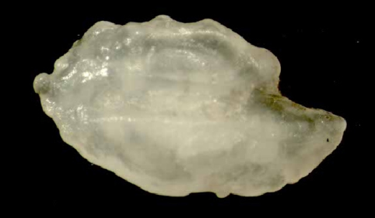
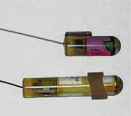
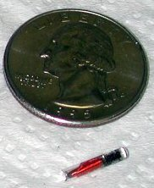
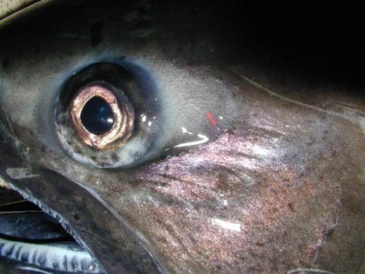
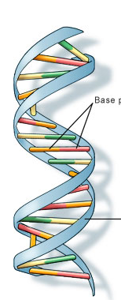
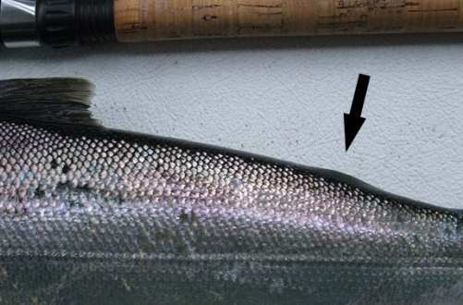

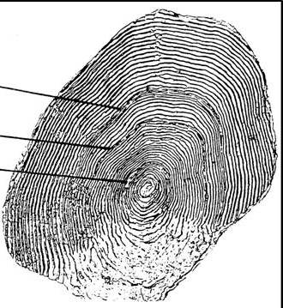
There are Many Tools available

Slide 30
The CWT Program is a Proven Tool for Providing the Data Necessary for Science-Based Adaptive Management Decisions
Recovery
Conservation
Hatcheries
Notes:
***********
historical data sets are the most powerful tools we have to detect trends in populations that have a high degree of annual variability
Proven system already in place (CWT program-40 years and counting)
Standardized data set with validations
Collaborative effort by multiple agencies, organizations and co-managers
Wide range of applications
Measure progress toward recovery
Hatchery Reform--a systematic, science-driven redesign of our hatchery systems

Slide 31
ACKNOWLEDGEMENTS
Bonneville Power Administration
Washington Dept. of Fish and Wildlife
US Fish and Wildlife Service
Nez Perce Tribe
Additional photos: David Frame, Mike Key

Slide 32
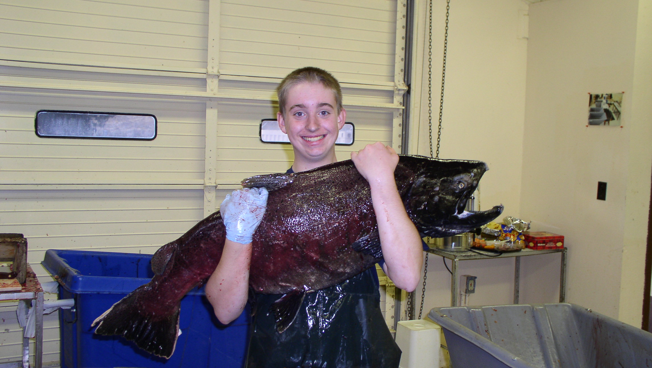
Questions?

