Slide 1

Status of the CWT system
Marianne McClure

Slide 2
The CWT System
  Exists, as a System
  Is Important
  Faces Challenges
  Is Irreplaceable, for now
  Needs Bolstered
  Is Efficient

Slide 3
  Exists, as a System
    Bilaterally agreed database specifications
    Coast wide Sampling System and Design
    Systems for data compilation, validation and uploading
    Publically accessible database (RMIS)
    Staff and committees for maintenance, development, and coordination
    (Agency staff, PSC Data Sharing and Data Standards, PSMFC Mark Committee)
    NOT A TRIVIAL TASK!
    (took ~ 10 years)
Notes:
#1 not trivial, CWT system is only stock i.d. method that has the complete system necessary for coastwide assessment

Slide 4
The CWT System
  Exists, as a System
  Is Important
  Faces Challenges
  Is Irreplaceable, for now
  Needs Bolstered
  Is Efficient

Slide 5
The CWT System
  Is Important
    Pacific Salmon Treaty International Obligation
    Provides estimates of ocean exploitation rates, essential for minimizing uncertainty in RME metrics by accounting for confounding effects (e.g. ocean harvest)
    Provides consistent time series of data (1979 on) for index based management frameworks using indicator stock programs, including PST, PFMC (e.g., FRAM), and terminal fishery models

Slide 6
The CWT System
  It’s Important
    Pacific Salmon Treaty International Obligation
Memorandum of Understanding (Par. B) transmitted with the Pacific Salmon Treaty included a commitment:
“The Parties agree to maintain a coded-wire tagging and recapture program designed to provide statistically reliable data for stock assessments and fishery evaluations.”

Slide 7
PSC SFEC summarized why all salmon fishery management agencies in the Pacific NW rely upon the CWT program:
the CWT program includes fully integrated tagging, sampling, and recovery operations along the entire west coast of North America;
the CWT provides sufficient resolution for stock-specific assessments; and
the CWT is the only stock identification technique for which a historical record (generally back to the mid 1970s) of stock-specific assessments may be computed.
Notes:
Concerns about the impacts of MM and MSF on the viability of the CWT were elevated to the PSC because of this commitment, and the SFEC was formed to address the issue

Slide 8
They defined a viable CWT program as one that:
Provides the ability to use CWT data for assessment and management of wild stocks;
Is maintained such that the uncertainty in stock assessments and their applications does not unacceptably increase management risk; and
Provides the ability to estimate stock-specific exploitation rates by fishery and age.
Notes:
Concerns about the impacts of MM and MSF on the viability of the CWT were elevated to the PSC because of this commitment, and the SFEC was formed to address the issue

Slide 9
The PSC convened a CWT expert panel in 2004, and explicitly charged them with evaluating methods of fulfilling the third criterion of a viable CWT program,
  i.e., estimating age- and fishery-specific mortality rates of salmon from natural stocks, in the context of mass marking and mark-selective fisheries:
“To determine what methods, CWT or otherwise, might be used to estimate age and fishery-specific mortality rates of salmon from natural stocks in the face of mass marking and mark-selective fisheries.”
Notes:
Going to come back later to some of the findings comparing various technologies they considered…

Slide 10
Hey! Wait a second. Why should I care about ocean fishery mortality rates? I have no control or purview over those…
Notes:
Emphasis added on “in a timely fashion”. Genetic studies such as PBT are computationally very intensive and take longer to obtain results.

Slide 11
The CWT System
  Is Important
    Pacific Salmon Treaty National Obligation
    Provides estimates of ocean exploitation rates, essential for minimizing uncertainty in RME metrics by accounting for confounding effects (e.g. ocean harvest)
    Provides consistent time series of data (1979 on) for index based management frameworks using indicator stock programs, including PST, PFMC, and terminal fishery models (e.g., FRAM)

Slide 12
In SIX parts…
  It’s Important
    Provides estimates of ocean exploitation rates, essential for minimizing uncertainty in RME metrics by accounting for confounding effects (i.e. ocean harvest)
          RME metrics, such as SARs
          Ocean exploitation rates can account for the fate of a substantial % of the cohort entering the fishery
Notes:
Even if you are not a fishery manager, you need the ocean exploitation rates to account for the variation in return rates due to ocean fisheries

Slide 13

The Big Black Box of Ocean Impacts
Without accurate estimates of stock specific ocean exploitation rates, ANY experimental impacts that affect survival (productivity) in ocean life stage are confounded with ocean fishery impacts, greatly increasing uncertainty in interpreting survival or productivity as a dependent variable or RME metric for those experimental treatments.
Notes:
CWTs are the only technology that currently provide this info

Slide 14
The CWT System
  Is Important
    Pacific Salmon Treaty National Obligation
    Provides estimates of ocean exploitation rates, essential for minimizing uncertainty in RME metrics by accounting for confounding effects (e.g. ocean harvest)
    Provides consistent time series of data (1979 on) for index based management frameworks using indicator stock programs, including PST, PFMC, and terminal fishery models (e.g., FRAM)

Slide 15
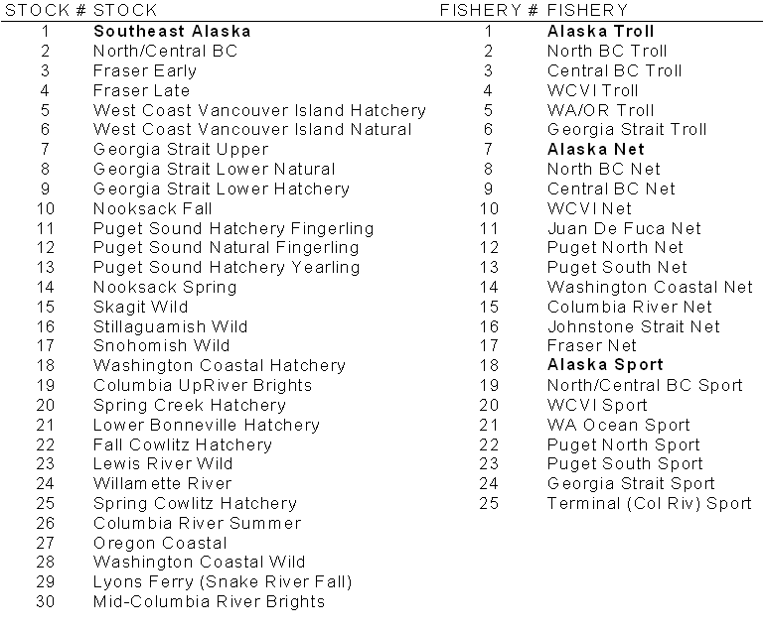
PST Management Framework
Stocks & Fisheries in Chinook Model

Slide 16
PSC Chinook Model Inputs
Base Period CWT Data
Fishery Catch Data
CNR Data
Past Escapement and/or Terminal Run Data
Terminal Run Forecasts
Fishery Policy (FP) Data
Maturation Rate and Adult Equivalent Data
Hatchery Enhancement Data
Spawner-Recruit Parameters
Proportion Non-Vulnerable (PNV) Changes
Inter-Dam Loss Factors

Slide 17
“Cohort analysis” of CWTs
Requires comprehensive coastwide sampling and recovery (including escapements)
Provides:
  Fishery exploitation by age
  Maturation rates
  Adult equivalents
  Marine survival rates
  Total mortality

Slide 18
Calculating the Abundance Index
AI = Abundance Index
C = Cohort Size
SR = Survival Rate
ER = Base Period Exploitation Rate
PNV = Proportion Non-Vulnerable
f = fishery
s = stock
a = age
b = brood year
y = calendar year

Slide 19
The CWT expert panel conducted an extensive review and found

Slide 20
The CWT System
  Exists, as a System
  Is Important
  Faces Challenges
  Is Irreplaceable, for now
  Needs Bolstered
  Is Efficient

Slide 21
The CWT System
  Faces Challenges
  Reduced tag recoveries
  Early 90s: Low marine survival rates
  Some fisheries reduced for conservation
  Reduced sampling: budgets/reprioritization
  Impacts of mass marking & mark selective fisheries
  Increased information demands for finer scale fisheries management

Slide 22
The CWT System
  Exists, as a System
  Is Important
  Faces Challenges
  Is Irreplaceable, for now
  Needs Bolstered
  Is Efficient

Slide 23
The PSC established a CWT Workgroup to implement the Expert Panel’s recommendations. They reiterated that the CWT sampling program is still the key element in successful monitoring of PSC fishery impacts:
“No other practical mark-recovery system has yet been devised that is capable of providing this level of detail in such a timely fashion…the CWT recovery program remains the only method currently available for estimating and monitoring fishery impacts on individual stocks of coho and Chinook salmon when implementing fishing agreements under the PST (Hankin et al. 2005).”
Notes:
Emphasis added on “in a timely fashion”. Genetic studies such as PBT are computationally very intensive and take longer to obtain results.

Slide 24
ISRP/ISAB Tagging Report :
Identified CWTs and PIT tags as the only source of SAR information (see Table 1)
ONLY CWTs allow estimation of ocean fishery impacts – no coast wide PIT tag sampling system
Notes:
Emphasis added on “in a timely fashion”. Genetic studies such as PBT are computationally very intensive and take longer to obtain results.

Slide 25
ISRP/ISAB Tagging Report :
“Coded wire tags (see Appendix A.1.) – Overall coordination: Very good but deteriorating. … The CWT
program is now challenged to meet the needs. Nevertheless, the technology is expected to remain important in Columbia River Basin and regional salmon decision making in the foreseeable future. Steps are required to ensure that tagging and tag recovery remains robust for estimation of vital life-history and harvest management statistics. Mass marking and mark-selective fisheries compromise the use of CWT data for estimating exploitation of natural populations, and that challenge remains unresolved…
3.8 We recommend that the most effective strategy is to continue to develop several tag technologies that, when used in combination, are highly effective at addressing all Fish and Wildlife Program management needs. The alternative would be a single tag technology that addresses most of the needs well, but does a mediocre job at addressing the remainder of the needs.”
Notes:
Emphasis added on “in a timely fashion”. Genetic studies such as PBT are computationally very intensive and take longer to obtain results.

Slide 26
The CWT System
  Exists, as a System
  Is Important
  Faces Challenges
  Is Irreplaceable, for now
  Needs Bolstered
  Is Efficient

Slide 27
The CWT System
  Needs Bolstered
  US and Canada set aside 7.5 million each for improvement of the CWT system over 5 year period
  Coded-wire Tag Implementation Team reviewing proposals and reports
  NMT also helping with tag donations

Slide 28
The CWT System
  Exists, as a System
  Is Important
  Faces Challenges
  Is Irreplaceable, for now
  Needs Bolstered
  Is Efficient

Slide 29
The CWT System
  Is Efficient
  Low impact on fish behavior
  Low cost of application
  2 Stage sampling and expansion
  Can tag weak stocks at higher rates to even the playing field during sampling and tag recovery
  Less expensive than PIT tags or Genetic methods
  Can be used for weak stocks

Slide 30
The CWT System
  Compared to PIT tagging…
  Allows tagging of small fish representative of subyearling life histories
  Less tagging effect on small fish – important for representativeness
  Coast wide recovery program allows estimation of stock-age specific ocean exploitation rates

Slide 31
The CWT System
  Compared to Genetic Stock ID methods…
  Allows separation of hatchery and wild stocks
  Provides age specific data, needed for cohort analyses, and therefore BYER and survival and productivity parameters
  Allows estimation of weak stocks

Slide 32
The CWT System
  Compared to Genetic Stock ID methods…
  Allows estimation of weak stocks
  Large positive bias associated with genetic based estimates of stock composition for stocks that contribute small portions to fisheries

Slide 33
The CWT System
Assume 100% sampling
95% accuracy
5% missclassification
Stock | 1 | 2 | 3 | 4 | 5
1 | 47,025 | 619 | 619 | 619 | 619
2 | 313 | 23,750 | 313 | 313 | 313
3 | 250 | 250 | 19,000 | 250 | 250
4 | 63 | 63 | 63 | 4,750 | 63
5 | 6 | 6 | 6 | 6 | 575
Totals | 47,656 | 24,688 | 20,000 | 5,938 | 1,719

Slide 34
The CWT System
GSI based estimates have large positive biases for stocks that make small contributions to fisheries, simply due to misclassification
Stock | Actual | Estimated | % Bias
1 | 49,500 | 47,656 | -4%
2 | 25,000 | 24,688 | -1%
3 | 20,000 | 20,000 | 0%
4 | 5,000 | 5,938 | 19%
5 | 500 | 1,719 | 344%

Slide 35
The CWT System
  Compared to PBT tagging…
  Cost of PBT on coastwide scale intractable
  Can’t use on wild stocks
  Computationally, extremely intensive

Slide 36
Conclusion
How do you replace this coastwide tagging and sampling system to provide the necessary information (stock-age specific exploitation rates, H vs. W) at less expense?
Alternatively, how do you fund a new data system to provide the necessary information for an alternative management framework?

