Slide 1
The Potential for Demand Response to Integrate Variable Energy Resources with the Grid
Greg Wikler – Navigant Consulting
Ahmad Faruqui – The Brattle Group
Ingrid Rohmund – EnerNOC
Pacific Northwest Demand Response Project
January 23rd 2014

Slide 2

Presentation Overview
  Demand response summary
  Discuss project objectives and task activities
  Identify variable energy resource (VER) growth in the West, highlight associated challenges, and introduce mitigation options (including demand response)
  Demand response resource assessment
    Potential results
    Program options
    Economic assessment framework
  Findings and recommendations

Slide 3
Demand Response: It is a transforming resource
  Historically, demand response (DR) was used to clip peaks in order to ensure system reliability and mitigate price spikes that occurred on an in-frequent and predictable basis
  Now DR is being considered for a wide variety of applications to balance reliability as a result of grid conditions (shortfall, oversupply, frequency) that are increasingly occurring on a frequent and un-predictable basis
DR 1.0
Potential Shortfall
DR 2.0
Potential Shortfall
Commercial Customer
Potential Oversupply
Commercial Customer
Time of Day
Time of Day

Slide 4
Project Objectives
  Identify the role that Demand Response (DR) can contribute to mitigate the challenges associated with a growing VER in the Western Interconnection
  Identify DR programs that can meet the needs of VERs
  Describe the various market constructs for which these programs serve
  Define how these programs would be administered
  Develop a framework that will enable more state/province-specific assessments of DR potential for 11 states and 2 provinces
  Different market environments will require different implementation approaches
  This is a planning study and is not intended to be an implementation guide

Slide 5
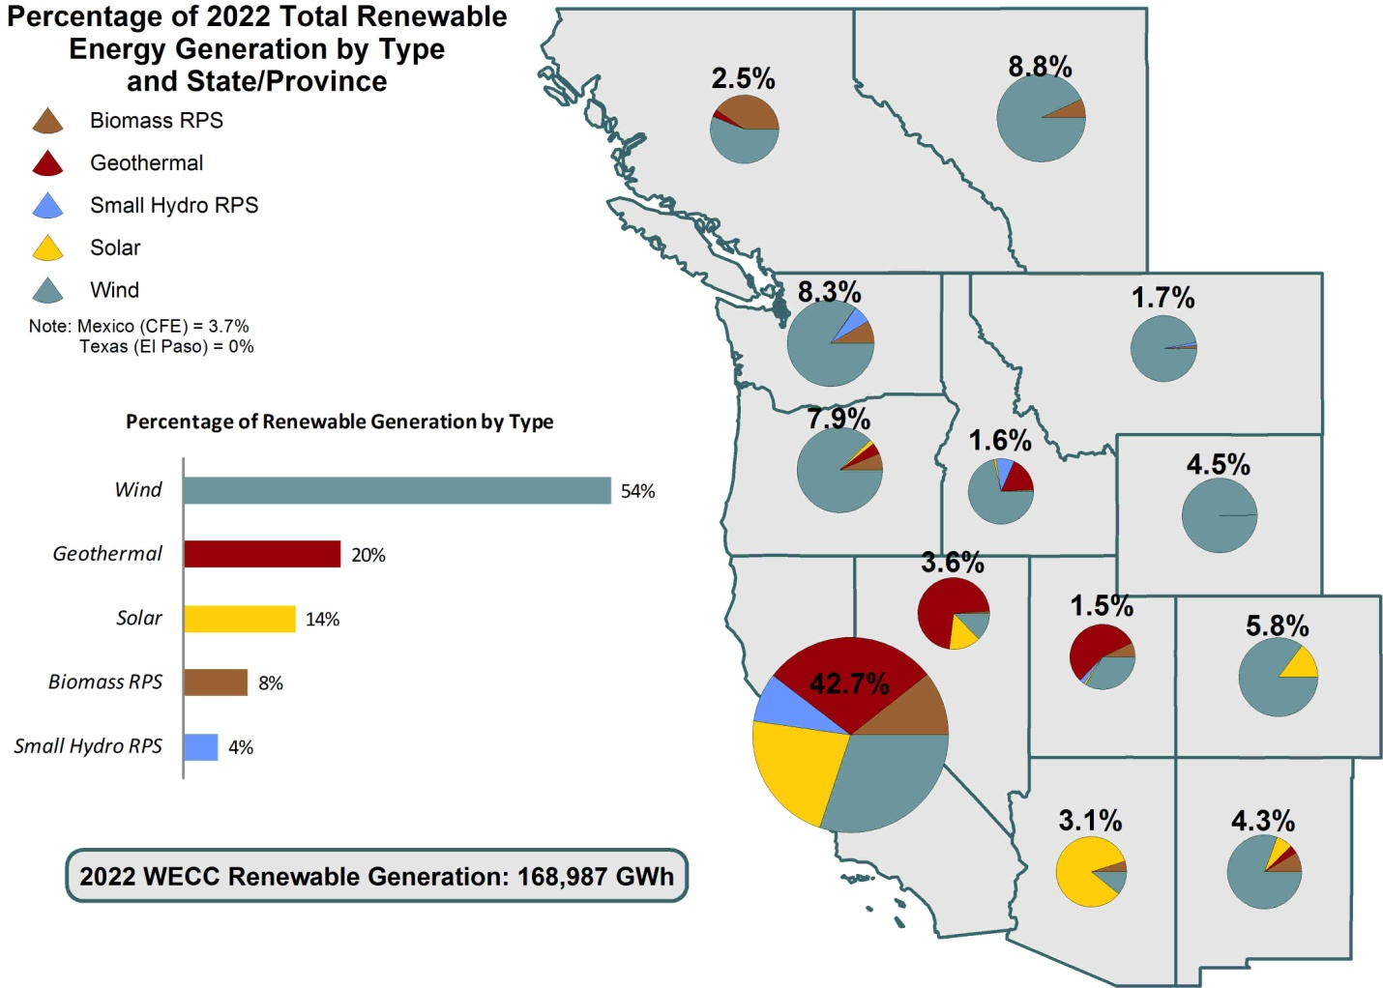
Major Contributors to VER: Solar and Wind Resources
Renewable Energy Shares in the Western Interconnection by 2022
  Overall Renewable:
  168,987 GWh
(16.6% of total generation)
  61.25 GW
  (22.4% of total capacity)
  Wind Share in Renewable:
  91,253 GWh (54%)
  34.7 GW (57%)
  Estimated Solar Share:
  23,658 GWh (14%)
  19.7 GW (32%)
Non-Variable
Renewable
BC
AL
Variable
Renewable
WA
MT
OR
ID
WY
NV
UT
CO
Assumed capacity factors by resource type:
Wind-30%
Solar-13.7%
CA
AZ
NM
Source: WECC 2022 PC1 Common Case document; July 25, 2013

Slide 6
Challenges with a Growing VER Portfolio
Variability in VER production | Aggregate output form renewable energy resources is drastically changing system load availability
Forecast uncertainties | All types of forecasts (wind and solar) are subject to inaccuracies
Ramping characteristics | VERs tend to have large and very steep and rapid ramps that are difficult to forecast
Over generation from VERs | Wind resources are likely to be more abundant at night (particularly in wind-rich-rich regions such as PNW and mountain states) during times of limited demand, leading to over-generation and thus grid reliability challenges
  These challenges are typically addressed by “backfilling” the renewable resource with different types of generation or storage options, including Demand Response

Slide 7
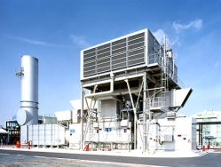
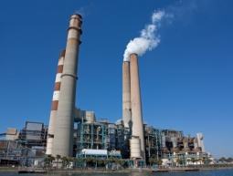
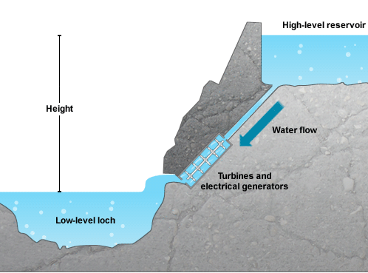
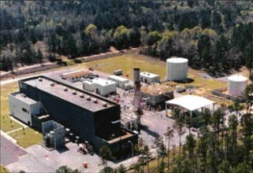
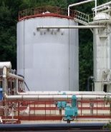
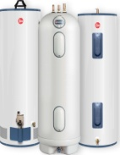
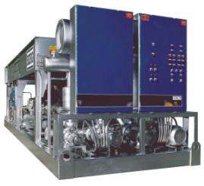

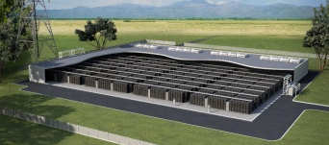

There are several options to mitigate the effects of VER but no one “silver bullet” solution
Traditional Generation
gas turbines, coal plants
Centralized Storage
pump storage hydro, compressed air, battery
Distributed Storage
water heaters, thermal storage, process loads, EVs
  The magnitude and economic viability of all options should be assessed
  Interstate transfers should also be assessed to correct load imbalances caused by VERs
  Demand Response works within the Distributed Storage set of options

Slide 8
DR 2.0 has the potential to mitigate the effects of VER
  But DR needs to be fast, swift and predictable
  Customer loads must be equipped with automation equipment
  Customer loads must be available 24x7 year round
  Customer loads must be measured on a frequent basis
  Customer loads must be capable of moving in both directions
  Different DR product types are needed to address VER integration challenges
  Contingency
  Regulation
  Load following
  Existing DR programs can be repurposed to meet the new challenges
  Legacy utility DR programs (DLC, Interruptible, Load Aggregator)
  Ancillary services with RTOs (ERCOT, PJM)
  Fast DR and load following pilots (PG&E, BPA, Hawaiian Electric)

Slide 9
Demand Response Potential Methodological Approach
  Establish baseline end-use load characteristics
  Determine technical potential
  Determine achievable potential
  Develop DR programs and approaches for VER integration
  Determine economic potential of the DR programs

Slide 10

DR Potential Analysis Framework
Foundation:
End-Use Data
Develop 8760 (weather normal) End-Use Load shapes by segment, building-type, end-use, and census region
Step 1:
Customize Load Shapes
Create state/province level segment and end-use level shapes based on mix of building-types in that state/province
Step 2:
Develop Baseline Forecast
Unitize all 8760 shapes by state/province, sector, segment and end use; scale appropriately using control totals over the forecast horizon
Step 3:
Apply Factors
Apply multiple factors (technical & achievable) to estimate the portion of load available for DR by end-use and segment. These factors are based on available literature on the topic
Step 4:
Estimate Technical and Achievable Potentials
Estimate total potential MW by day-type, state/province, sector, segment, and end-use

Slide 11
Commercial and Residential Sectors Dominate in Potential DR Resource Availability
Aggregate DR Potential on a Typical Summer Weekday in 2020

Slide 12
Seasonal Variations in DR Potential Availability
Typical Summer Weekday in 2020
Typical Winter Weekday in 2020
Typical Spring Weekday in 2020
Typical Fall Weekday in 2020

Slide 13
Average Hourly Load Reduction Profiles for Contingency Services
Typical Summer Weekday in 2020
Typical Winter Weekday in 2020
Typical Spring Weekday in 2020
Typical Fall Weekday in 2020

Slide 14
Aggregate DR Potential by State/Province in 2020
Typical Summer Weekday ‘Load Following’ Potential
Total Load Decrease Potential- 2,542 MW
Total Load Increase Potential- 757 MW

Slide 15
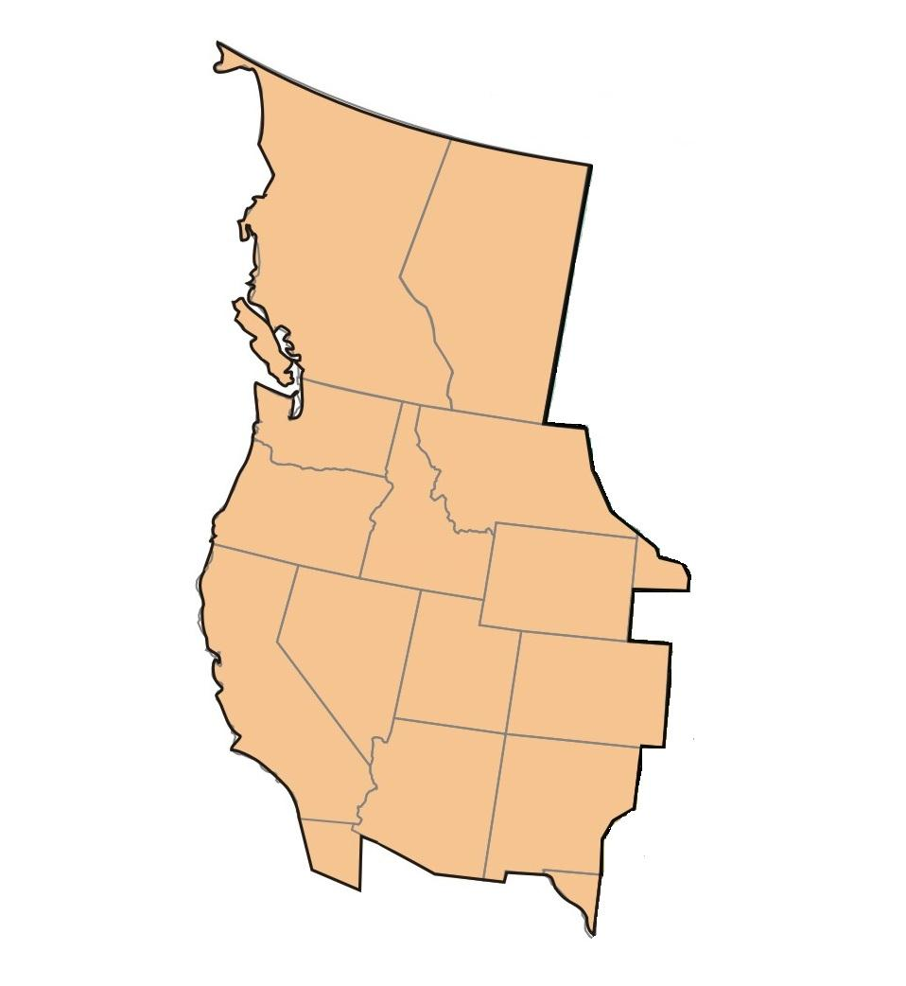
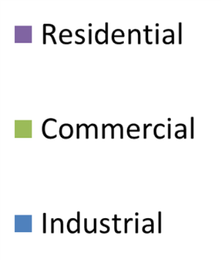
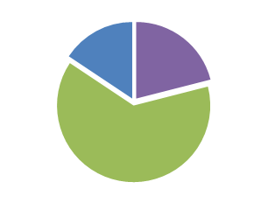

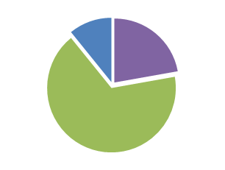
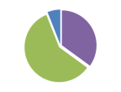

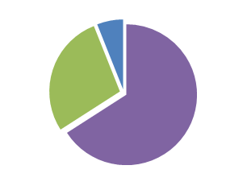
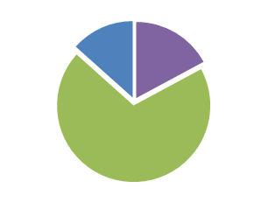
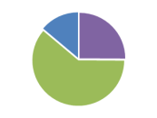
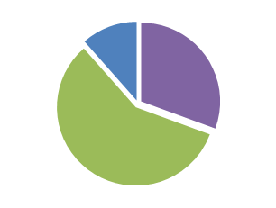
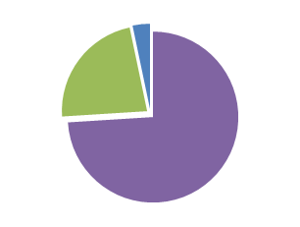
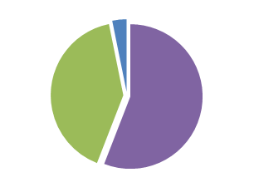
DR Potential Load Decrease by State/Province
Shares in the Western Interconnection Potential
“Load Following” Potential for a Typical Summer Weekday in 2020
4.7%
  Total Load Decrease Potential- 2,542 MW
    Residential: 995 MW
    Commercial: 1,304 MW
    Industrial: 243 MW
4.5%
8.3%
1.4%
2.0%
4.2%
1.2%
5.5%
3.0%
5.7%
34%
21.1%
3.9%

Slide 16

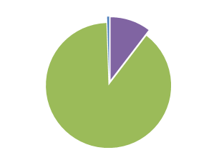
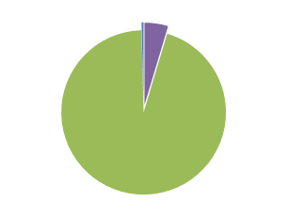
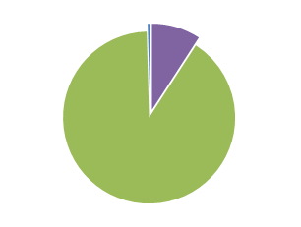
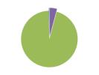
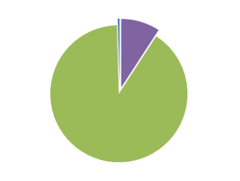
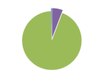

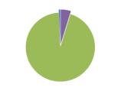
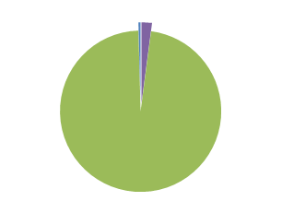
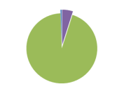
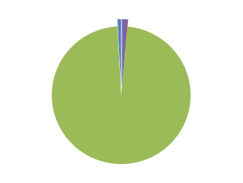
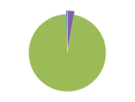
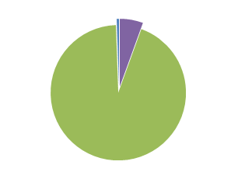
DR Potential Load Increase by State/Province
Shares in the Western Interconnection Potential
“Load Following” Potential for a Typical Summer Weekday in 2020
  Total Load Increase Potential- 757 MW
    Residential: 35 MW
    Commercial: 718 MW
    Industrial: 5 MW
6.7%
7.2%
11.8%
2.2%
2.7%
6.3%
1.9%
3.0%
3.5%
8.8%
33%
9.8%
3.0%

Slide 17
Residential Sector Potential is Dominated by Cooling Load
Residential Sector Potential on a Typical Summer Weekday in 2020

Slide 18
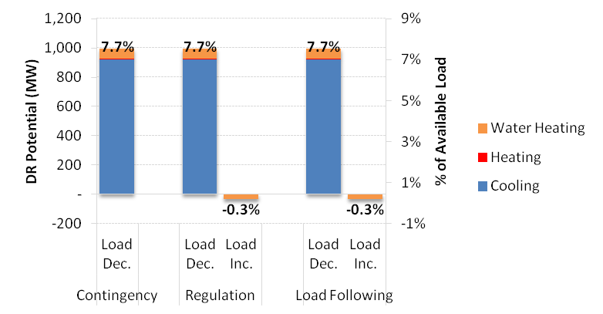
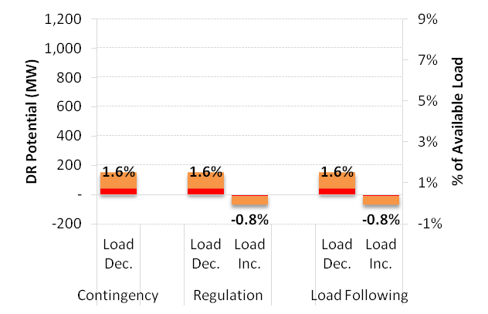
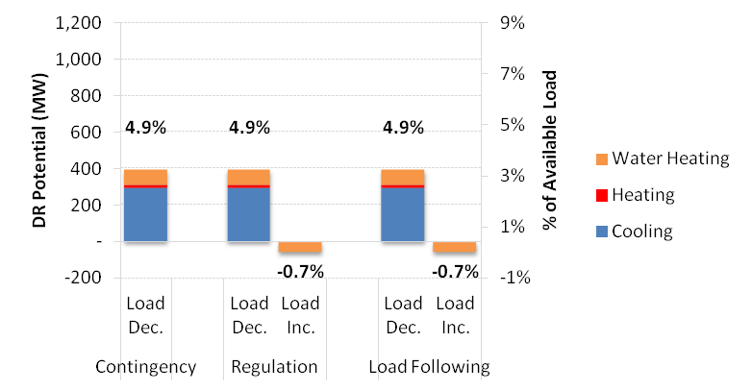
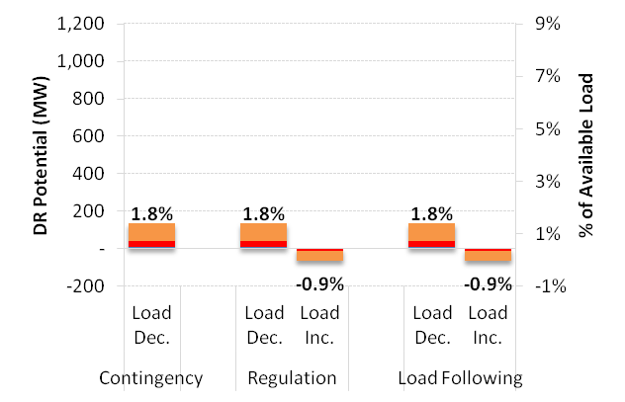
Residential DR Potential Varies by Available End-uses Across Seasons
Typical Summer Weekday Potential in 2020
Typical Winter Weekday Potential in 2020
Typical Spring Weekday Potential in 2020
Typical Fall Weekday Potential in 2020

Slide 19
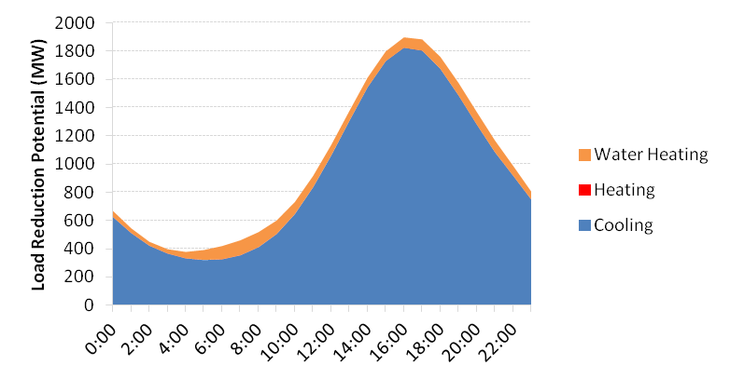
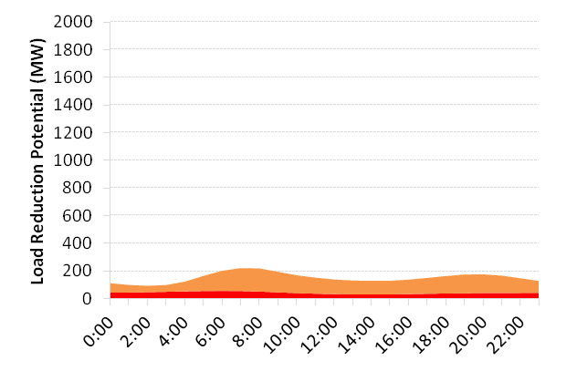
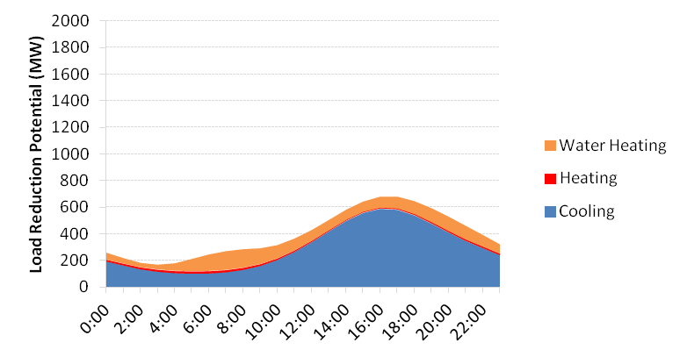
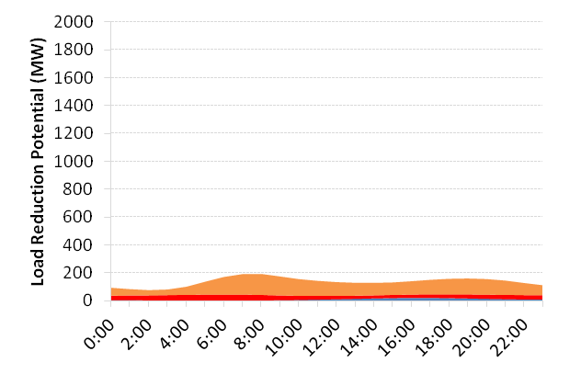
Residential: Hourly Load Reduction Profiles for Contingency Services
Typical Summer Weekday Profile in 2020
Typical Winter Weekday Profile in 2020
Typical Spring Weekday Profile in 2020
Typical Fall Weekday Potential in 2020

Slide 20
Commercial Sector Potential Availability is Dominated by Retail and Large Office Buildings
Commercial Sector Potential on a Typical Summer Weekday in 2020

Slide 21
Seasonal Variations in Commercial DR Potential Availability
Typical Summer Weekday Potential in 2020
Typical Winter Weekday Potential in 2020
Typical Spring Weekday Potential in 2020
Typical Fall Weekday Potential in 2020

Slide 22
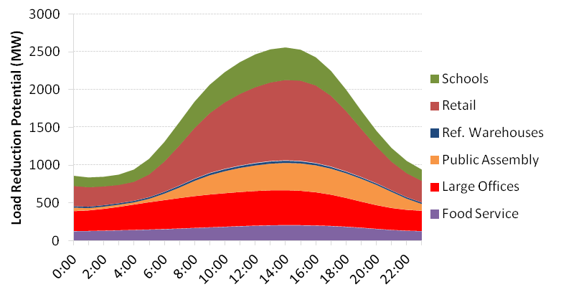
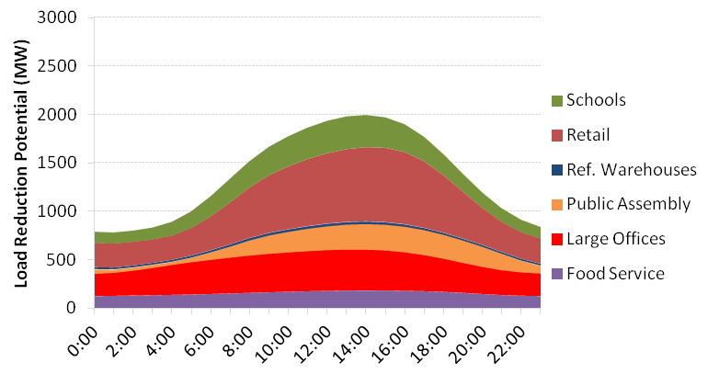
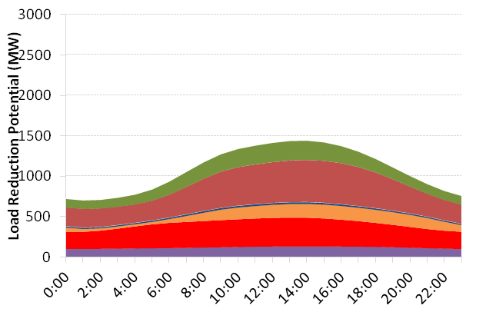
Commercial: Hourly Load Reduction Profiles for Contingency Services
Typical Summer Weekday Profile in 2020
Typical Winter Weekday Profile in 2020
Typical Spring Weekday Profile in 2020
Typical Fall Weekday Profile in 2020

Slide 23
Water/Wastewater Treatment Plants and Ag Pumping Dominate Industrial Potential Availability
Industrial Sector Potential on a Typical Summer Weekday in 2020

Slide 24
Seasonal Variations in Industrial DR Potential
Typical Summer Weekday Potential in 2020
Typical Winter Weekday Potential in 2020
Typical Spring Weekday Potential in 2020
Typical Fall Weekday Potential in 2020

Slide 25
Industrial: Hourly Load Reduction Profiles for Contingency Services
Typical Summer Weekday Profile in 2020
Typical Winter Weekday Profile in 2020
Typical Spring Weekday Profile in 2020
Typical Fall Weekday Profile in 2020

Slide 26
High Participation Scenario Analysis
  We ran a sensitivity analysis under higher participation level assumptions, as compared to the “base” scenario.
  Participation rates are assumed to be 1.5 to 2 times “base” scenario participation levels.
  Scenario assumed to be driven by aggressive efforts to market and deploy DR 2.0 programs to end-use customers.
  This scenario could also be spurred by rapid decline in technology enablement costs, thereby accelerating adoption by customers.
  Comparison of results shows that the overall load curtailment potential increase ranges from ~30-55%, as compared to the base scenario.

Slide 27
Base and High Participation Level Potential Estimates Comparison
Aggregate DR Potential on a Typical Summer Weekday in 2020

Slide 28
DR 1.0 vs. DR 2.0 Potential Estimates
  Estimated DR 1.0 Potential in 11 WECC states
  13.6 GW in 2022
  Ref: WECC 20-year Demand Response Forecast. Prepared by the Brattle Group for Lawrence Berkeley National Laboratory, June 2012
  Estimated DR 2.0 Potential in 11 WECC states (Potential Load Decrease in ‘Load Following Product’)
  2.3 GW in 2022 (Base Scenario)
  3.3 GW in 2022 (High Participation Scenario)
  DR 2.0 Potential as a % of DR 1.0 Potential in 11 WECC states
  ~17% (Base Scenario)
  ~24% (High Participation Scenario)

Slide 29
Reshaping the "Duck Chart” through DR?
Illustration of the Potential Implications of DR Integration on Net Load (CA Example)
CAISO “Net Load Curve” for March 27, 2020
  Average DR Potential Impacts on Net Load for a Typical Winter Weekday
    Load Decrease Potential (% of “Net Load”)~4%
    Load Increase Potential (% of “Net Load”)~0.5%
Please note that the “net load” curve with DR is estimated using average winter weekday load profile for CA, and not specifically for the month of March and on the 27th day of the month
This chart is for illustration purposes only, and does not represent the actual CAISO load data. It is meant to illustrate the relative magnitude of the DR potential estimates vis-à-vis the “net load”.

Slide 30
DR Program Considerations
  A new generation of DR programs can possibly help realize the potential opportunities for addressing VER integration challenges
  Additionally, existing DR programs could also be modified and positioned to address VER integration challenges
  These DR programs will need to embody characteristics such as:
    Responding to events with short notification periods
    Responding to a relatively high frequency of DR events
    Capable of providing bi-directional response
    Sustaining load reductions over relatively long time periods
  Automated response with advanced control and communication capabilities will be a key component of program design
  Program designs will need to take into consideration customer segments and end-uses that are being targeted.
    Frequent starts and stops will have an impact on processes, maintenance and lifetime of equipment and this will need to be addressed
    Impacts on customer electricity bills, caused by load increase, will also need to be considered
    Appropriate incentive levels will need to be designed

Slide 31
DR Program Considerations (continued)
  Opportunities exist to leverage the customer base enrolled in traditional DR program offerings offered by utilities across western states.
  Existing residential and small commercial direct load control (DLC) type programs could serve as a base from which to further build upon
  Targeted loads include air-conditioning, space heating, and water heating
  Advanced DLC technologies will enhance performance and include smart appliances
  Irrigation loads are increasingly becoming an attractive target for advanced DLC applications
  Western states with significant DLC programs include California, Colorado, Idaho, New Mexico, Nevada, and Utah
  Existing commercial and industrial curtailment type programs could serve as a base from which to further build upon
  Targeted loads include HVAC, lighting and industrial processes
  Utilization of automated controls and advanced communication systems will be necessary to ensure performance
  An aggregated portfolio of customers is likely to help fulfill essential program attributes
  Western states with sizeable C&I participation base in DR options are- Arizona, California, Colorado, New Mexico, Nevada, Oregon, and Washington

Slide 32
DR Potential: Assessing the Economic Viability
  Data and methodology gaps limit our ability to thoroughly assess the economic potential of the DR options
  Data about the size and cost of the various VER integration options is limited
  No cost effectiveness methods currently exist to assess VER options
  Key questions:
  What are the costs associated with the DR programs?
  What is the right value for the DR products that are integrated with VER?
  What is the resource to be avoided for load reductions and load increases?
  Are the standard practice approaches for DR cost-effectiveness appropriate for VER resource integration?

Slide 33
Cost Effectiveness Framework
  DR program cost elements
  Program implementation and operations
  Enablement costs for automation equipment and telemetry
  Customer incentives (capacity and energy)
  DR program benefit elements
  Load reductions: Avoid the investment in traditional generation resources, such as a peaking plants
  Load building: Avoid the investment in special equipment designed to mitigate the effects of overproduction of electricity on the grid
    Consider potential benefits associated with additional revenue to renewable energy developers

Slide 34
Findings and Recommendations
  Findings:
      DR 2.0 will play an important role in mitigating the effects of VER in the next decade
      There are a limited number of customer segments and end-use loads that can accommodate the needs for VER integration
      Utilities can adapt existing several existing DR programs to meet the technical requirements for VER integration
      DR is one of many options to mitigate the effects of VER
  Recommendations:
Develop the necessary parameters to support a meaningful analysis of DR cost-effectiveness of for VER integration
Identify the magnitude and economic viability for all options that can mitigate the effects of VER
Utilities and balancing authorities in the Western Interconnection should begin developing their own estimates of DR potential for VER integration
Develop pilot programs to improve the quantification of DR potential and test new breakthrough technologies

Slide 35
Appendix Slides
  Definitions of Ancillary Services Product Types
  States and Provinces Included in the Study

Slide 36
Ancillary Services Products Definitions and Attributes
Spinning Reserves- The California ISO defines spinning reserves as follows- “Spinning reserve is the portion of unloaded capacity from units already connected or synchronized to the grid and that can deliver their energy in 10 minutes and run for at least two hours.” (Source- Perlstein et.al., 2012)
Non-spinning Reserves- The California ISO defines non-spinning reserves as follows- “Non-spinning (or supplemental) reserve is the extra generating capacity that is not currently connected or synchronized to the grid but that can be brought online and ramp up to a specified load within ten minutes.” (Source- Perlstein et.al., 2012)
Regulation- The California ISO defines regulation as follows- “Regulation energy is used to control system frequency that can vary as generators access the system and must be maintained very narrowly around 60 hertz. Units and system resources providing regulation are certified by the ISO and must respond to ‘automatic generation control’ (AGC) signals to increase or decrease their operating levels depending upon the service being provided, regulation up or regulation down.” (Source- Perlstein et.al., 2012).
Load Following- The California ISO defines load following as- “Load following is the ramping capability of a resource to match the maximum megawatts by which the net load is expected to change in either an upward or a downward direction in a given hour in a given month...” (Source- Perlstein et.al., 2012).
DR Program Attributes Required to Provide Products Capable of Supporting Integration of Variable Generation Resources
Attribute | Spinning/non-spinning reserve | Regulation | Continuous ramping/load following
Telemetry | Required | Required | Required
Response time | <10 minute; <10 second to begin ramping is desirable | <1 minute | <1hour
Automated response | Required | Required | Required
Event limitations | Dozens to more than 100 events, lasting at least 1 hour each | Continuous availability desired | 10 hours or more duration, minimum of one hour
Daily/seasonal availability | 24x7 year round | 24x7 year round | 24x7 year round, with seasonal variation
Target end uses | Agricultural and municipal water pumping, electric water heating | Temperature controlled warehouses, industrial motor load on Variable Frequency Drives (VFDs) | Commercial Lighting and HVAC
Source: Perlstein et al, “Potential Role of DR Resources in Maintaining
Grid Stability and Integrating Variable Renewable Energy”, July 2012.

Slide 37
States and Provinces Included in the Study
  States
  Arizona, California, Colorado, Idaho, Montana, New Mexico, Nevada, Oregon, Utah, Washington, and Wyoming.
  Provinces
  Alberta, British Columbia

