Slide 1
Getting More from DR in the Northwest:
Non-wires Solutions and Other Benefits
Pacific Northwest Demand Response Project
Snuller Price, Partner

Slide 2
Agenda
Background on E3 and Northwest Projects
Expanding the DR definition
Cost-effectiveness and valuation needs
E3’s top 5 list of R&D needs in demand response

Slide 3
About E3
E3’s expertise in 8 key practice areas has placed us at the center of energy planning, policy and markets in California and the West.
Emerging Technology Strategy
Energy Markets and Financial Analysis
Transmission Planning and Pricing
Resource Planning and Procurement
Energy and Climate Policy
Energy Efficiency and Distributed Resources
Cost of Service and Rate Design
International Electricity Policy and Planning

Slide 4
Demand Response Projects
Micro-grid at University of California San Diego with Viridity
California utility proposals for high penetration PV integration with Enbala
CPUC DR Cost-effectiveness
SCE / CPUC Permanent Load Shifting
U.S. EPA Smart Appliances
CAISO FERC Order 719 Filing

Slide 5
E3 Northwest Resource Planning Projects
Current
  BPA Non-wires assessment
    Hooper Springs Transmission Line
    I-5 Transmission Corridor Reinforcement
  PNGC Power
  Seattle City Light: Environmental Considerations
Prior
  BPA Transmission planning process
  SCL Distribution planning
  PSE integrated gas / electric planning, distribution capital planning

Slide 6
Research Questions E3 is Interested in Pursuing
Question #1: Good applications?
  Long term planning; what DR technologies have the most promise in supporting our goals of reliability, cost, and environment?
Question #2: Cost-effective?
  Cost-effectiveness assessment; what DR applications and investments are a good value for ratepayers?
Question #3: Market place?
  Markets or payment streams to encourage applications, technology that have significant value

Slide 7
Demand Response Definition
Classic definition of DR is a peak shaving program designed to provide system capacity
  History in non-firm service to customers
  Much of California’s current DR portfolio
    A/C thermostat setback
Northwest requires a different definition
  Not many years ago, the aMW was the only real metric
  Large amount of system capacity available from BPA
  Different challenges
    Local constraints, wind integration, carbon reduction
    Large energy intensive industries increasingly non-competitive
    “reliability, cost, and environment”

Slide 8
Demand Response Technology
Communications and Controls
  AMI systems with one-way or two-way communication
  Smart, communicating devices
  Optimization / control systems
New Opportunities
  Plug-in vehicles
  Latent ‘storage’ in loads; flexible process, thermal capacity
  Smart appliances

Slide 9
The landscape of different grid services in the expanded definition

Slide 10
How do you know when you’ve found a good idea?
Improvement Planning metrics
  Reliability
  Cost
  Environment
Regulatory acceptance (for at least pilots)
  Typically means ‘cost-effective’
  Perhaps path to ‘cost effective’; market transformation is a ‘relatively new’ approach
Market and industry
  Is there a value proposition to support the technology development and provide customers a reason to participate?

Slide 11
Categories of Value and Magnitude
Generation system capacity
  Displacing the construction of a new generation facility for capacity
Transmission local capacity
  Displacing the construction of new transmission
Distribution local capacity
  Displacing the construction of new transmission
Reserves
  Standby generation in the event of a contingency
Firming and load following
  Flexible or dispatchable generation to balance net load
Reduced air emissions
  Reduced CO2 emissions and criteria pollutants; NOx, SOx, PM

Slide 12

Relative Value of DR (in CA)
Over 3/4th of the value in capacity

Slide 13
CA DR Program Cost-Effectiveness
Cost-effective
Marginal
Not Cost-effective
Demonstrating cost-effectiveness can be challenging: only ~1/3 of CA programs are more than marginally cost-effective

Slide 14
Top 5 Northwest Applications
Non-wires alternatives
Use large industrial load to provide local capacity and renewable integration
Permanent load shifting for electric end-uses
  Space and water heating
  Large cooling systems
West-side communicating thermostat standard
Controlled charging of plug-in electric vehicles

Slide 15
Non-wires Alternatives Application
Identify and contract local capacity to relieve the constraint driving new transmission investment
  Requires BPA operational changes, lower costs than transmission and at least equivalent reliability
Typical challenges in non-wires studies
  Getting enough local peak reduction in time, often we only have 2 or 3 years which is not long enough
  Providing assurance that peak load will be there to BPA planning and operations responsible for reliability
Most recent two studies have been ‘cost-effective’ but timing and reliability will likely hold them back
Take-away is to start the transmission process earlier, we can also start our DR earlier

Slide 16
Need for Project:
I-5 Problem Description
Risk of overloads on two critical paths along I-5 Corridor during summer peak with heavy North-South Flows
South of Allston (SoA)
  Limiting Outage: Loss of Keeler-Pearl or Allston-Keeler 500 kV lines (N-1); could cause thermal overloads on parallel lower voltage facilities
  Updated studies show criteria violation could occur
  by summer 2016 (requiring project energization by spring 2016.
South of Napavine (SoN)
  Limiting Outage: Losses of Paul-Allston #1
  and #2 500 kV lines; could cause thermal
  overloads on parallel lower voltage facilities or voltage instability in Portland area
I-5 Corridor Overview

Slide 17
Phase 1 I-5 Non-Wires Analysis
Preliminary screen of non-wires measure potential for deferring I-5 project
  Based on load-flow distribution factors & regional cost test economic screen for local non-wires measures
Results
  Energy efficiency (EE), demand response (DR), and distributed generation (DG) alone are insufficient for deferral, but deferral up to spring 2022 possible if
  combined with contracts for generator redispatch
Recommendations
  Continue on current I-5 project schedule
  Investigate feasibility of identified non-wires measures for deferral, especially generator redispatch
* Emphasis added

Slide 18
Phase 1 Non-Wires Potential Summary:
Lower Load Growth Forecast
South of Napavine
MW Flow
2020 Flows remain below operating limits after non-wires measures of:
  Flow reduction effect of EE, DG, and DR
  1450 MW Generator Redispatch
South of Allston
MW Flow
TTC: Total Transfer Capability
SOCCS: South of Chehalis Sectionalizing Scheme
18

Slide 19
Hooper Springs Proposed Project
Load growth in the LVE/Fall River area has created a potential to violate NERC single contingency criteria during winter critical peak demand hours
32 mile, 115 kV single-circuit line
Plan to energize by winter 2013/2014
Connects to PacifiCorp line near Three Mile Knoll substation and Lanes Creek substation on Lower Valley Energy’s system

Slide 20
Summary of Draft Key Findings
Cost: Non-wires alternative is marginally cost effective, overall portfolio benefit-cost ratio: 1.2
Timing: Does not appear feasible to implement non-wires alternative by 2013/2014
  EE & DR are not sufficient, NWA success is dependent on construction & operation of gas generator but:
  Local/state permitting & construction = min. 24 months
  Large generator interconnection study = 4 to 18 months
  Generator communications link expected to require 3 years (additional research is underway on communications link)
Fuel supply: gas pipeline capacity cannot meet generator fuel needs during critical peak, requires LNG storage. LNG deliveries can be challenging to schedule to LVE’s territory.
* Emphasis added

Slide 21
Non-Wires Portfolio Shortfall in 2013 & 2014

Slide 22
Industrial load flexibility
Large industrial load can provide renewable integration and possibly local capacity if needed
  Business case based on renewable integration
  Use for local capacity if the need arises
Key challenge is in the business case
  What is renewable integration worth? Probably the opportunity cost of hydro electricity
  Who pays for it? Wind generators, or system operators?
BPA / FERC issue on wind curtailment also has broader regional implications for wind development

Slide 23
Why does flexibility matter in a hydro-dominated system?
Loads may do a better job at lower cost
  More flexible, no minimum flow, temp, dissolved oxygen, fish concerns
  Alternative of uneconomic dispatch of hydro (the root of the current controversy for wind integration and FERC complaint)
  Using loads (like storage) for fast dispatch reduces stress on and increases efficiency of hydro generators
  Other value streams; non-wires alternatives and using loads to integrate local DG at feeder level

Slide 24
Permanent Load Shifting
Increase early morning load to assist with wind integration every day, reduces morning peak ramp on electric water and space heating
  Relatively high penetration of electric heating
Improved system load factor will have system capacity benefits in some cases, plus local transmission, distribution and in some cases
Higher use of wind and hydro for high value loads will decrease carbon emissions and make better use of the

Slide 25
Broad Scenario Modeling Results
Avoided costs across all scenarios
Ex: 8 hour shift starting at 9 am has present value benefits of ~ $2,000/kW
Climate Zone 12 (e.g., Sacramento)

Slide 26
Overgeneration - 2010
Model contains estimates of overgeneration by hour for each year based on expected wind penetration
Estimated wind penetration of ~2,500 MW in 2010
  Wind generation never exceeds load minus must-run generation

Slide 27
Overgeneration - 2020
Estimated wind penetration of ~8,800 MW
  ~1,700 hours of overgeneration
  Predominately in Spring Off-Peak hours
PLS charging during hours with overgeneration receives avoided cost benefit of marginal renewable resource.
  ~$91/MWh in 2008

Slide 28
Communicating thermostat
E3 has supported the California Energy Commission Title 24 and Title 20 standards on thermostats
Current proposal is to require an ‘upgradeable’ communicating thermostat on all air conditioners
  Customers will have a communication ready thermostat if they choose to opt into the program
Concept is that if penetration of the devices is very high, a small thermostat set back will go largely unnoticed, but provide significant capacity savings
Air conditioning load is increasing on the west-side load centers of the BPA territory including PGE
A low incremental cost feature would likely be cost-effective for west-side utilities with AMI

Slide 29
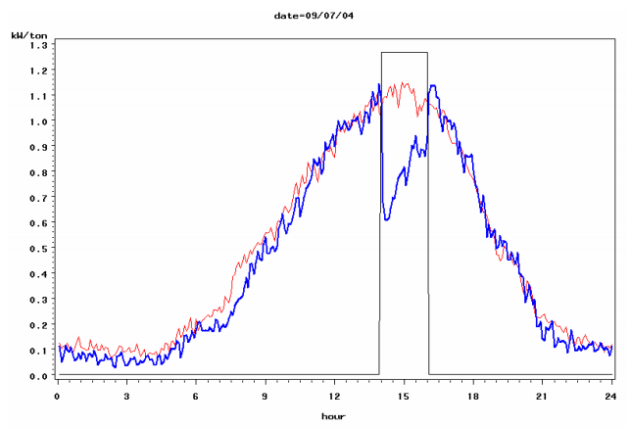
Upgradable Communicating
Thermostat Impacts from CA Studies
Normalized demand from households participating in the 2004 SCE Energy$mart Thermostat Program. The blue line represents demand on Sept 7th, 2004 when thermostats were set up 4F from 2pm to 4pm. The red line represents average demand on control days.
 | Herter 2007 | SDGE Smart Thermostat | SCE Energy$mart Program | 2008 PCT CASE study
Climate Zones | 7 and 10 | 7 and 10 | 74% in 8, 9, 10 | 12
Temp | 90F-95F | 70F-85F | 85F-95F | Average: 98F High: 100F
Average Demand Reduction 9 (kW/ton) | 0.20 (5h event) | 0.10 (2006 ave.) | 0.17 (hour 2) | 0.30
High Demand Reduction 9 (kW/ton) | 0.30 (2h event) | 0.14 (2004 ave.) | 0.33 (hour 1) | 0.42

Slide 30
Smart charging of electric vehicles
Our research on meeting long term CO2 reduction goals shows that vehicle electrification is necessary to meet IPCC levels
  Science
Increasing throughput on existing utility facilities also has the prospect of reducing rates for customers
  Public Utilities Fortnightly
Even renewable electricity at high cost (~0.20/kWh) is low cost compared to gasoline and diesel
Most major vehicle manufacturers have electric vehicles out or in the near-term pipeline, this is the time to standardize the charging / pricing / control mechanisms

Slide 31
Ratepayer and Shareholder Benefits of PHEV Load Growth
Revenues
Costs
Net Benefits
PHEV adoption provides $69 Million net benefit to ratepayers
$69
While providing an incremental return on rate base to utility shareholders of ~$14 Million.
PHEV Rates Revenue
$180
Cost of Generation
Only program that simultaneously provides societal, ratepayer and shareholder benefits
CO2 Benefit
$13
Program Cost
$54
$17
Charger Depreciation
$14
Return on Ratebase
$233
$164

Slide 32
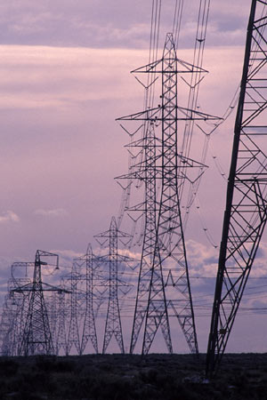
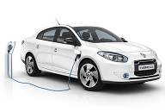
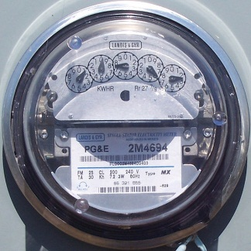
Electrification & Low-C Generation
High level of electrification of transportation, industry, buildings is required to meet the 80% reduction target
Electricity demand doubles between now and 2050, “driven” largely by electric vehicles
Nearly all electricity must be from low-carbon generation by 2050
32

Slide 33
Electrification & Energy Efficiency
Electrification
Energy Efficiency
PV
Roofs
563
452
GWh
272
152
2010
Electric Demand
2050
Baseline
Electric
Demand
Building
EE
Industrial
Ag & Other EE
PV Roofs
2050
Electric
Demand
net of EE/PV
Building
Elect.
Industrial
Ag & Other
Elect.
Transport
EVs
2050
Decarb.
Eelctric
Demand

Slide 34
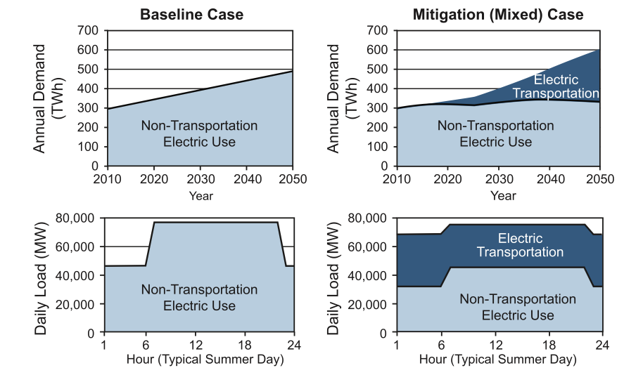
‘Smart Charging’ is Critical
Williams et al., Science 2012

Slide 35
Discussion
Exercise;
How would you rank these top 5 applications?
What is missing?
What should we take off the list?
Top 5 List
Non-wires alternatives
Use large industrial load to provide local capacity and renewable integration
Controlled charging of plug-in electric vehicles
Permanent load shifting for electric end-uses
  Space and water heating
West-side communicating thermostat standard

