Slide 1
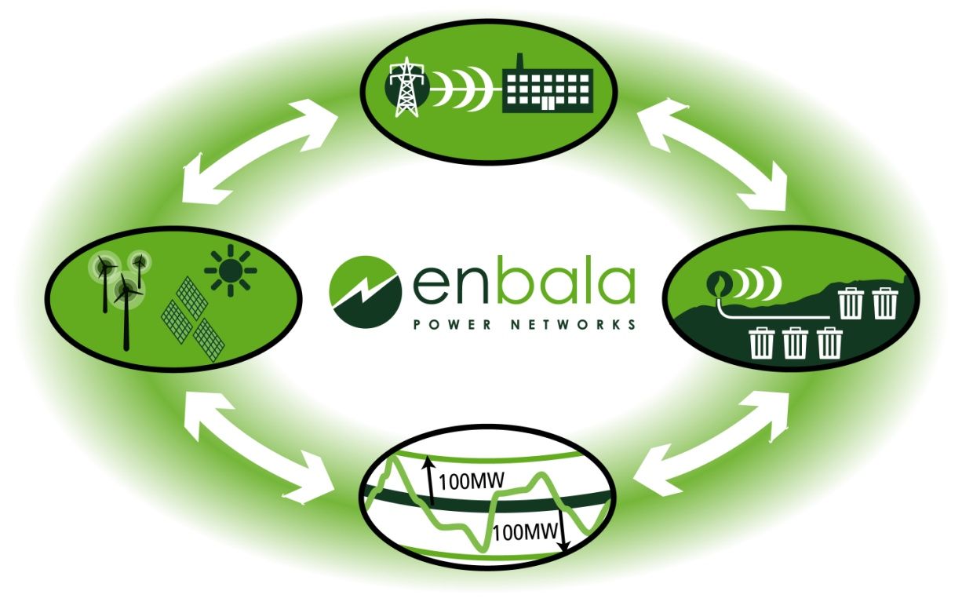
Smart Grid Solutions That Pay You
Networked Loads for New Opportunities in
Demand Response
The information contained in this presentation is for the exclusive and confidential use of the recipient. Any other distribution, use, reproduction or alteration of the information contained in this presentation, by the addressee or by any other recipient, without the prior written consent of ENBALA Power Networks Inc. is strictly prohibited.

Slide 2
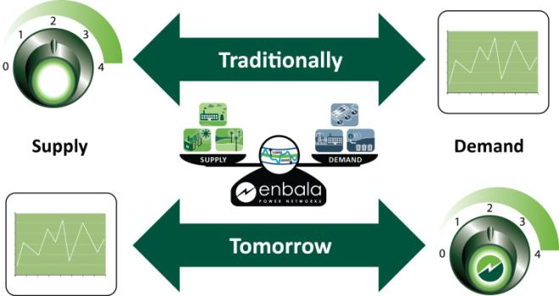
Grid Optimization Needs New Tools
Grid operators control generators to ramp up and down.
Grid operators increasingly rely on loads to participate in the management of the electric grid.

Slide 3
Demand-Side Management Opportunities
Market Maturity for demand side assets to participant
Frequency Response
Primary Frequency Response
Grid Balance
Future
HV Transmission Relief
Local Voltage/ VAR Control
Distribution Relief
Integrate DX-Connected Renewables (Solar/Wind)
Synch Reserve
Integrate TX-Connected Renewables (Wind/Solar)
Market Ready
Speed of Response
= Size of Opportunity
Curtailment (Traditional Demand Response)
Mature
Frequency of Request
Notes:
Demand Response refers to all the ways in which demand side assets can react to the needs of the power system
For many people, curtailing load a few times a year in reaction to peak demands on the power system is “demand response”
But so much more is possible!!
Already loads participate in operating and sync reserves
But with new and more intelligent technologies, loads can participate in many more ways
Regualtion Services
Ramp
Localized DR
T & D capital deferral
One of the key promises of “the smart grid” is much tighter integration of loads with the needs of the power system
And we have the technology to deliver on this today

Slide 4
Much more FREQUENT communication and requests

Slide 5
Requirement is Bi-Directional Capability
Regulation represents required balance in the grid
As likely to require the use of more power as curtailment
Notes:
We have become used to thinking about DR as curtiailment .. But frequently the grid needs loads to consume more power.
This happens with Regulation, but in some markets it happens at other times as well -- either to adsorb intermittent wind or solar, or to help manage other forms of generation mix
Intelligent DR products can help with these grid balance problems too

Slide 6
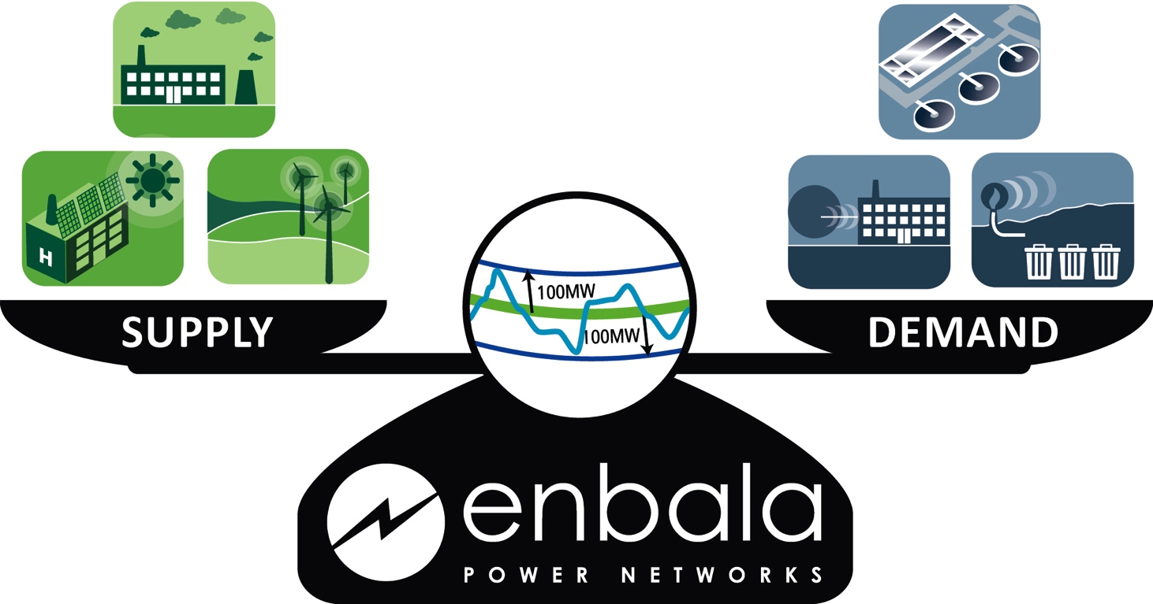
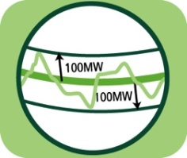
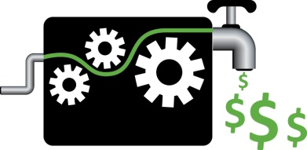
Much Less Intrusive to the Customer
Requirements are more frequent and
have shorter notice
Requires intelligent capture of inherent flexibility in processes
Requires the ability to define constraints such that operational priorities rank first
Notes:
If we are going to have loads participate both faster and more frequently -- then we need to have technologies that can respect their operational priorities FIRST
That means capturing inherent flexbility and it means the ability to define constraints

Slide 7
The Challenge for Loads
It is hard for loads to participate directly in most ancillary services markets
Responsiveness required is quite frequent, often bi-directional
The reality is that the load’s primary objective outweighs participation in challenging markets
Additional administrative challenges
Understanding the markets
Bidding requirements; real time monitoring; measurement and verification
Managing real time changes in availability and status
Almost certainly requires some form of aggregation to help coordinate the response of many loads to deliver the robustness, reliability and resiliency required by the power system --- DER’s

Slide 8
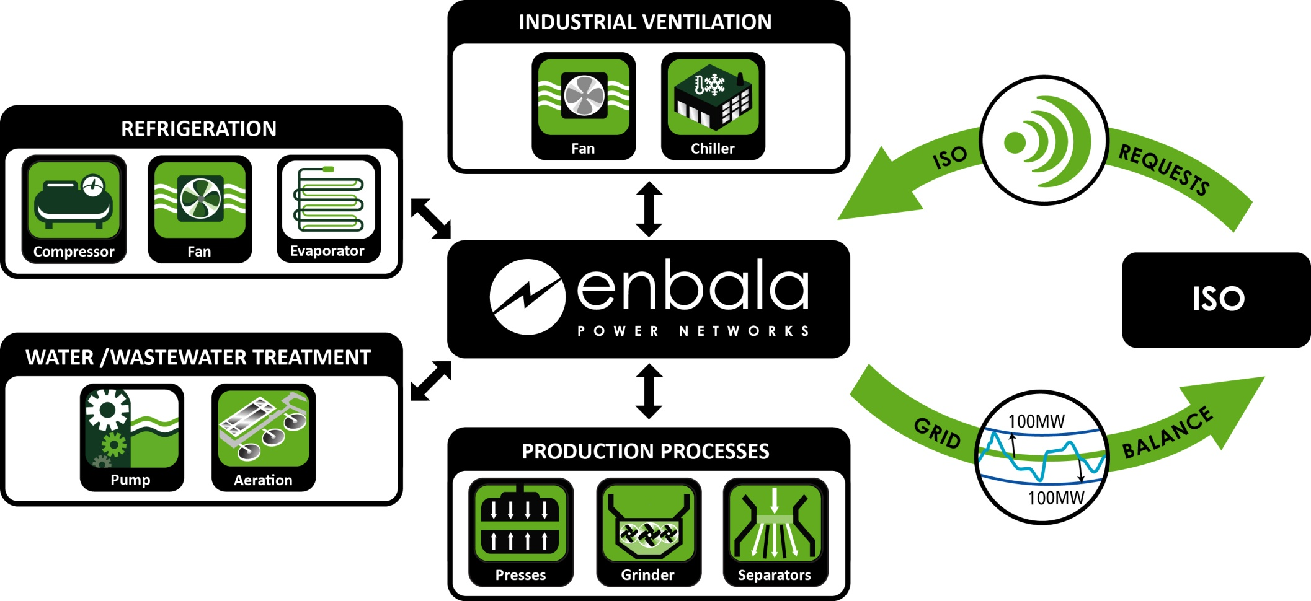
ENBALA Power Network
Notes:
ENBALA has developed the “ENBALA Power Network” to take advantage of this new opportunity for the regulation market.
The network consists of a variety of resource which on their own would not be able to provide system regulation however when operated in a network Sempa is able to supply high quality regulation to the ISO and provide Hosts with an additional revenue source for an existing asset.
This unique system is able to aggregate and harmonize active networks of geographically dispersed resources so they can be leveraged and subsequently rewarded as an alternative source of Regulation.
The network may consist of many types of resources… EFW, Pumps, Chillers, Aeration, grinders, … Any large electrical load with capability to change state in response to regulation control signals may be a candidate.
We are supplying virtual power plants to electricity system operators, allowing them to far more effectively manage the real time requirements of the electricity system. We are doing it by building the ENBALA Power Network.

Slide 9
New Demand-Side Management Paradigm
The grid management platform must conform to the client’s business…
Not the other way around.
ENBALA Power Network Client Pool

Slide 10
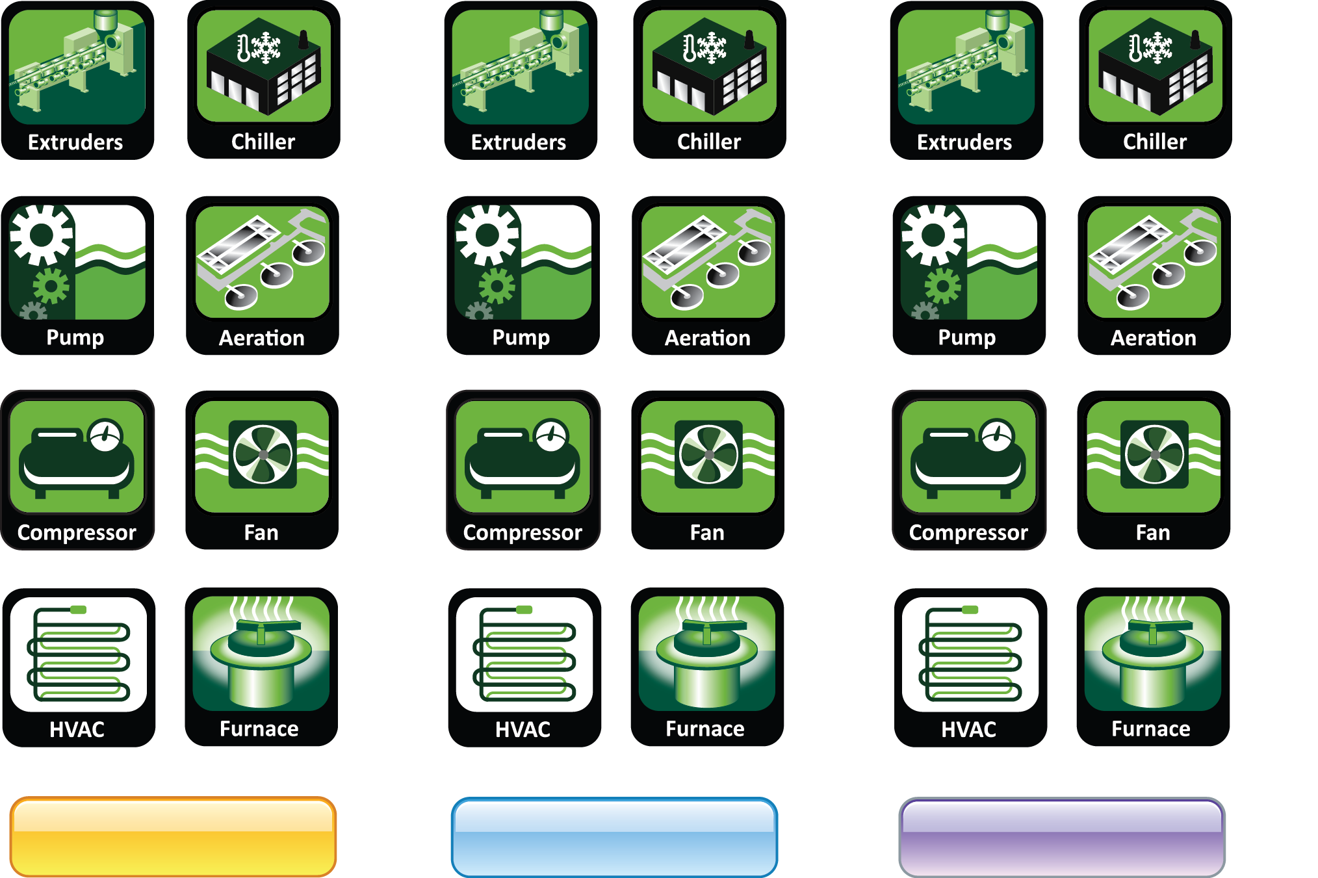
Demand Side Management
Grid Balance
Distribution Relief
Primary Frequency Response

Slide 11
Networked Loads Make All The Difference
DEMONSTRATION
Notes:
Thanks very much for taking the time listen to our presentation. We are happy to answer any questions you might have.

Slide 12
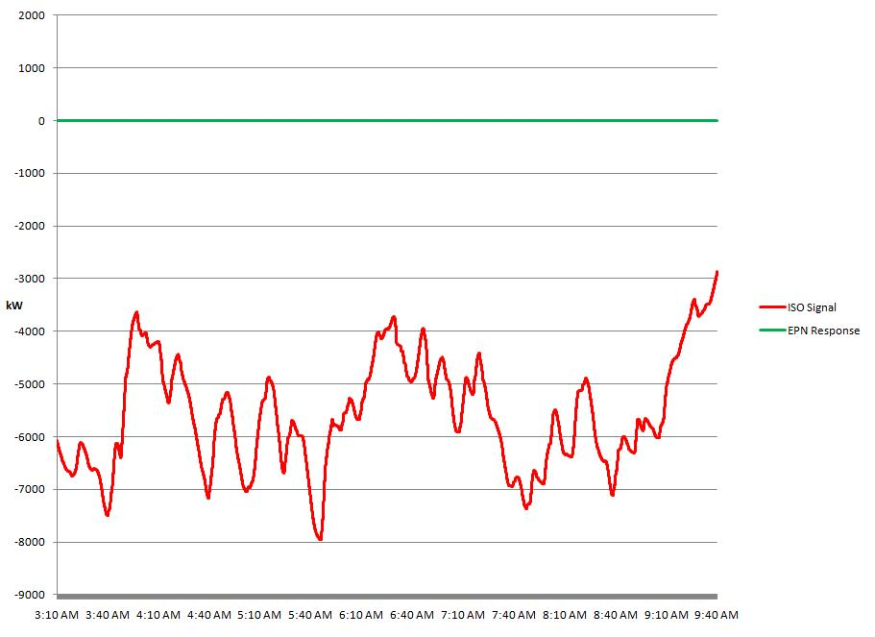
ISO Signal
Notes:
Now moving on from the resource host perspective, to an ISO perspective I will now show how system regulation is achieved.
The red line shown on the graph represents the regulation signal sent by the ISO to ENBALA’s R3OE server. The green line represents the response of all resources and thus the amount of regulation being provided.

Slide 13
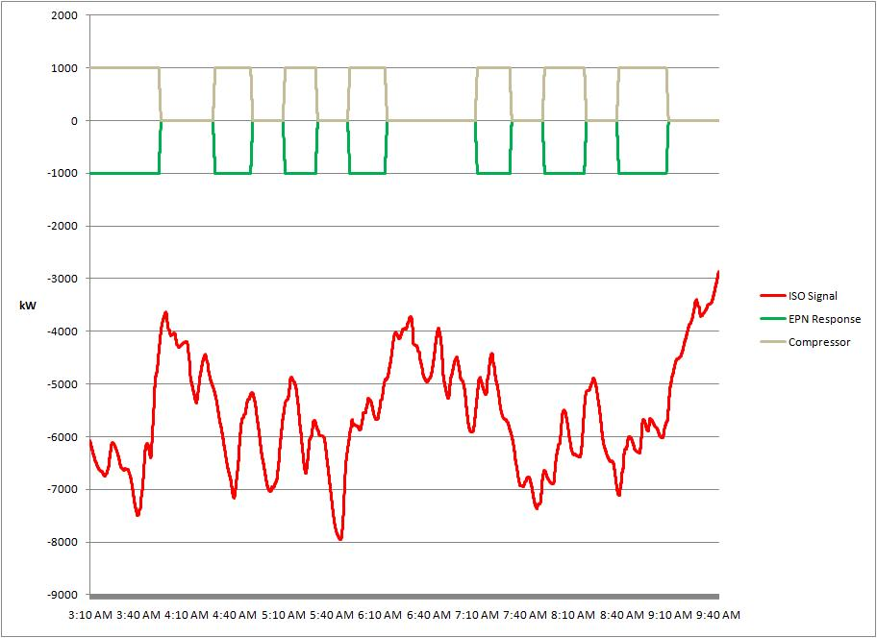
Resource Response
ENBALA Power Network Client Pool beginning to respond to ISO signal.
Notes:
As resources are added to the network, you can see how their individual response contributes to total regulation response.

Slide 14
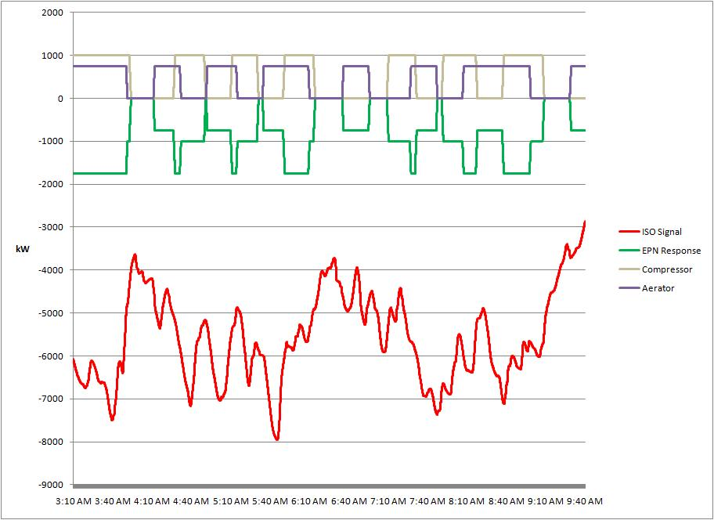
Resource Response

Slide 15
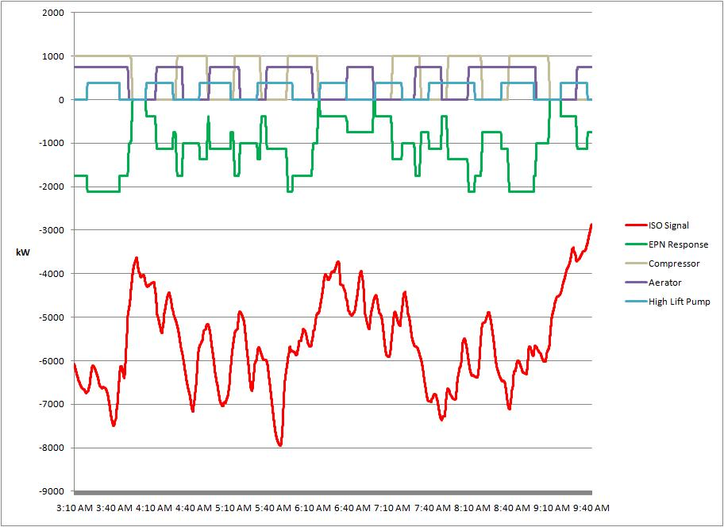
Resource Response
More participants from the Client Pool are responding to requests.

Slide 16
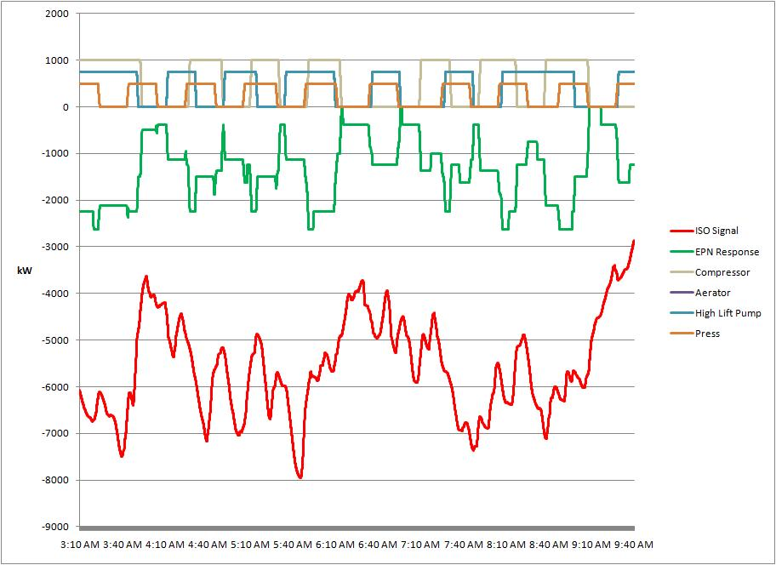
Resource Response
Notes:
Again, ENBALA always honours process and equipment constraints. If we look at the statistics of one of the resources within the network, we can get a quick snap shot of the resource operation. The operating statistics over this regulation period show that this pump operates within the defined constraints. This particular resource had a limitation of: 2 starts per hour A minimum on time of 15 minutes and a minimum off time of 10 minutes. All of which as well within the agreed upon constraints.

Slide 17
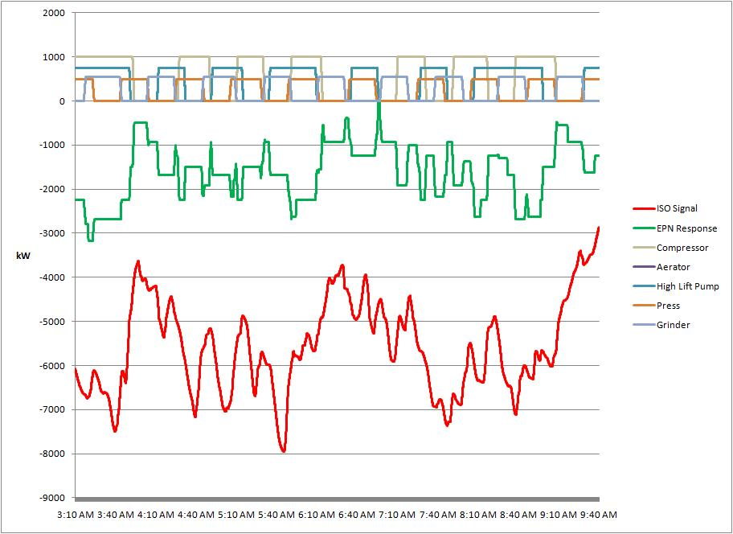
Resource Response

Slide 18
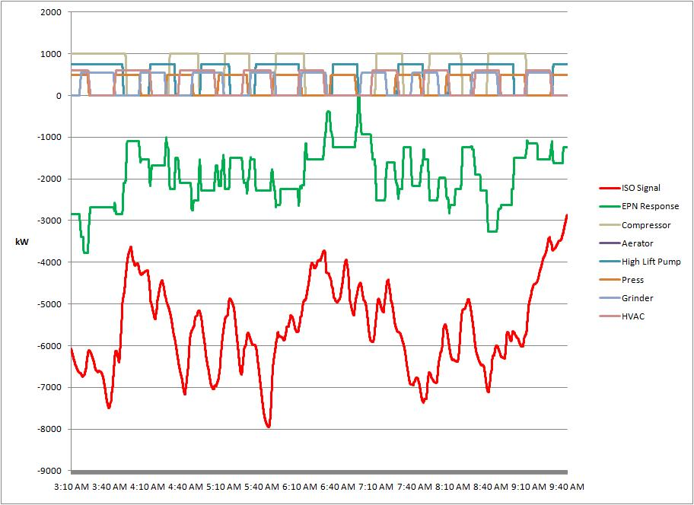
Resource Response
Notes:
As all the binary and analog resource responses are added, we can combine each response to form an aggregate response of all resources in the network.

Slide 19
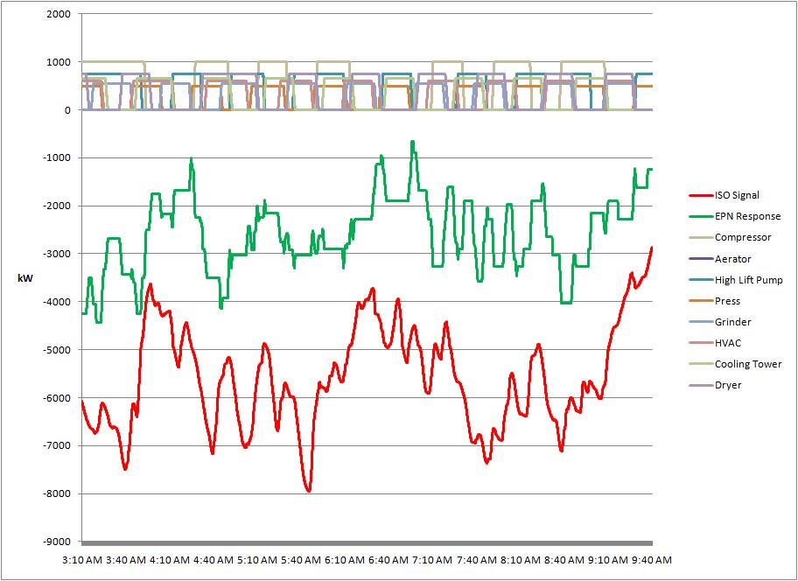
Resource Response
The green line is EPNs aggregated response from the Client Pool.

Slide 20
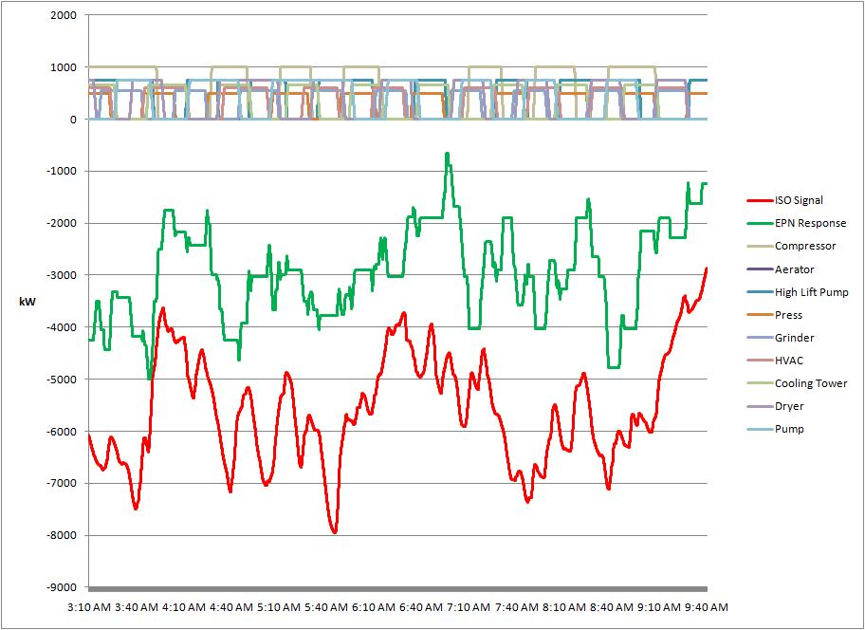
Resource Response

Slide 21
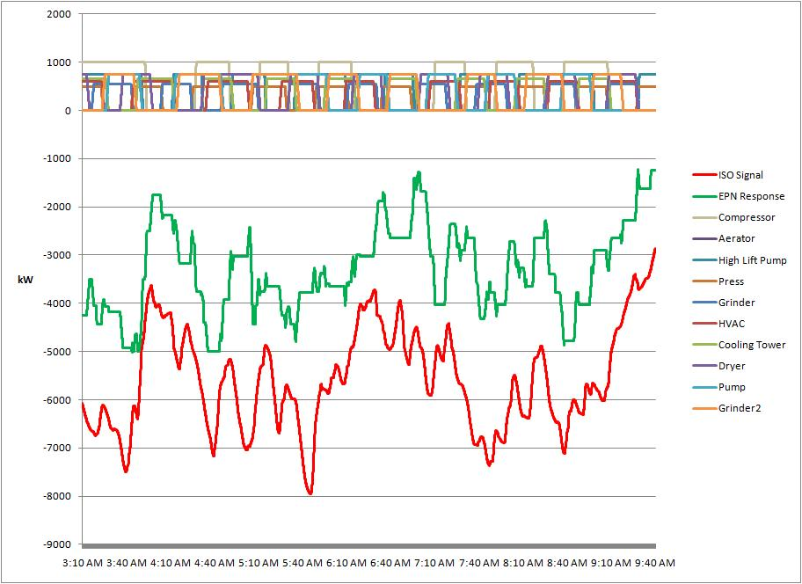
Resource Response

Slide 22
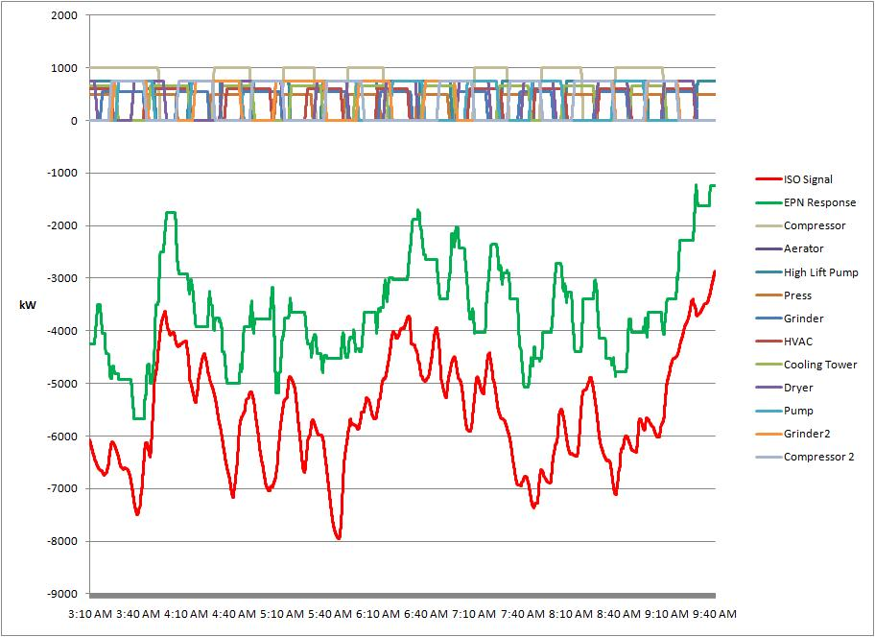
Resource Response
8 binary assets (on/off) responding to the ENBALA Power Network.

Slide 23
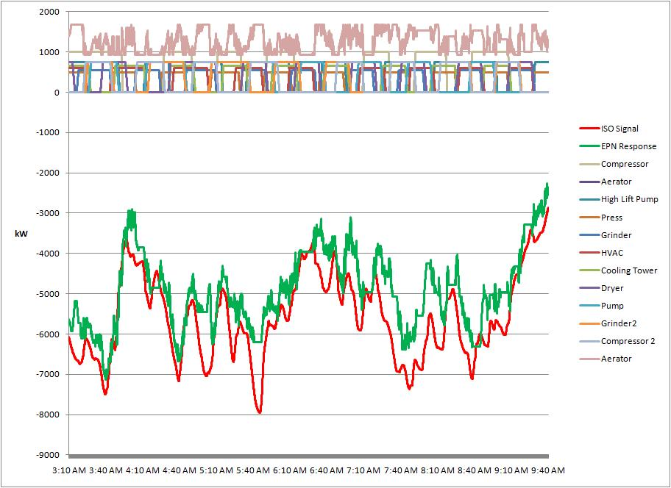
Resource Response
The 9th participating load is a VFD – providing a continuous response (ranging between 1000 kW – 1750 kW)

Slide 24
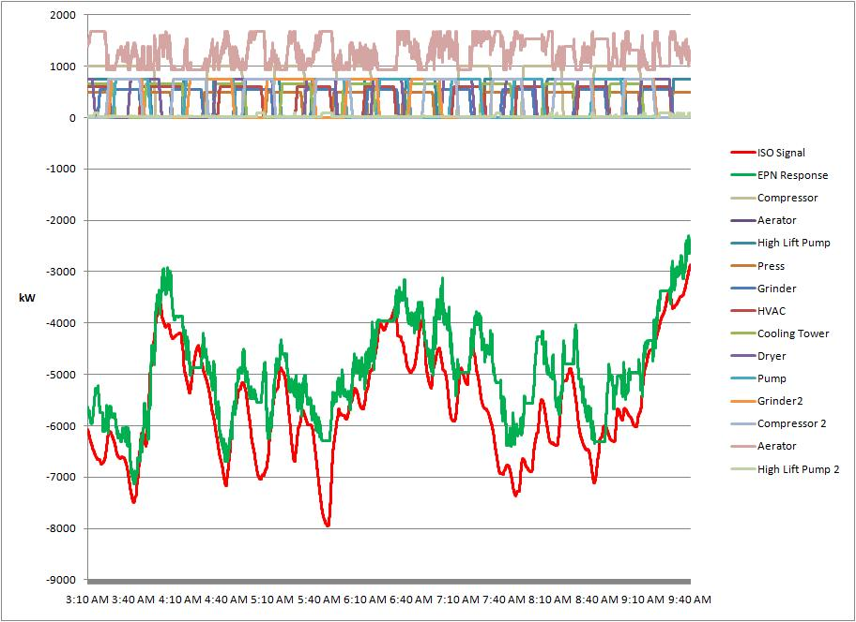
Resource Response

Slide 25
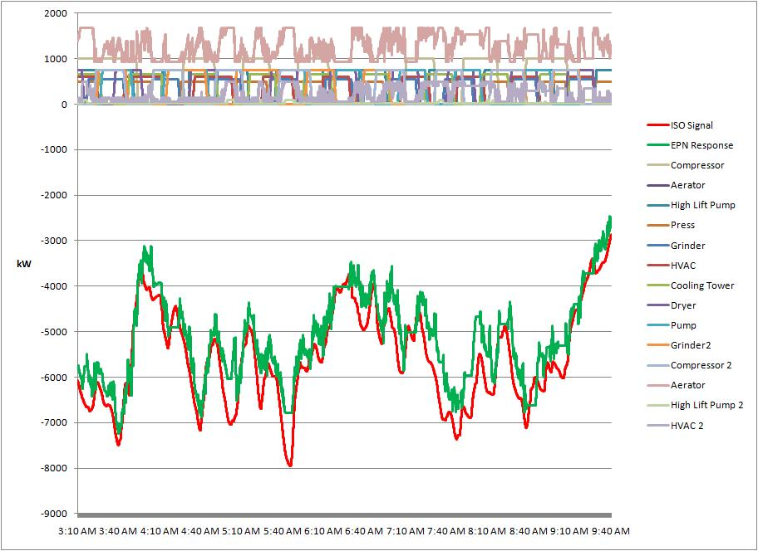
Resource Response

Slide 26
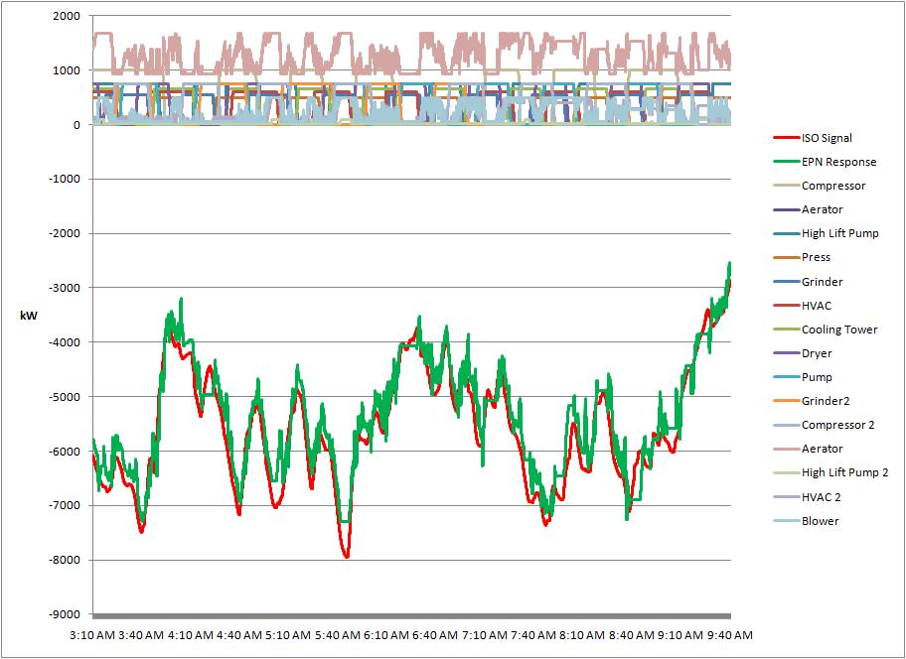
Resource Response

Slide 27
Resource Response
The aggregate response of each resource in the network is compiled to form a unified regulation response.
Notes:
Once all the resources are added, you can see the final aggregate response to the ISO regulation signal.
As you have seen EPN responds to minute-by-minute changes by the ISO to provide regulation, but does NOT necessarily make minute-by-minute changes to industrial resources. Resources may be able to only change state hour-by-hour, and that resource can still be effectively employed to provide regulation.
This is possible because of resource aggregation but also possible because of the inherent overbuild within the EPN network. Essentially network overbuild means total capacity of the network is always larger than the amount of regulation being provided. Resources are only called upon when they are available, and when they are not, the network overbuild ensures that another resource would be utilized to provide regulation.

Slide 28
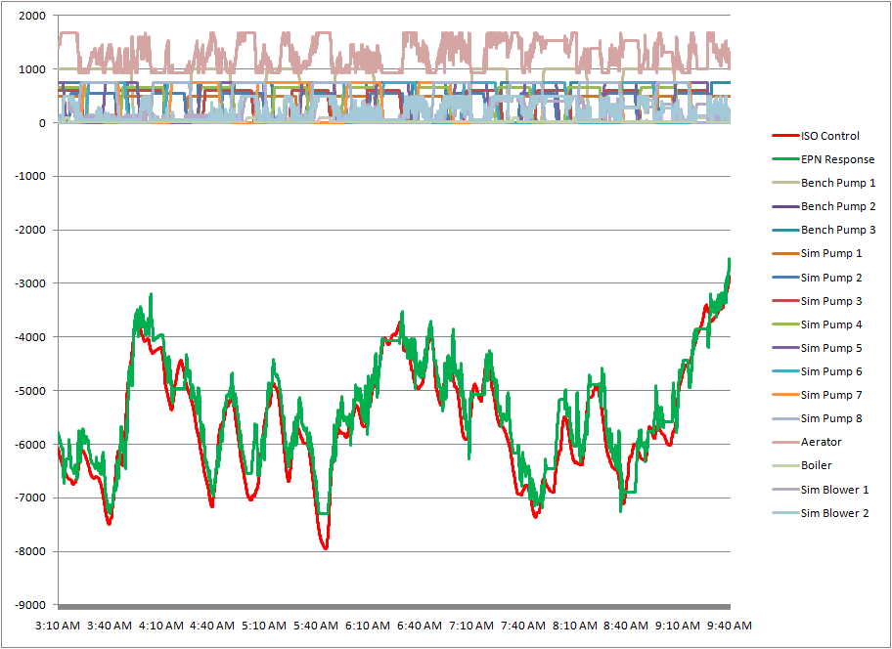
Regulation – Resource Response
The aggregate response of each resource in the network is compiled to form the regulation response
Notes:
Once all the resources are added, you can see the final aggregate response to the ISO regulation signal.
As you have seen EPN responds to minute-by-minute changes by the ISO to provide regulation, but does NOT necessarily make minute-by-minute changes to industrial resources. Resources may be able to only change state hour-by-hour, and that resource can still be effectively employed to provide regulation.
This is possible because of resource aggregation but also possible because of the inherent overbuild within the EPN network. Essentially network overbuild means total capacity of the network is always larger than the amount of regulation being provided. Resources are only called upon when they are available, and when they are not, the network overbuild ensures that another resource would be utilized to provide regulation.

Slide 29
Real World Load Response

Slide 30
So Why Isn’t This Happening Everywhere?
Regulatory
Drive and Focus in ISO’s and Utilities
Engagement of Loads

Slide 31
Regulatory
FERC Order 719 Requires ISO’s to create a level playing field in ancillary services markets
Largely, they can (and do) claim to have done this
In reality, most jurisdictions continue to have “technical, administrative” barriers to entry
Do not permit loads to aggregate to provide ancillary services
Aggregation rules are somewhat arbitrary and slow adoption
Operational systems (at ISO’s) not upgraded for different resources to participate; reluctance to establish as priority
Do not allow multiple CSP’s to participate with same clients (creating effective barrier to new entrants)
Layered rules: States require separate registrations

Slide 32
Drive and Focus of ISO’s and Utilities
Largely, ancillary services markets are functioning reasonably well (almost completely served by generation side assets)
In most ISO’s, other priorities, driven by larger stakeholders, dominate the agenda
Almost everyone believes that loads can provide ancillary services, and most think it is a “good thing”
But most are not focused on seeing more of it happen
Requires stronger support among policy makers
Minimum targets for demand side participation?
Encouragement in load participation?
Fortitude to understand and make

Slide 33
Engagement of Loads
Recession of 2008 took the pressure off -- reduced scrutiny over energy bills
Reduced demand caused a reduction (generally) in electricity prices
Also reduced volatility in prices
Reduced corporate pressures to reduce energy costs
Some (legitimate) concern over implications of participation in ancillary services markets
Requires more “connectness”
Requires new thinking and some effort (implies early adopters first)
Not sure whether it is “worth it”
Most markets for ancillary services have experienced price declines
Less value -- certainly a concern for loads to participate
Less assured return -- participation in a market does not produce a guaranteed return
Different than traditional DR

Slide 34
Making it Happen
Utilities can provide the necessary leadership
Run commercialization programs ..
Small pilots don’t encourage real participation
Large, real loads want to know there is a long term program that will pay them for their participation
Their time -- to evaluate and implement -- is available ... They don’t like to waste it
Insist on real results that truly have the capability for broad roll-out
Any and all pilots should have this characteristic
They should be economic and viable ...
Use the brand and leadership of the utility to encourage and value load participation
Loads do look to the utility to understand “what is important”
When they see it, they act!

Slide 35
Questions & Comments?

Slide 36
Thank You
Ron Dizy
President & CEO
416 419 6393
rdizy@enbala.com
www.enbala.com

