Slide 1
Demand Response At
Idaho Power
Pete Pengilly
Customer Research & Analysis Leader

Slide 2
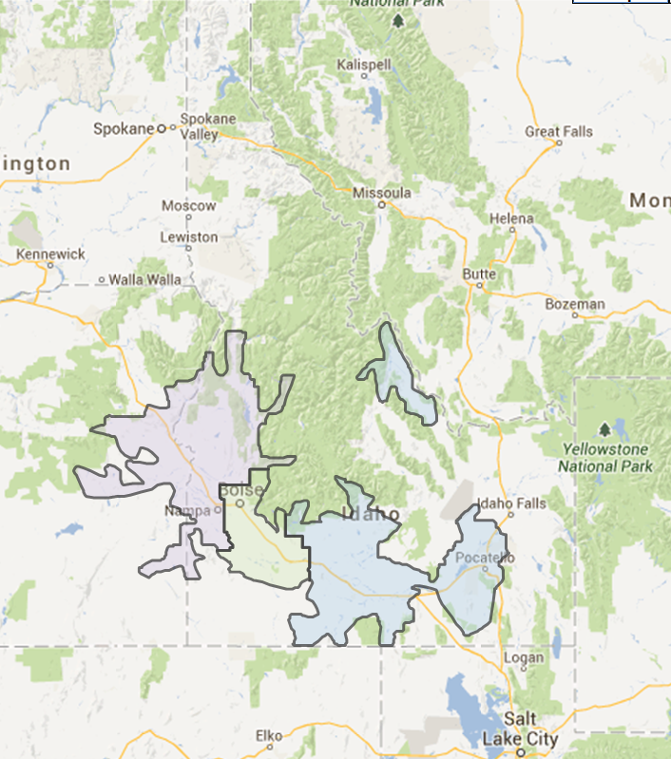
Idaho Power Company
Approximately 500,000 Service Locations
24,000 sq miles
Population 1,000,000
System Peaks
3,214 MW - 2008
3,268 MW - 2012
3,407 MW – 2013

Slide 3
Idaho Power Demand Response Growth
MW

Slide 4
Demand Response in 2012
Approximately 438 MW DR capacity in three programs
Irrigation ~ 340 MW
AC cycling ~ 45 MW
Large C&I – aggregator ~ 53 MW
12.6 % of all time record peak (prior to 2013)
Total cost in 2012 of approximately $21 Million
496 Oregon Service Locations participating, 1.4 %of total

Slide 5
Idaho Case No. IPC-E-10-46
Revisions to the Irrigation Peak Rewards Program
Filed December 10, 2010
The revised Program, as proposed, will more closely align program incentives with the Company's need for demand response
Requested:
  Change in pricing – 25% fixed incentive 75% variable
    Possible greater incentive if used to its maximum
  One event per season included in fixed incentive
  Extended hours option to include the 8:00-9:00 hour
  Changes to the manual option and opt-out penalties
  Company may limit participation to better align the Program with capacity needs.

Slide 6
Idaho Case No. IPC-E-10-46
Revisions to the Irrigation Peak Rewards Program
Order No. 32200 received March 9, 2011
Results:
  Incentive structure 75% fixed payment 25% variable payment (as compared to the previous tariff)
    With the potential of getting a higher incentive if program use was maximized
  No dispatch events included in fixed incentive
  Change in opt out penalties approved
  Addition of extended interruptible option 8:00 – 9:00 p.m. approved
  Do not limit participation in the Peak Rewards Program

Slide 7
Case No. IPC-E-10-46
Revisions to Irrigation Peak Rewards
“Staff recommended the Commission deny the Company’s proposal to add the limiting language, and stated the Company should not only accept participants but should promote the Program in order to achieve peak load reduction over the long term”
“On this record, the Commission finds that adding language to limit participation in the Program is not necessary, and could unduly discourage participation.”
Order No. 32200 page 11, March 9,2011

Slide 8
IPUC Order No. 32250
“This demand response program is dispatchable, reliable and often less expensive than purchasing power during periods of heavy load. In its audit Staff determined that participants in the 2010 irrigation season were interrupted for 12 hours out of 60 potential hours, or 20% of potential hours. Staff Comments at 4. To reduce the Company’s power supply costs during these heavy-load hours, Staff recommended that the Company increase the use of its curtailment hours in the Irrigation Peak Rewards Program.”
IPC-E-11-06 Power Cost Adjustment Case pages 4-5, May 31, 2011

Slide 9
IPC-E-12-15 Order No. 32667
October 22, 2012
Staff Comments: Staff predicted that the Irrigation Peak Rewards program will rarely be dispatched and may need to be refined if the dispatch cost continues to outpace the cost of market-energy prices.
Commission Decision: Based on our review of the record, we are concerned that the new incentive structure may be limiting the effectiveness of the Irrigation Peak Rewards Program. We direct the Company to continue to monitor the Program and to take such steps as may be needed to improve it, consistent with the Commission’s directive to pursue all cost-effective DSM programs.

Slide 10
Integrated Resource Planning: 2013 IRP
Load and Resource (L & R) Balance Analysis
  For Peak load Idaho Power uses a 95th percentile load and 90th percentile water – 1/20 year loads and 1/10 year water conditions
  Integrated Resource Plan Advisory Council (IRPAC) meets throughout the year on ‘IRP years’
  Portfolio Advisory Committee workshop November 20, 2012 L & R analysis was complete
  Energy Efficiency Advisory Group (EEAG) webinar December 5, 2012
  File Case No. IPC-E-12-29 on December 21, 2012
  IPCO had anticipated making changes to Irrigation Peak Rewards in the fall of 2013 prior to the L & R Balance Analysis

Slide 11
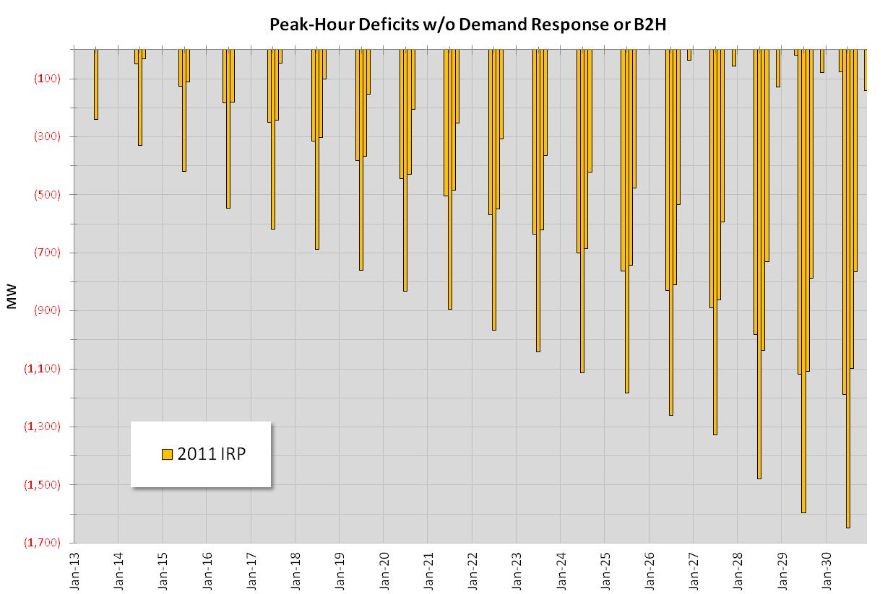
Peak-Hour Deficits – 2011 IRP
400+ MW of DR
Notes:
Aurora Planning Model

Slide 12
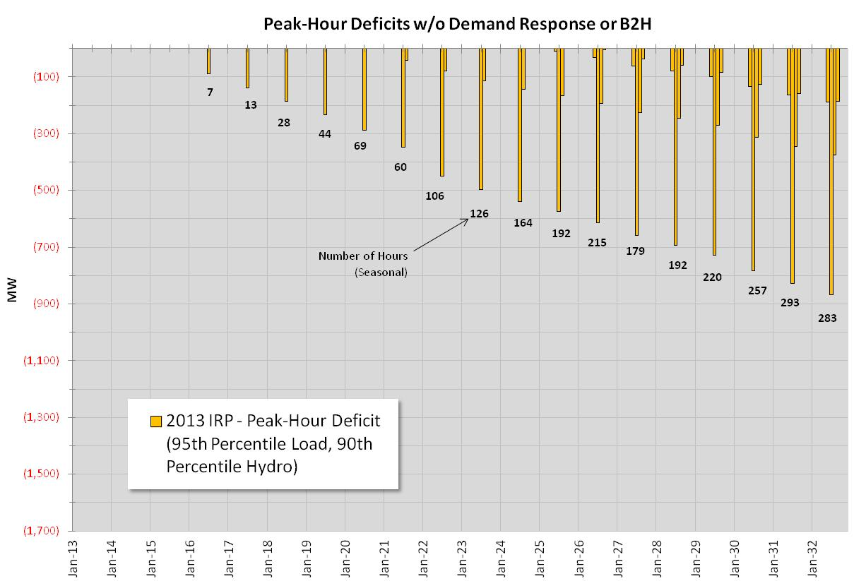
Peak-Hour Deficits - 2013 IRP

Slide 13
IPC-E-12-29 – December 21, 2012
Temporary Suspension of two DR Programs
Order No. 32776 - Settlement Agreement – Continuity payments
Parties Included
  IPUC Staff
  Idaho Irrigation Pumpers Association (IIPA)
  Idaho Conservation League (ICL)
  Snake River Alliance (SRA)
  In 2013 Saved ≈ $10 Million in customer funds vs. 2012
FlexPeak Management
  Renegotiated terms of EnerNOC Contract
A/C Cool Credit program
  Participants received $1.00/month for three months (vs. $7.00)
  No DR events
  No new participants in 2013 – no cycling events
Irrigation Peak Rewards
  Irrigation Peak Rewards – reduced incentives – no DR events
  For existing participants only no new participants
Notes:
By suspending programs and renegotiating the EnerNOC contract IPCo saved about $10 million in customer money.

Slide 14
IPC-E–13-14 & UM 1653
Continuation of DR Programs 2014 and Beyond
Series of five public workshops established in Idaho Case No. IPC-E-13-14
Oregon docket UM 1653 opened to facilitate participation by Oregon Staff and Oregon parties in the workshop process
Intent of the workshops was to provide stakeholders an opportunity to discuss and evaluate the continuation and/or modification of Idaho Power’s three demand response programs:
  A/C Cool Credit
  Irrigation Peak Rewards
  FlexPeak Management

Slide 15
Review of Demand Response Workshops
Workshops were hosted at Idaho Power in Boise
Facilitated by a third-party, professional facilitator, Dune Ives, Ph.D. of Milepost Consulting
All-day workshops held on:
  Wednesday, July 10
  Tuesday, July 23
  Wednesday, August 7
  Monday, August 19
  Tuesday, August 27 (included settlement discussions that culminated in a settlement agreement that has been filed in Idaho)

Slide 16
Review of Demand Response Workshops
  In addition to Idaho Power personnel, nearly 50 individuals representing 20 different organizations participated in the workshops
  Participating organizations included:
    Idaho PUC Staff Oregon PUC Staff , Oregon CUB
    Irrigation Pumpers Association Industrial Customers of Idaho Power
    Idaho Conservation League Idaho Sierra Club
    Snake River Alliance Northwest Energy Coalition
    Idaho Office of Energy Resources Idaho State Senate, District 17
    J.R. Simplot Company McCain Foods
    Monsanto/Seminis King Hill Irrigation District
    EnerNoc, Inc. Honeywell Smart Grid Solutions

Slide 17
Demand Response Settlement
Basic overarching DR concepts – Idaho Power must:
  Use existing DR resources when possible, this currently represents approximately 400 MW of potential DR
  Include DR offerings for all three customer classes
  Keep costs as low as possible
  Re-evaluate the value calculation as IRP changes
  Take a long-term outlook
  DR avoided cost calculations use 170 MW single cycle combustion turbine, apply effective load carrying capacity, assume 20 year life, and include 60 hours energy savings
  Strive for consistency in dispatch across all programs

Slide 18
Demand Response Settlement
Size and Value of Idaho Power DR resource:
  Resource Size. Minimum size of deferred resource used for the value calculation is 170 MW. It is appropriate for Idaho Power to incur and recover costs based on deferring this resource.
  Value. Minimum annual value of DR is equal to levelized cost of resource over 20 years plus energy savings. Currently this is $16.7 million per year for all DR programs. This will be the DR value even in years when IRP shows no need. This calculation will be updated each IRP and may include changes in need, capital cost and financial assumptions.

Slide 19
Avoided Capacity Calculation

Slide 20
Demand Response Settlement
A/C Cool Credit Program – tariff changes
  Participants: No new marketing, allow: existing participants , customers moving into a home with device or on to a new home, will accept those requesting to join.
  Program Details:
    Season 6/15 through 8/15 weekdays excluding holidays
    Events will be no longer than 4 hours, and no more than 15 hours per week and 60 hours per season
    There will be a minimum of three events per season with no advanced notice (has never had advance notice).
    Participants, with advance notice, may opt out of two events per season
  Incentive: Participants will receive a fixed incentive of $15 for season ($5/month) as credit on bill.
Notes:
All programs can be used in event of system emergency
Program size: if program changes, parties to agreement may file to modify program.

Slide 21
Demand Response Settlement
Irrigation Peak Rewards– tariff changes
  Participants. Participation is limited to past program service locations with active, working load control device. Idaho Power will not actively market program.
  Program Details:
    Season 6/15 – 8/15, Mon – Sat, no holidays
    Hours: 1-9 p.m., up to 4 hours/event, up to 15 hours/week, maximum 60 hours/season - minimum of three events as other programs
    Advanced notice: no advance notice for customers in Option 1 and 2, and four hours for customers in Option 3
    Participants may opt out five times - opt-out fee applies
  Incentive.
    Fixed payment. Participants will receive fixed incentive of $5/kW plus $0.0076/kWh per month. (≈ $16/kW/season)
    Fixed incentive includes the three minimum dispatch events.
    Variable payment. If Idaho Power conducts more than the three minimum events, participants will receive a variable incentive of $0.148 per kWh ($0.198 per kWh for extended option).

Slide 22
Demand Response Settlement
FlexPeak Management – program changes
  Participants. Idaho Power will not actively seek to expand the capacity of program – participants are industrial and large commercial customers.
  Program Details:
    Same season (6/15 – 8/15), event hours (similar) and minimum of three events as other programs
    Events will occur 2:00 p.m. to 8:00 p.m.
    Two hour advanced notice to participants
  Incentive.
    A fixed and variable incentive structure may be used, as long as the variable portion is low enough that it does not prevent the program from being dispatched. If a variable and fixed incentive structure is used, a minimum of three events will be included in the fixed incentive. The variable incentive will be paid to participants if Idaho Power conducts dispatch events in the FlexPeak Management program for more than the three minimum dispatch events

Slide 23
Demand Response Settlement
Idaho Power will investigate the feasibility of using DR as non-spinning operating reserves by September 2014. If a pilot is feasible, Idaho Power will work with Staff and other interested parties to develop pilot program.
Notes:
Critical Infrastructure Protection (CIP)
Availability

Slide 24
Idaho Power Total Demand Response
July 16, 2010

Slide 25
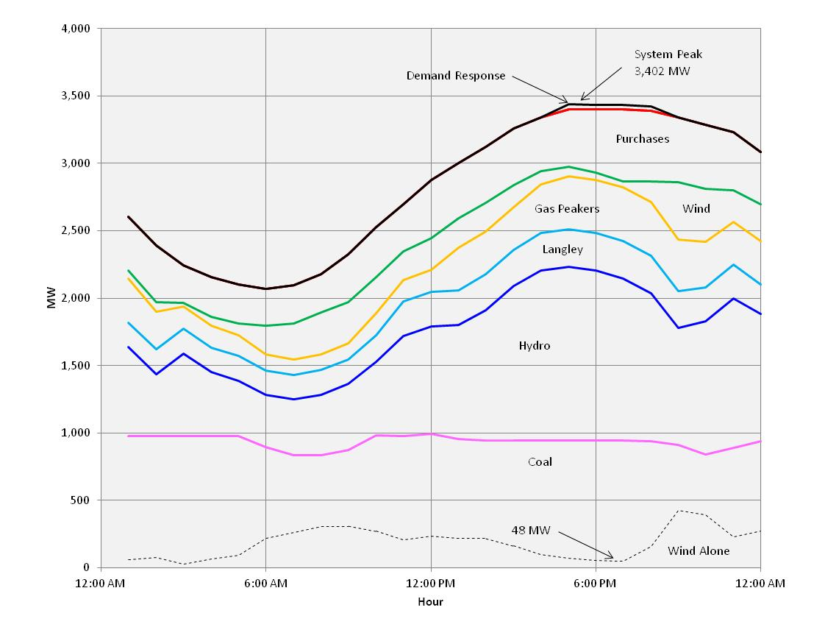
Generation Mix July 1, 2013
Boise High Temperature 110 degrees

Slide 26
Program Design – A/C Cool Credit

Slide 27
Irrigation Peak Rewards
Components
Irrigation: Prior to 2013
Irrigation: Proposed Design
Target Customers
Irrigation Customers
Irrigation Customers
Dates Available
June 15 - Aug 15
June 15 - Aug 15
Available Days
Mon-Sat
, no holidays
Mon-Sat
, no holidays
Times-of-Day Available
1 p.m. to 9 p.m.
1 p.m. to 9 p.m.
Hours per Event
Up to four hours per event
Up to four hours per event
Hours per Week
Up to 15 hours per week
Up to 15 hours per week
Hours per Season
Maximum 60 hours for summer
Maximum 60 hours for summer
Minimum number of events
0
3
Emergency Use
Yes
Yes
Cost to Customer
On service locations less than 50 Hp -
No new installs
Original control device Installation cost
varies depending on size and option
Advance Notification to
By 4 pm the day before
No Notification for Automatic dispatch option: Four
Customer
hours for Manual dispatch option
Incentive
Fixed: $26/ kW paid through a $5/ kW
Fixed: $5/ kW demand credit
demand credit and $.019/ kWh credit to
and $.0076/ kWh credit to the customer
the customer
Variable: Average of 17 cents/kWh to the
Variable: Average of 16 cents/kWh to the customer
customer
Opt Outs
Maximum of 5 times, $1/ kW each time
Maximum of 5 times, $5/ kW first 3 events of program,
$1/ kW after first 3 events
Permanent Opt Out
$500 during program season - No charge
$500 during program season - No charge when out
when out of program season
of program season
Who Can Participate
All irrigation customers (unless installation
All past participating irrigation dispatch service
is unsafe)
locations with a device. Also, 2012 timer option
service locations have option of converting to the
dispatch option in 2014.

Slide 28
Demand Response at Idaho Power
Questions/Comments?
Pete Pengilly
ppengilly@idahopower.com
208-388-2281

