Slide 1
Demand Response 2010 and Beyond
April 28, 2011
Pete Pengilly

Slide 2
Demand Response at Idaho Power
Current programs and results
Value of Demand Response load reduction
Dispatch of Demand Response resources
Optimum level of DR reduction for Idaho Power’s system and 2011 IRP Analysis
Method and level of payment for Demand Response
Reporting of Demand Response Peak reduction
IPUC Case No. IPC-E-10-46: Revise Peak Rewards

Slide 3
Programs
Irrigation Peak Rewards
Using cell phone communication and manual intervention to turn off irrigation pumps during peak times (AMI switch pilot)
FlexPeak Management
Under contract with EnerNoc to offer demand response to large commercial and industrial customers
A/C Cool Credit
Cycles residential A/C units off and on during peak times

Slide 4
Peak History at Idaho Power
System peak
3,214 MW June 30, 2008
System winter peak
2,528 MW December 10, 2010
Summer 2009 system peak
3,031 MW July 22, 2009 (actual-w/o DR)
Summer 2010 system peak
2,930 MW June 28, 2010 (actual-w/o DR)

Slide 5
Summer 2010
Date | 6/29/2010 | 7/16/2010 | 7/26/2010 | 8/5/2010
High Temperature (F) | 93⁰ | 101⁰ | 92⁰ | 101⁰
A/C Cool Credit (MW) | 33 | 34 |  | 35
FlexPeak Management (MW) | 30 | 34 | 31 | 33
Irrigation Peak Rewards (MW) | 196 | 222 |  | 121
Total (MW) | 259 | 290 | 31 | 189

Slide 7
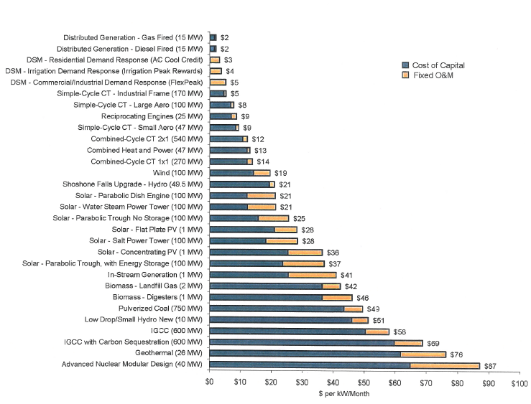
2009 IRP : Capacity $/kW Month

Slide 8
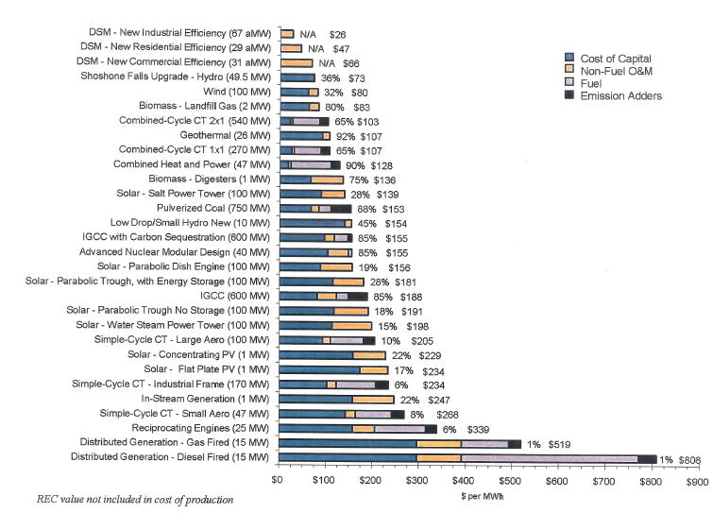
2009 IRP : Energy $/MWh
DR ≈ $850/MWh

Slide 9
2010 Results
Peak Rewards: In 2010 reduced peak load by 222 MW by controlling pumps on 2038 service locations.

Slide 10
Dispatch Method 2010
Met every Thursday throughout the summer with:
Program Managers
Power Supply
Generation Dispatch
Transmission Planners
Energy Traders
Day Ahead Operators
Regulatory Affairs
Considered:
Load Forecast
Temperature Forecast
Generation Availability
On-Peak Energy Prices & Availability
DR Program Parameters/Availability/Dispatch

Slide 12
Idaho Power Total Demand Response
July 16, 2010

Slide 13
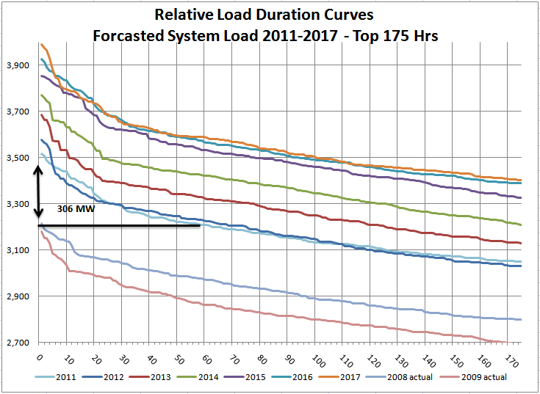
MW
Hours
Notes:
90th percentile load = 1 in 10 chance of load being this high
95th percentile water = 1 in 20 chance of water being this low

Slide 14
Fifteen days above dispatch line
3,209 MW

Slide 15
Theoretical 2011 Dispatch of 310 MW DR

Slide 16
Approx. Generation Capacity

Slide 17
IRP Analysis Results
A | B | C | D | E | F | G | H | I
Year | Peak Load (MW) | 60th Hour Peak Load (MW) | Energy Efficiency (MW) | Existing and Committed Supply-Side Resources (MW) | L&R Balance Deficit Position w/o DR Programs (MW) | Achievable DR with 60 Hour Programs (MW) | Demand Response Target (MW) | Operational Target (MW)
2011 | 3,515 | 3,209 | 17 | 3,120 | 378 | 306 | 306 | 330
2012 | 3,430 | 3,227 | 34 | 3,241 | 155 | 203 | 155 | 310
2013 | 3,684 | 3,326 | 50 | 3,390 | 244 | 358 | 244 | 315
2014 | 3,770 | 3,422 | 65 | 3,386 | 319 | 348 | 319 | 315
2015 | 3,854 | 3,532 | 79 | 3,382 | 393 | 322 | 322 | 321
2016 | 3,925 | 3,566 | 93 | 3,379 | 453 | 359 | 359 | 351
2017 | 3,991 | 3,588 | 108 | 3,374 | 509 | 403 | 403 | 351
2018 | 4,056 | 3,650 | 122 | 3,368 | 566 | 406 | 406 | 351
2019 | 4,123 | 3,711 | 136 | 3,363 | 624 | 412 | 412 | 351
2020 | 4,190 | 3,827 | 150 | 3,358 | 682 | 363 | 363 | 351
Minimum

Slide 18
Conclusions:
There is an optimum amount of Demand Response for the Idaho Power system
In conjunction with the IRP planning process, Idaho Power plans to set a demand response target that will be updated with each new IRP
Energy Efficiency department will work to align program design with system needs
Stakeholders need to be involved in this process
Program design needs to be continually re-assess for program improvement and increase value
Peak load reporting policies need to be addressed

Slide 19
IPUC Case No. IPC-E-10-46: Dec 2010 Revision of Irrigation Peak Rewards
Change the incentive structure: 40% fixed 60% variable
Include one event in fixed payment
Change how large customers participate > 1,000 hp
Modify the opt out option and penalty
Add the 8-9 p.m. hour on an optional basis and slightly increase incentive
Add limitation of participation language based on need

Slide 20
IPUC Case No. IPC-E-10-46: Order 32200
Change the incentive structure: 75% fixed 25% variable
Do not include one event in fixed payment
Approved: Change how large customers participate > 1,000 hp
Approved: Modify the opt out option and penalty
Approved: Add the 8-9 p.m. hour on an optional basis and slightly increase incentive
Do not limit participation based on need

Slide 21
Demand Response @ Idaho Power
Questions/Comments?
Pete Pengilly
1 208 388 2281
ppengilly@idahopower.com

