Slide 1

Pilot Program – Nippon Paper as a Source of Ancillary Services
Pacific Northwest Demand Response Project
Northwest Power and Conservation Council
23 February 2012
Philip D. Lusk
Power Resources Manager
360.417.4703
plusk@cityofpa.us

Slide 2
Today’s Topics
Background
Advanced Metering Infrastructure Efforts
Rate Design Efforts
Demand Response Efforts
Fast DR as Ancillary Services

Slide 3
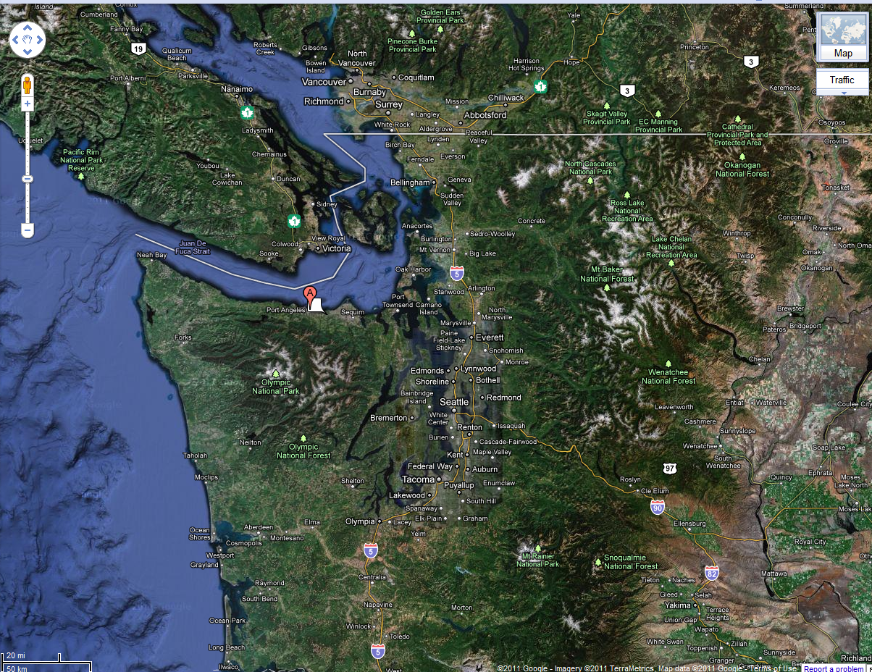

Slide 4


Slide 5
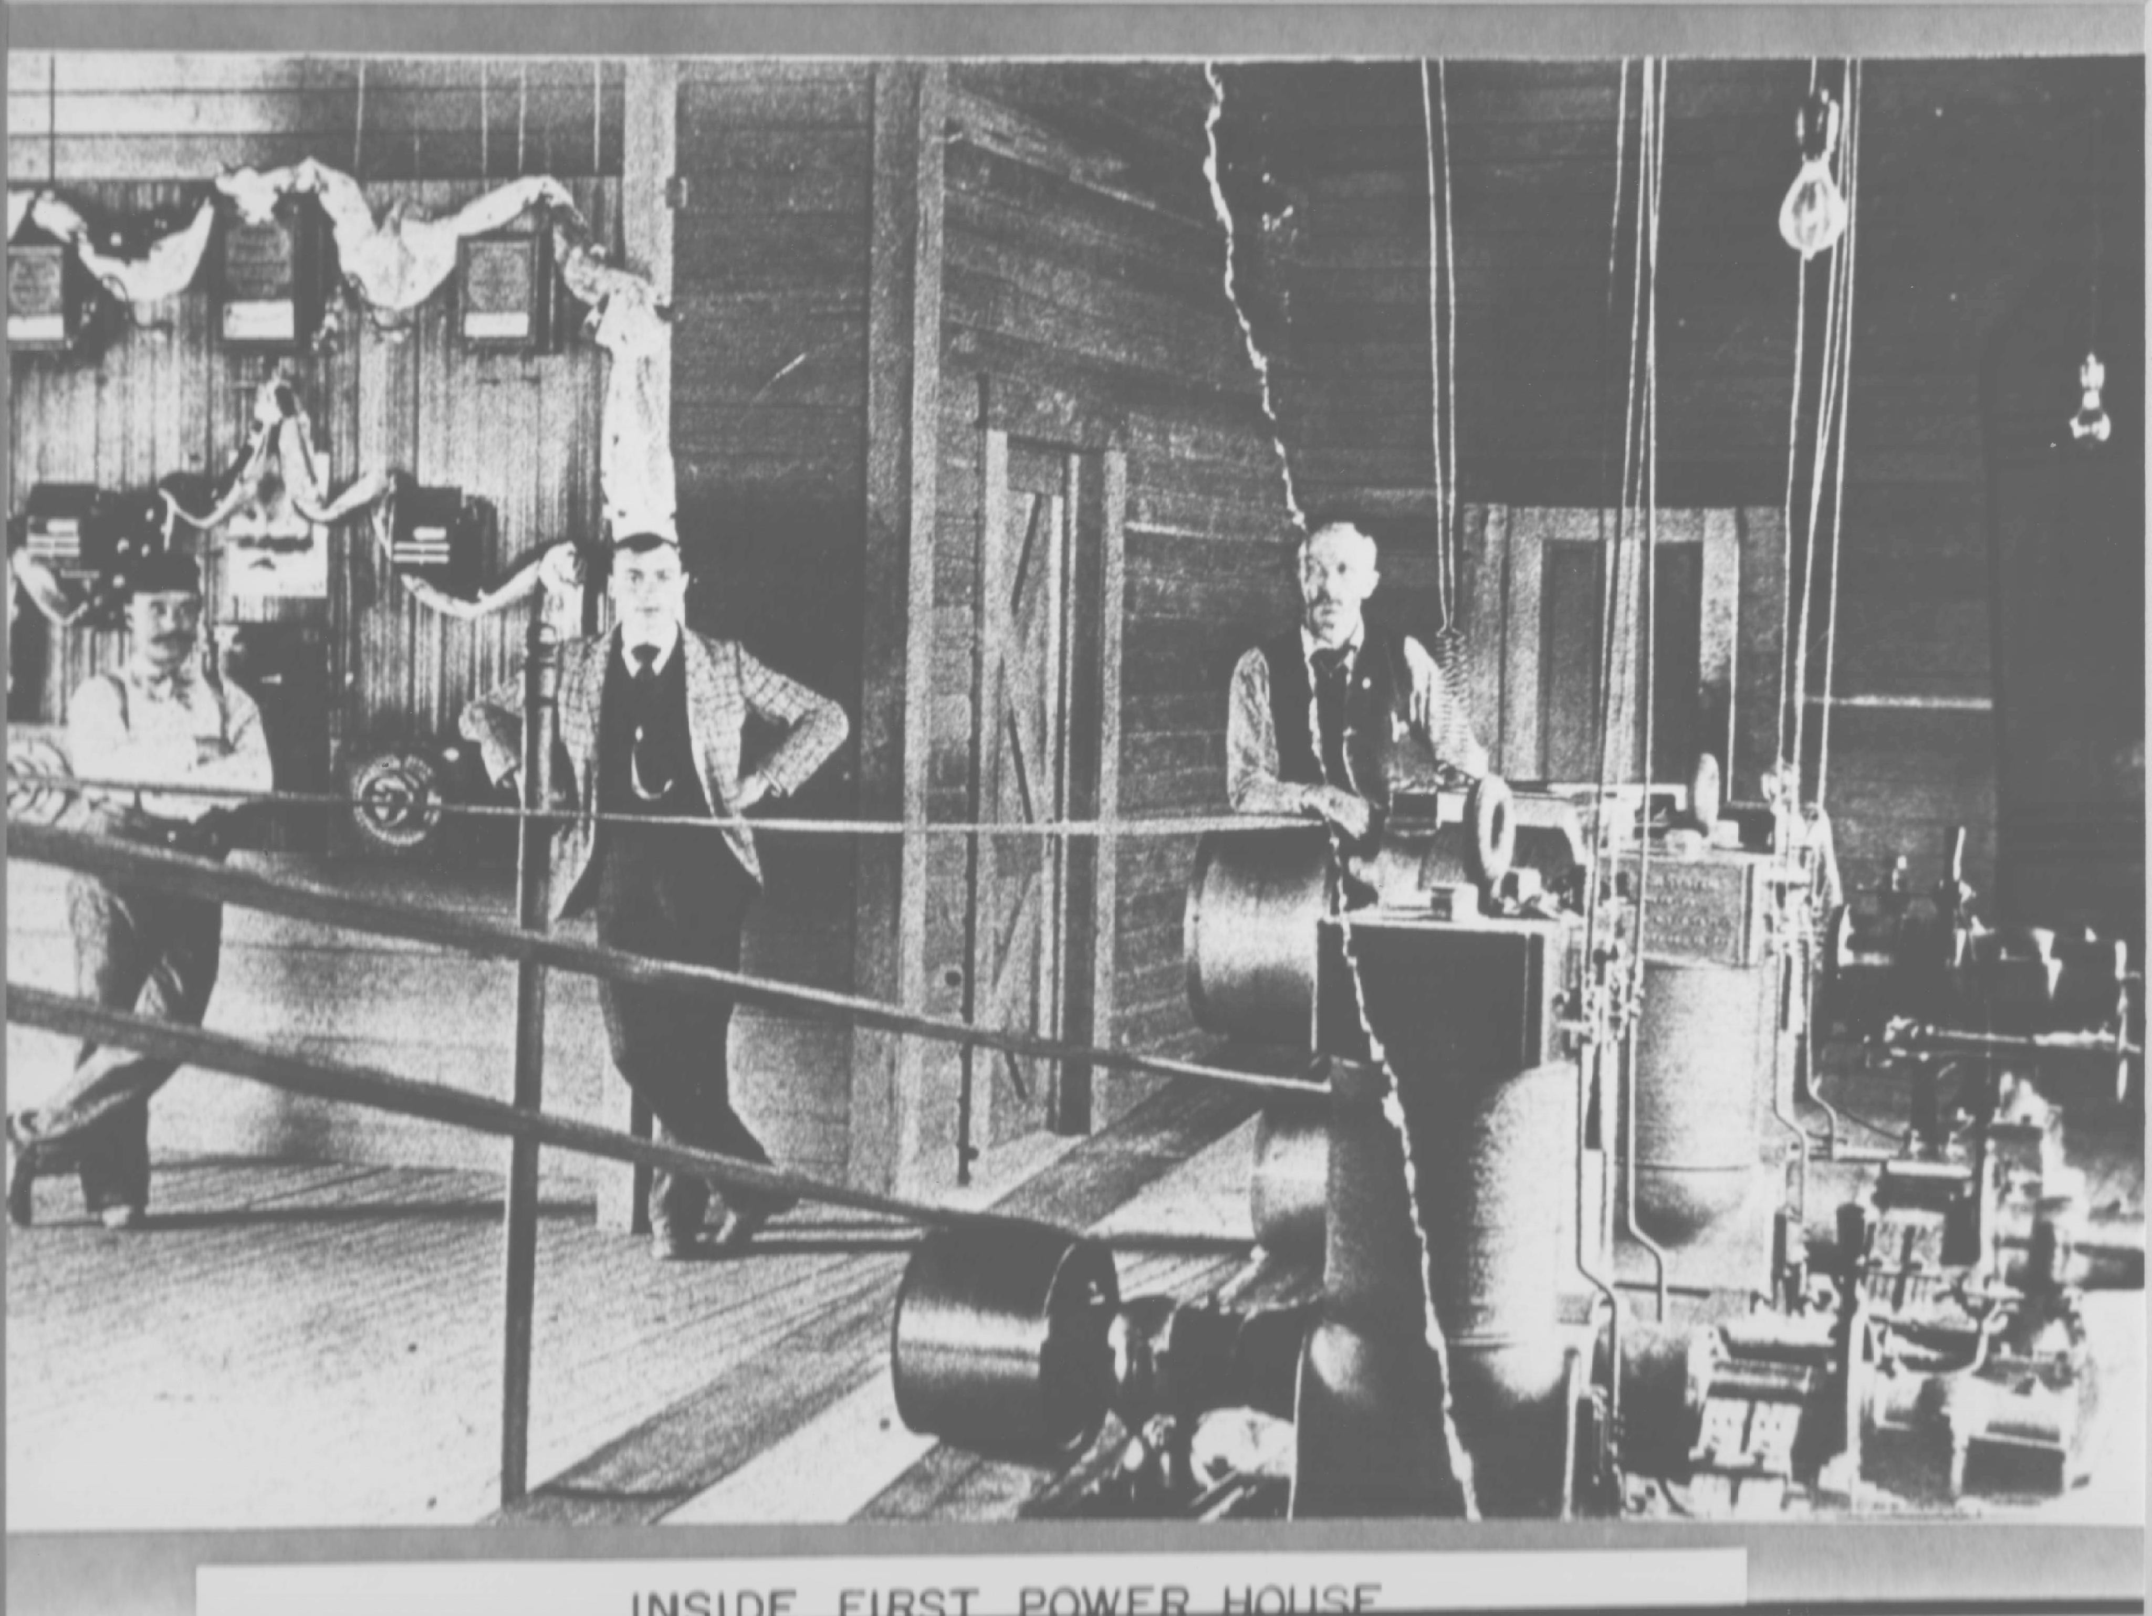
Notes:
On February 14th, 1891, the current was turned on and Port Angeles was illuminated by electricity. "On Saturday evening, the current was first turned on and the City presented the appearance of being studded with stars." There were nine street lights, and the switch was thrown by Miss Ray Rockman, actress and sister of the plant’s owner, Louis Rockman. Rockman sold the electricity at a rate of 18 cents/kWh, roughly equal to $4.00/kWh in 2011 dollars.

Slide 6
Strengths, Weaknesses, Opportunities, Threats
Strengths
  Conservation reduced City’s 2010 power purchases by 2.1%, directly saved customers $869,000 and created a net economic benefit of more than $2 million
Weaknesses
  Limited current generation resources on the Peninsula
Opportunities
  Advanced metering infrastructure, enhanced conservation and new renewable choices within City’s service territory
Threats
  Strong potential for significant increases in wholesale power costs and decreases in the BPA "Tier 1" power system

Slide 7
Port Angeles’ Dual Challenge
Tiered Rate Methodology became effective on October 1, 2011
  Manage contract demand quantity, load shape, and critical peak periods
The City’s electric and water meters are wearing out
  Many under measure what people use
Notes:
2/22/2012
7

Slide 8
Advanced Metering Infrastructure Efforts
All electric and water meters in City’s service territory replaced with AMI by the end of 2012
  10,600 electric meters
  8,400 water meters
"Turn-key" solution
  Procure and install a complete AMI system using one Vendor with minimum City intervention

Slide 9




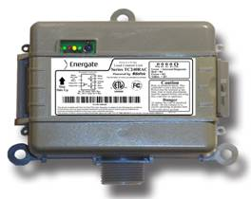



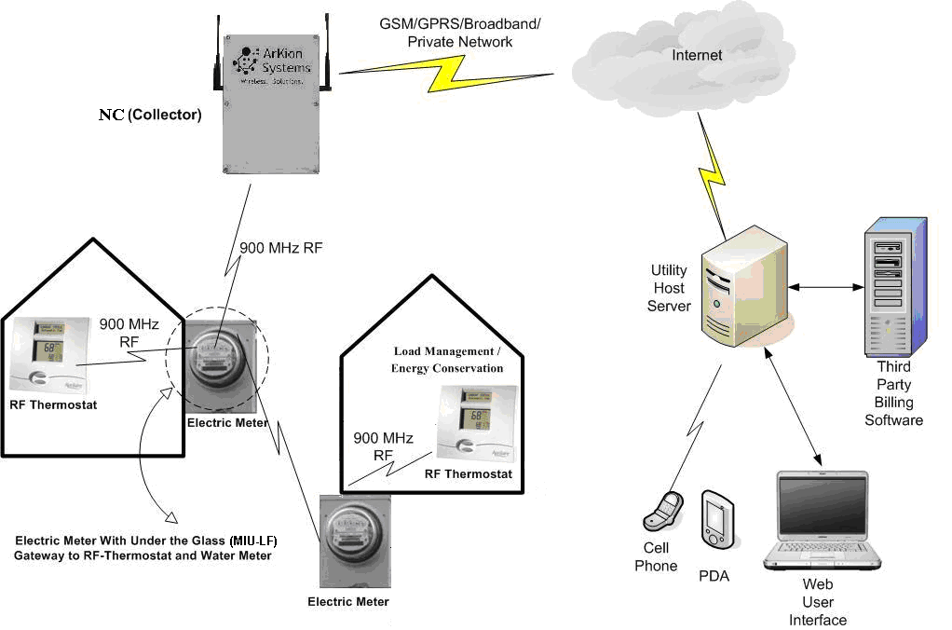

AMI System Overview
Mi.Node
Water meter
Smart
Thermostat
Metropolitan Area Network
Fiber optics
900 MHz
Mi.Gate (Collector)
Mi.Node
Electric meter
Mi.Node
Electric meter
900 MHz
Water Heater Demand Response Controller
Mi.Host
(SW + Server)
City Utility
Billing Software
Mi.Node
Water meter
Customer
Cell
Phone
Customer Web Based
Interface
Customer PDA

Slide 10
Immediate Benefits
AMI meters are highly accurate so everyone pays for what they use—it’s fair
The AMI system allows the City to run its electric and water utilities efficiently and at the lowest cost possible
Customers can have more control over their bill
  By using power when it’s least expensive

Slide 11
Retail Rate Design Study Recommendation
Ramp up conservation efforts
    Seasonal rate means that energy is priced correctly in the winter months
      Higher winter energy rate sends an appropriate rate signal
      Reinforces conservation program efforts in areas such as insulation and heat pumps
    Voluntary demand response projects for all customer classes
      Avoid exceeding contract demand quantity, maintain similar load shape to BPA, and mitigate critical peak periods

Slide 12
New Electric Utility Rate Design
Time-of-Use Rate without demand for residential, general service, and non-profit customer classes
    Customer base charge
    Winter & summer seasons including peak period, off-peak period, and shoulder period energy charges
    Demand response credits
Time-of-Use Rate with demand for general service demand and primary customer classes
    Customer base charge
    Winter & summer seasons including peak period, shoulder period, and off-peak period energy charges
    Demand charges during peak period only
      Reduced demand charges for demand response participants?

Slide 13
New Rate Design Schedule
Time-of-Use retail electric rate design
  Rate design incorporated into AMI System
  Retail rates determined Spring 2012
  Retail rates effective 2013
Encourages all electric customers to
  Reduce winter energy consumption
  Shift peak period consumption to lower-priced shoulder and off-peak periods
  Participate in voluntary demand response programs

Slide 14
Voluntary Demand Response Efforts
Customer-Side*
  Residential DR Pilot (600 customer units)
    Water heaters, smart thermostats, thermal storage
  Residential Wind Integration Pilot (41 customer units)
    Water heaters, thermal storage
  Commercial & Industrial DR Pilot (8 customers)
    Open Automated Demand Response Communication Standards (OpenADR) communications protocol
  Industrial Wind Integration Pilot (1 customer)
Utility-Side
  Voltage Optimization (VO)
    Deploy automated system to monitor and report lowest end-of-line feeder into City’s SCADA system
* Made possible with the support of the Bonneville Power Administration

Slide 15
Fast DR as Ancillary Services?
Ancillary services defined by the FERC:
  “…those services necessary to support the transmission of electric power from seller to purchaser given the obligations of control areas and transmitting utilities within those control areas to maintain reliable operations of the interconnected transmission system.“
    scheduling and dispatch
    reactive power and voltage control
    loss compensation
    load following
    system protection
    energy imbalance

Slide 16
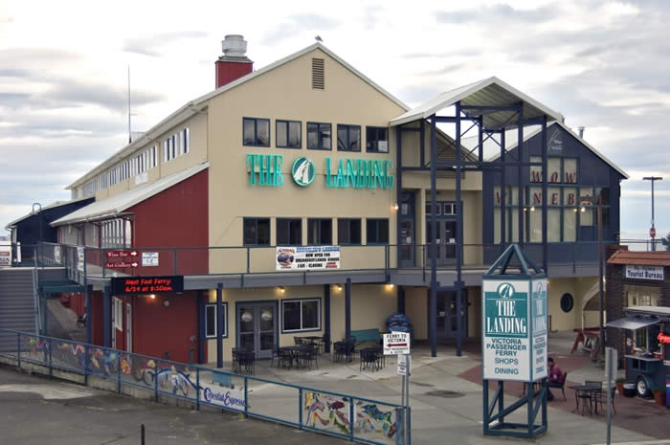
Fast-DR/Renewable Integration Using LI-Battery Storage (70-kW)

Slide 17
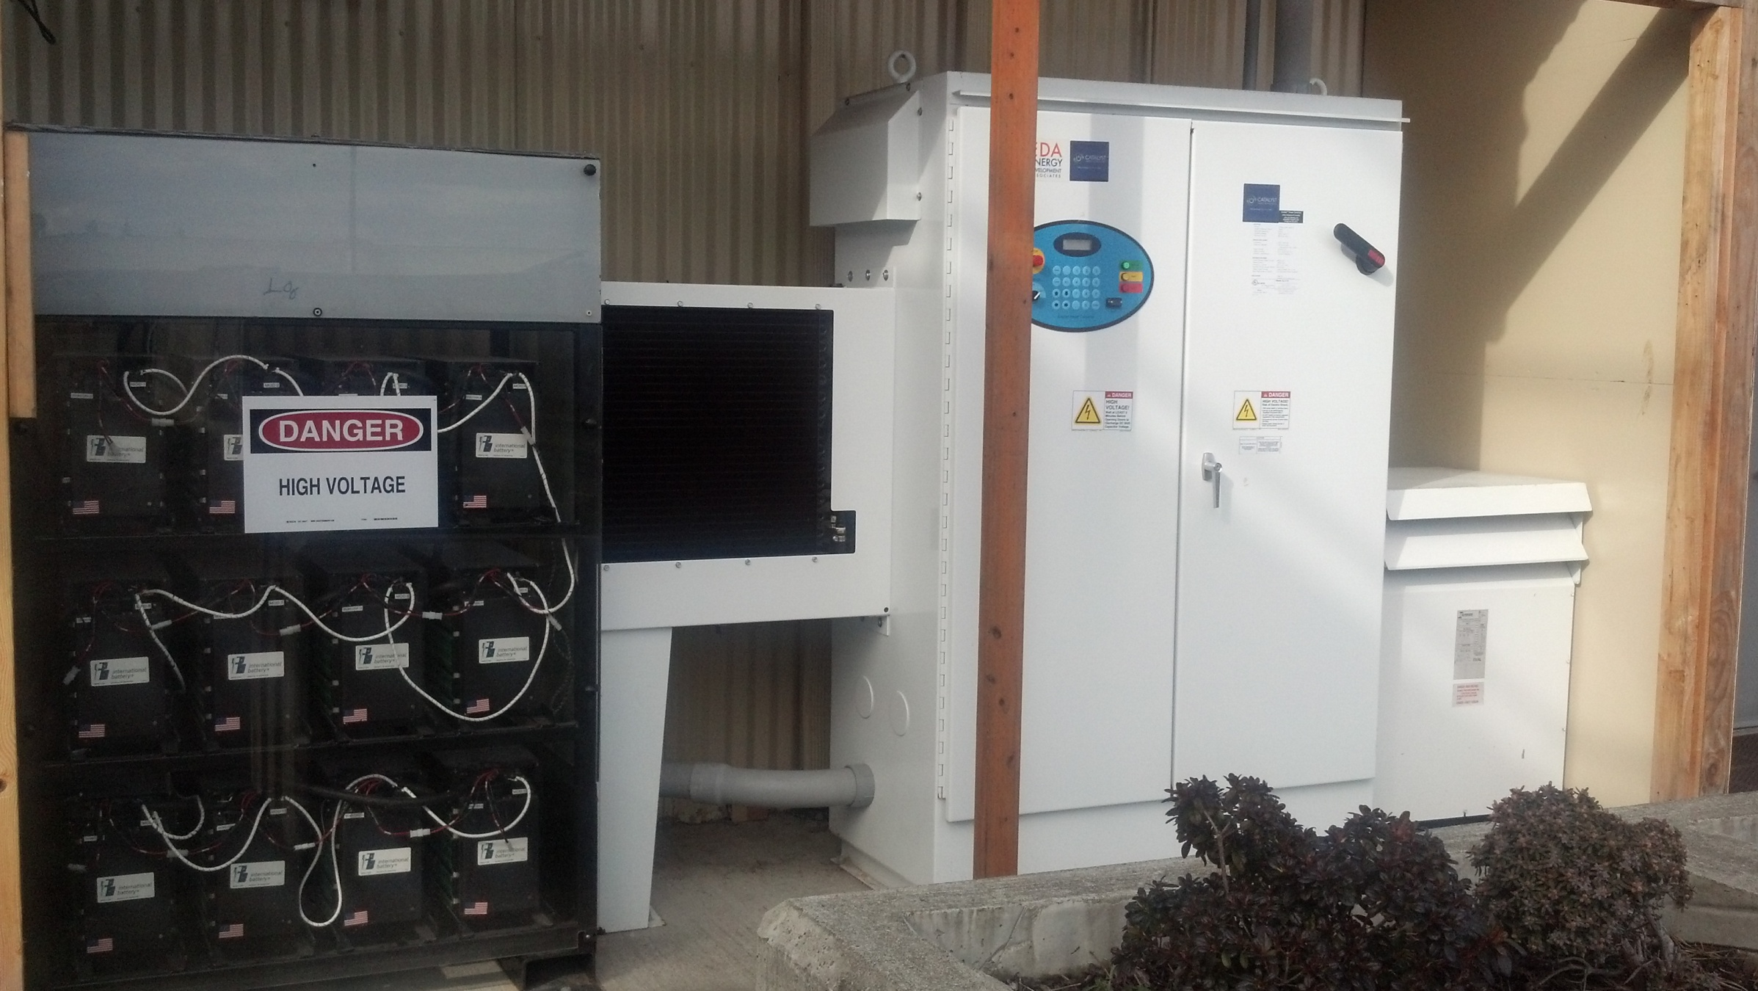
Landing Mall LI-Battery Storage Project

Slide 18
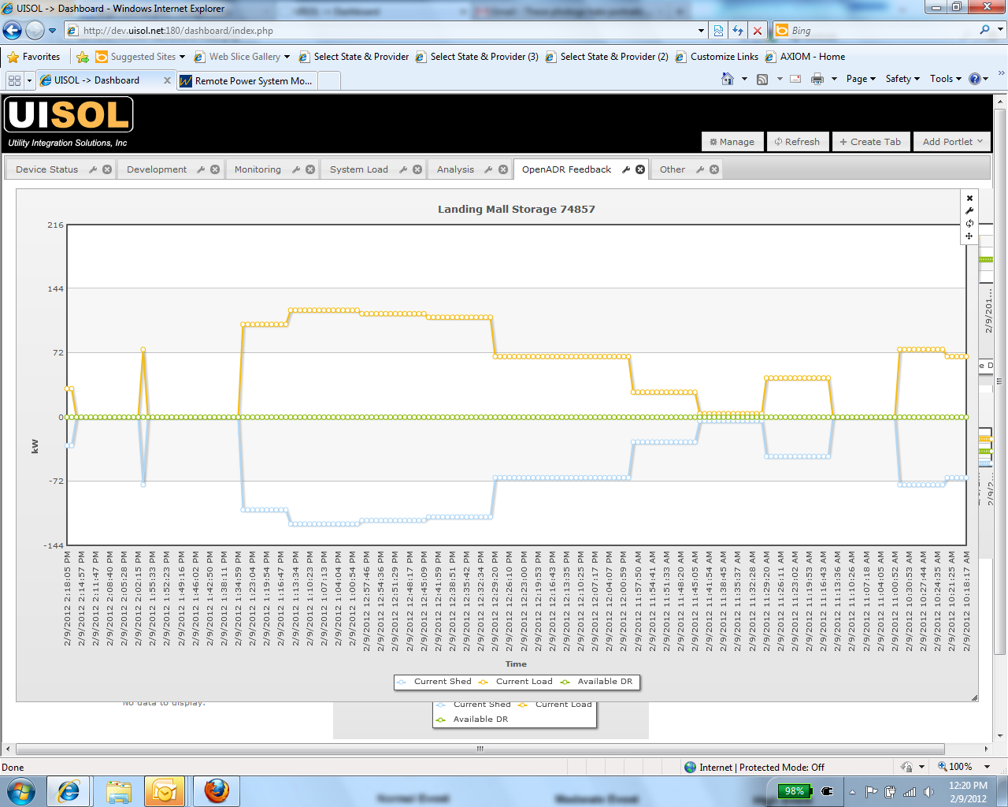

Slide 19
Fast-DR/Renewable Integration Using Mechanical Pulping Refiner Loads
Nippon Paper International
  48 aMW load
  72 MW peak load and 24 MW low load
  45 MW refiner load to produce pulp for paper
Potential as a Balancing Resource?
  36 MW DEC
  41 MW INC

Slide 20
Nippon Paper Industries “Products” Now Being Evaluated
Voluntary reduction of
  non-production related loads with a day-ahead notice
  production-related electrical loads with a 10-minute notice
  production-related electrical loads with a day-ahead notice
Voluntary increase of a production-related electrical load with a 10-minute notice

Slide 21
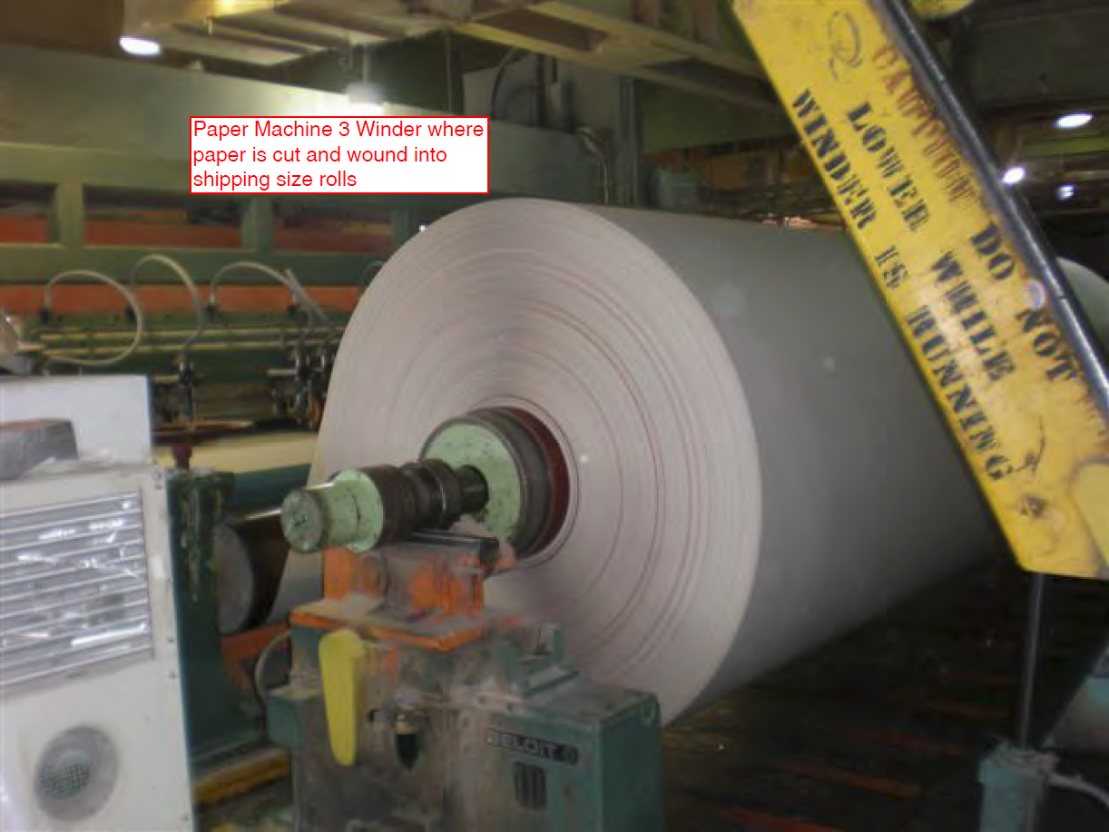

Slide 22
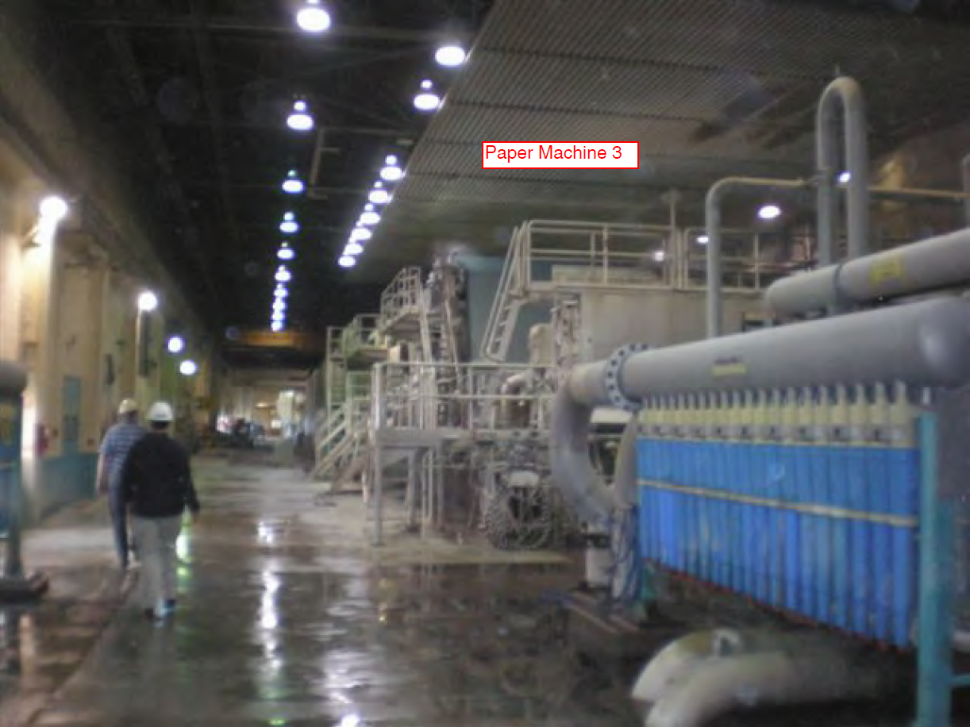

Slide 23
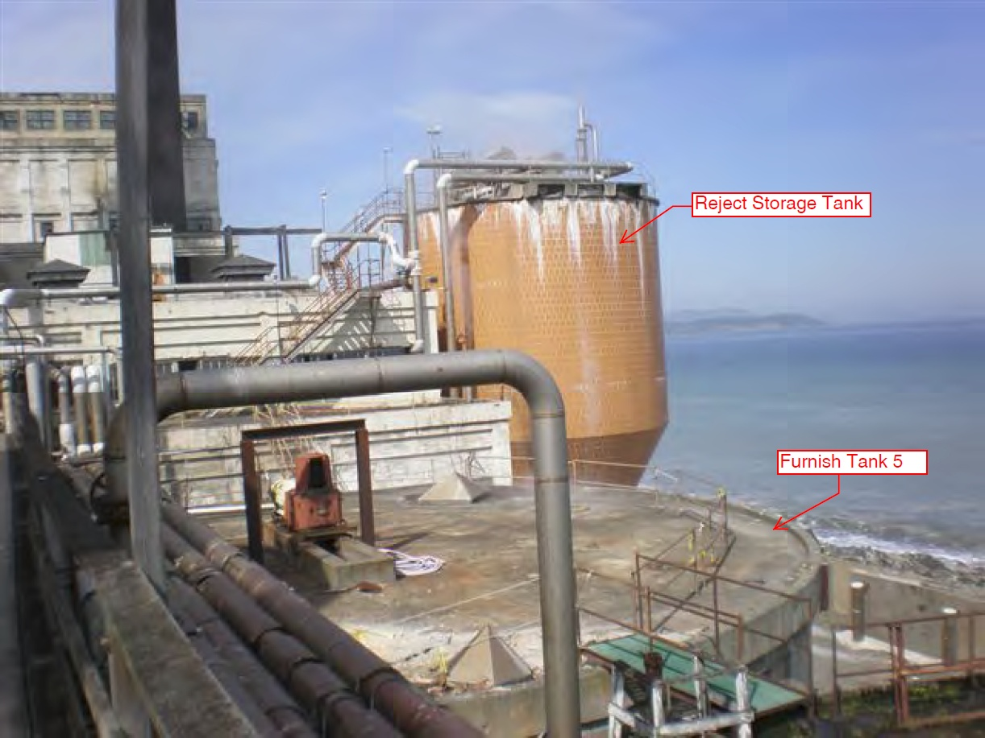

Slide 24
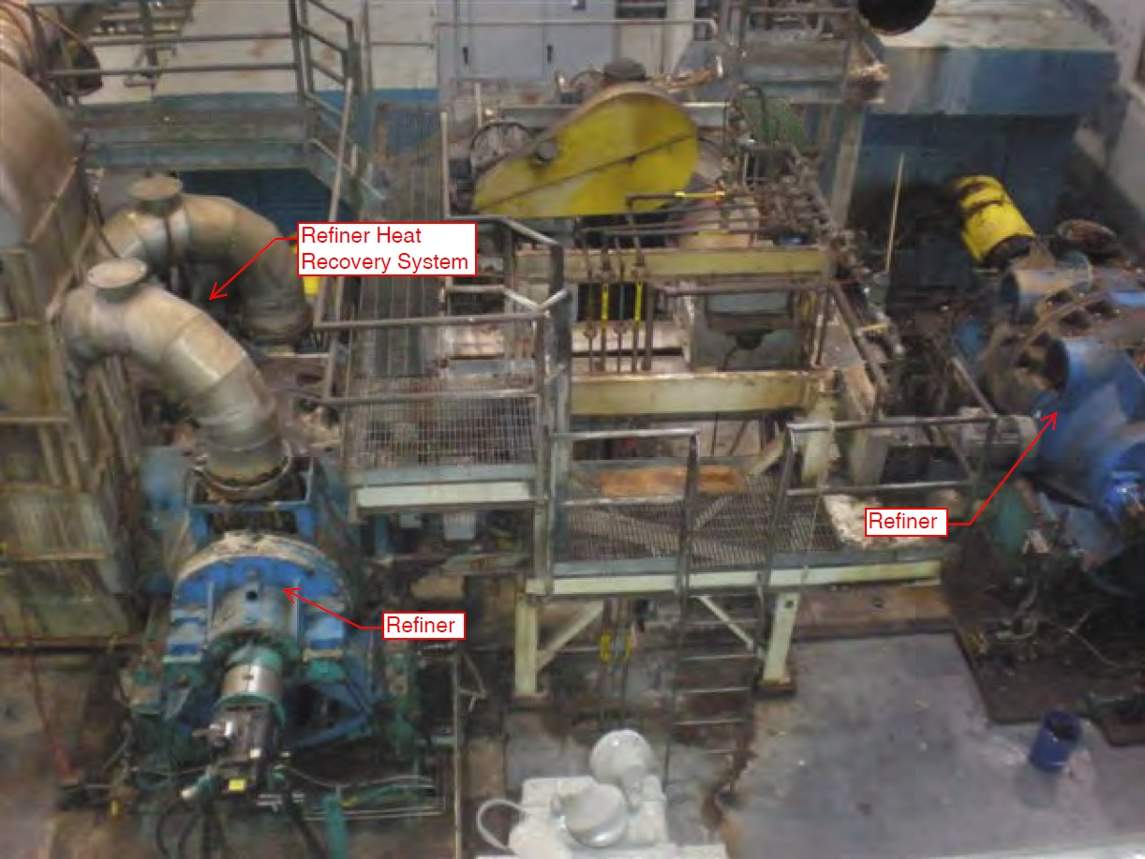

Slide 25
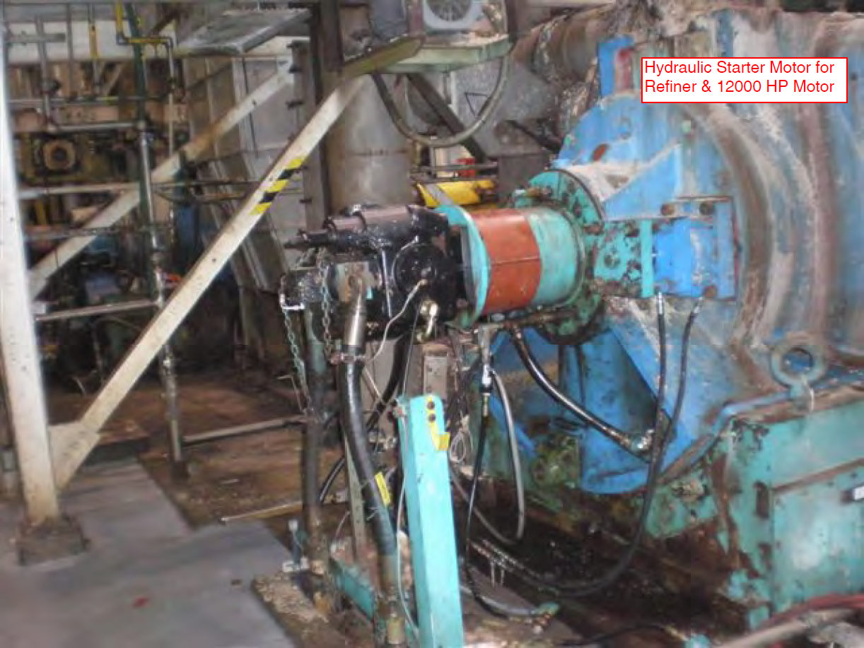

Slide 26
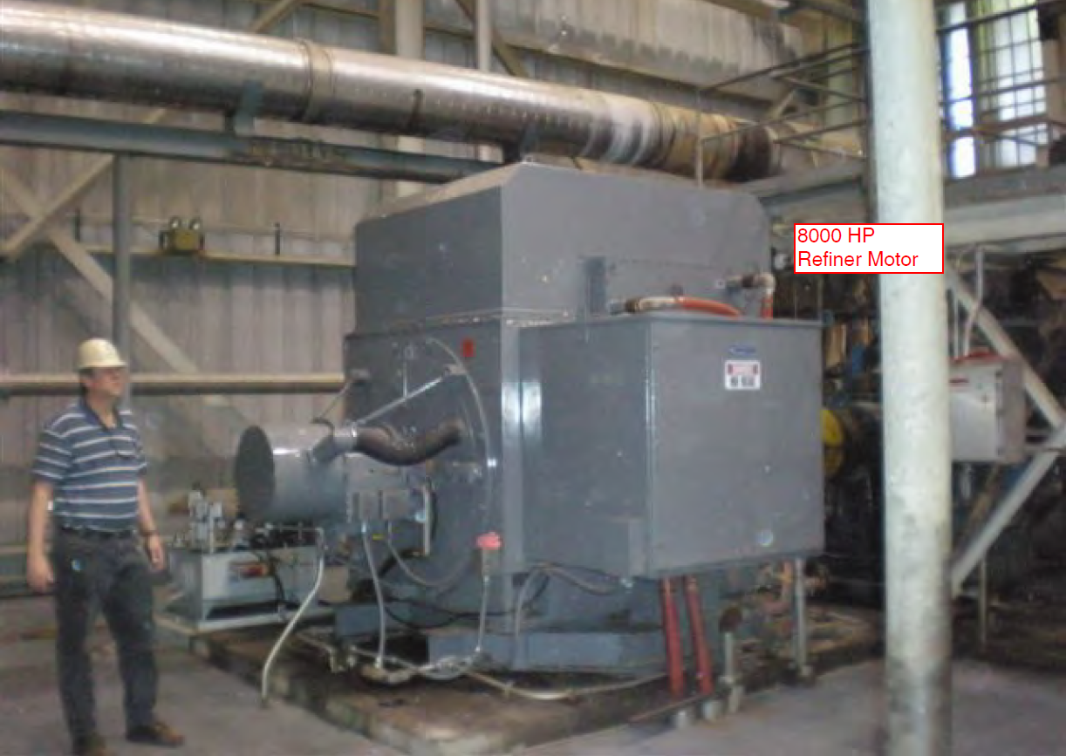

Slide 27
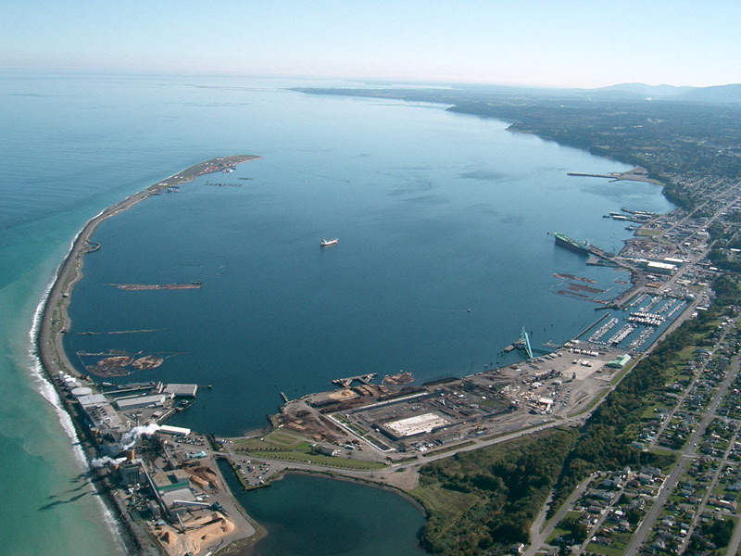
Phil Lusk
Power Resources Manager
Public Works & Utilities Department
plusk@cityofpa.us
360.417.4703
http://www.cityofpa.us

