Slide 1
Considerations for Demand Response in the PNW Industrial Sector

Slide 2
Outline
Review of Industrial Sector
  Industries
  Sub-Systems / Technologies
Review of Regional Industrial DSM Programs
Samples of Real DR Event
Hurdles to Address

Slide 3
Introduction to Cascade Energy
Offices in Oregon, Utah, and Washington
  Staff of ≈70 (incl. ≈45 Engineers)
Industrial energy efficiency consulting
  Food processing, pulp & paper, petrochemical, manufacturing, etc.
  Refrigeration, compressed air, pumping, fans, controls, lighting, process upgrades – we hunt brake horsepower!
Our business:
  Design and management of utility energy efficiency programs
    BPA Energy Smart Industrial Program
    ETO Production Efficiency Program
  Traditional retrofit or new construction technical support
  Energy management services & tools
Corporate energy management:
  e.g. Sysco (110 distribution centers)
  e.g. SuperValu (28 distribution centers)

Slide 4
Pacific Northwest Industries
Pulp & Paper
Food Processing
Refrigerated Warehouses / Fruit Storage
High-Tech
General Manufacturing
Chemical
Primary Metals & Value-Added

Slide 5
Base Load & Potential from 6th PP

Slide 6
Common Systems & Equipment
Compressed Air
Refrigeration
Pumping
Fans / Blowers / Aerators / Vacuum
Hydraulics
Material Handling / Conveying
Refiners
Electric Resistance Heating
Miscellaneous
  Sawmill de-barker & head rig, battery chargers, cranes, etc.

Slide 7
Characteristics of Industrial
Can be VERY large equipment or systems
Long operating hours
Highly interactive systems
Many systems are custom or one-off
Operating strategies and staff may be specialized
Institutional or “tribal” knowledge is commonly involved

Slide 8
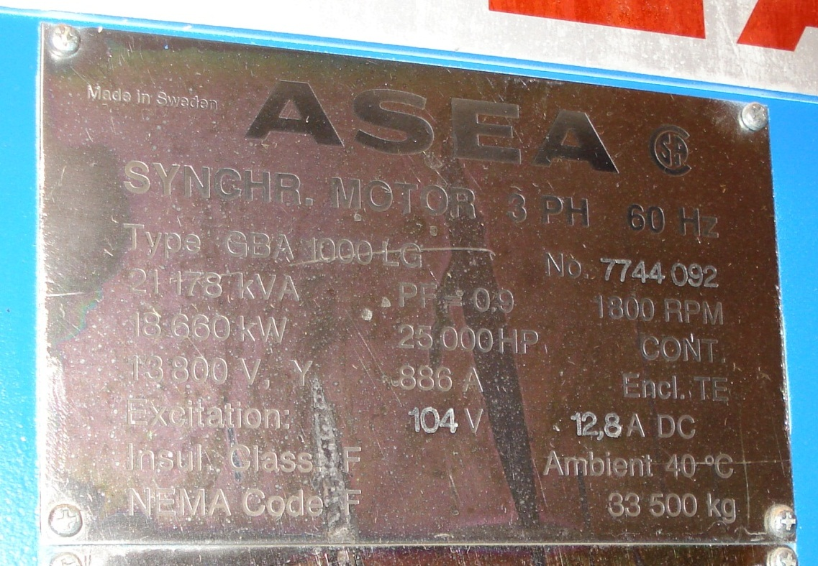
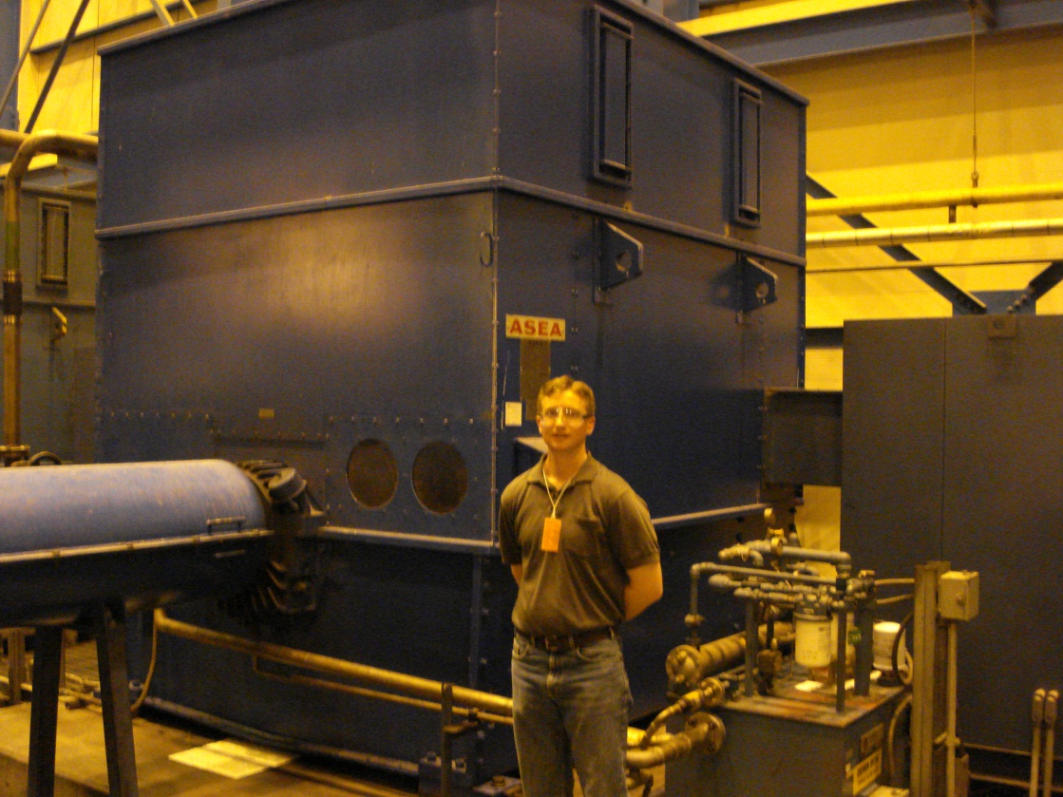
Refiners
A 25,000 hp Motor
Draws 15-20 MW!

Slide 9
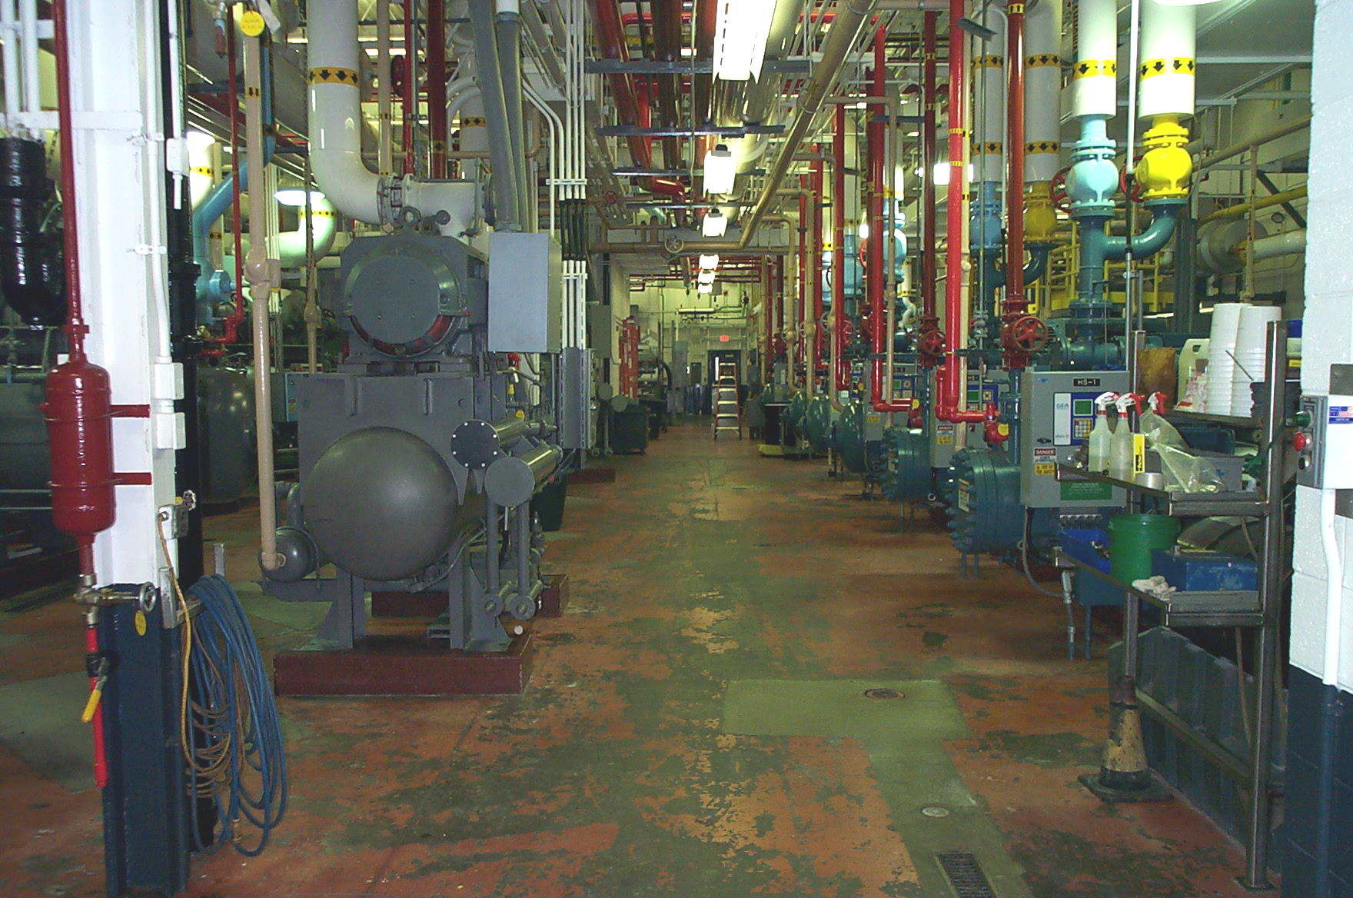
Refrigeration Systems

Slide 10
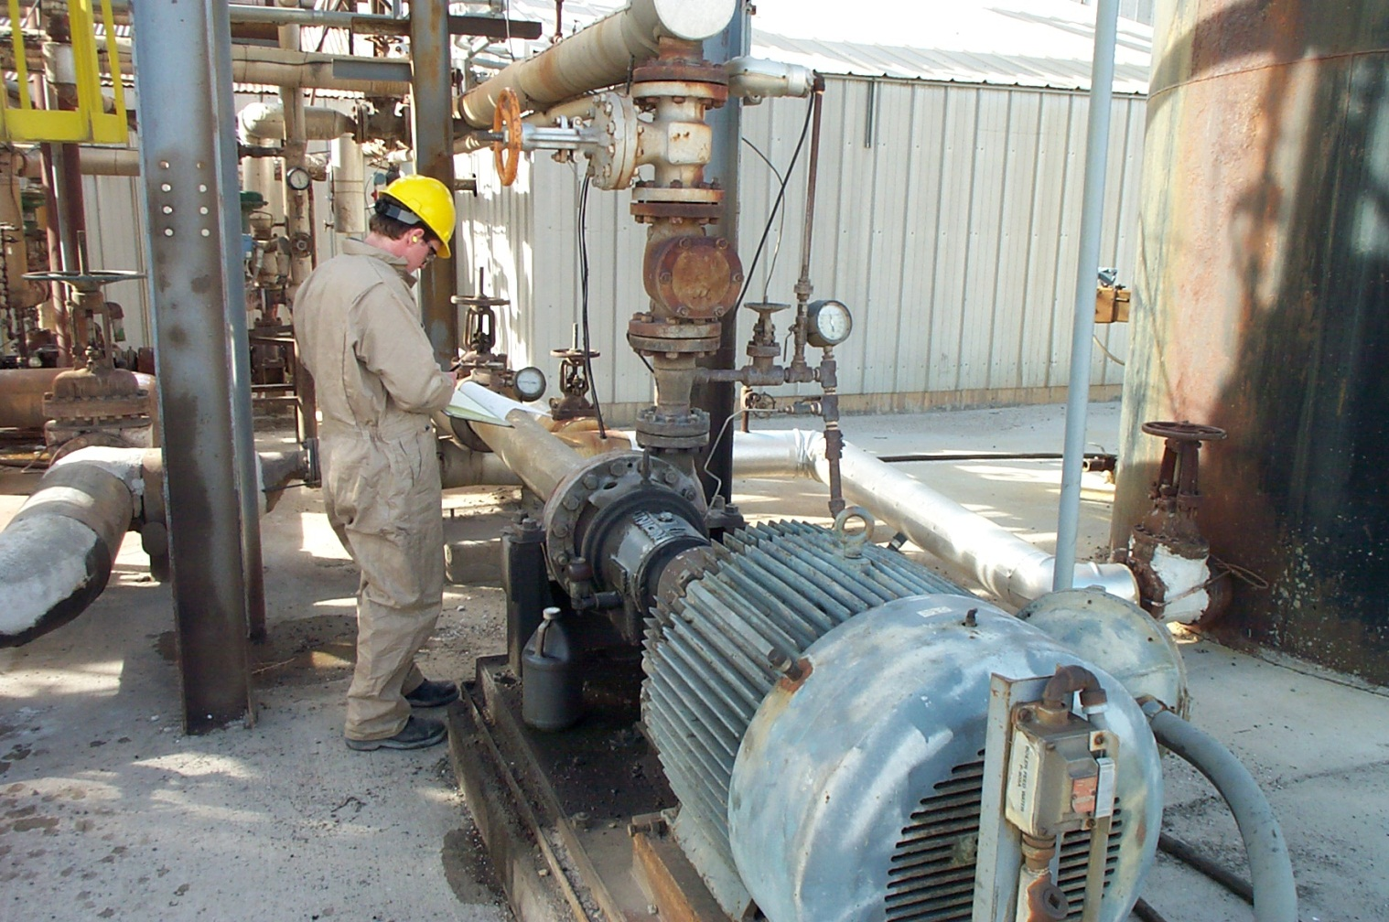
Pumping Systems

Slide 11
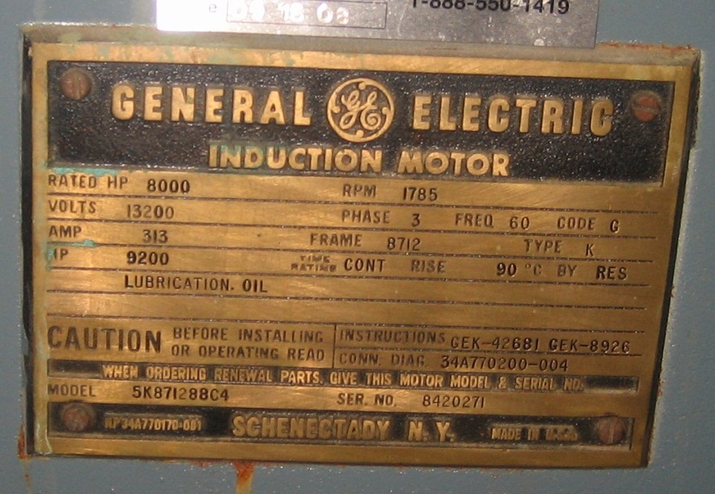
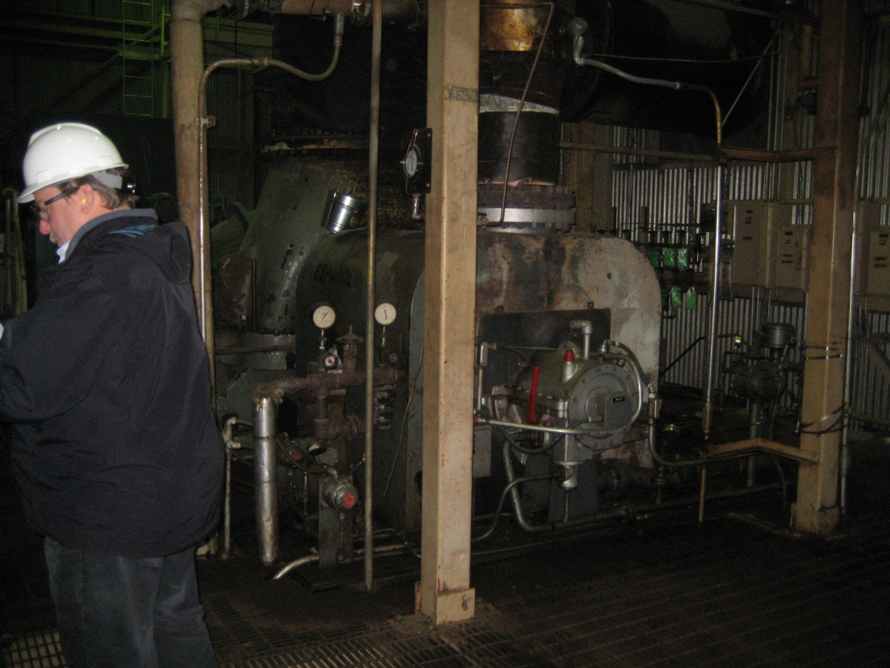
Process Compressors

Slide 12
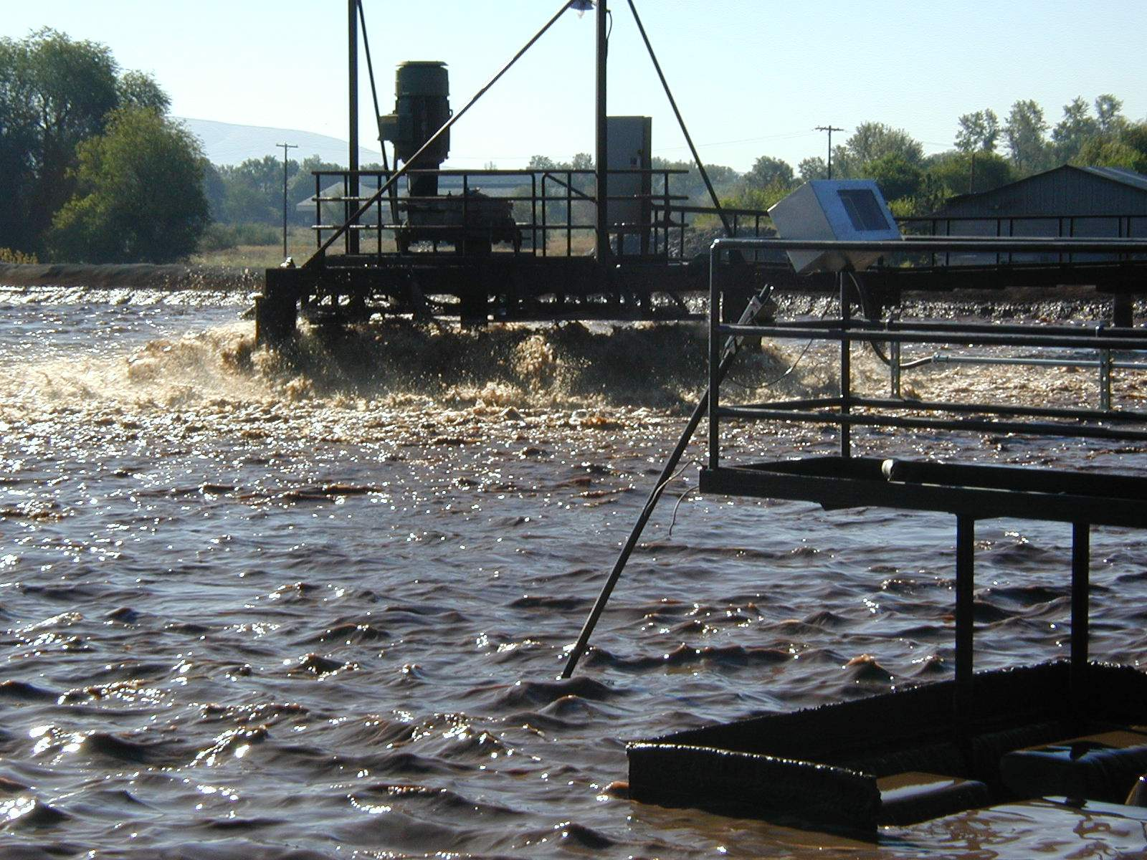
Water Treatment

Slide 13
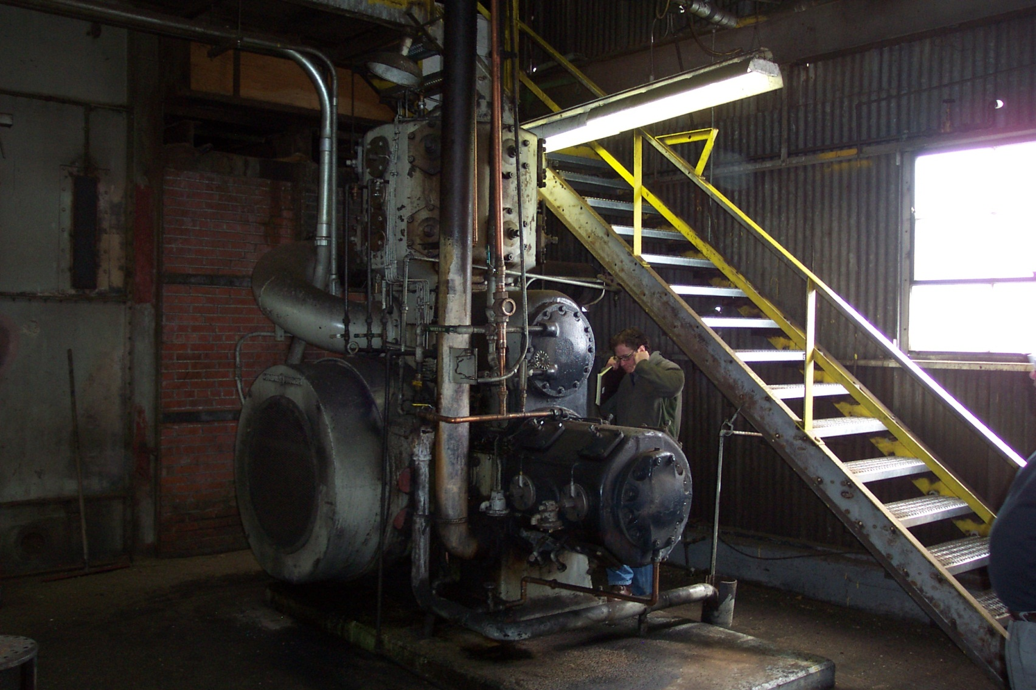
Compressed Air

Slide 14
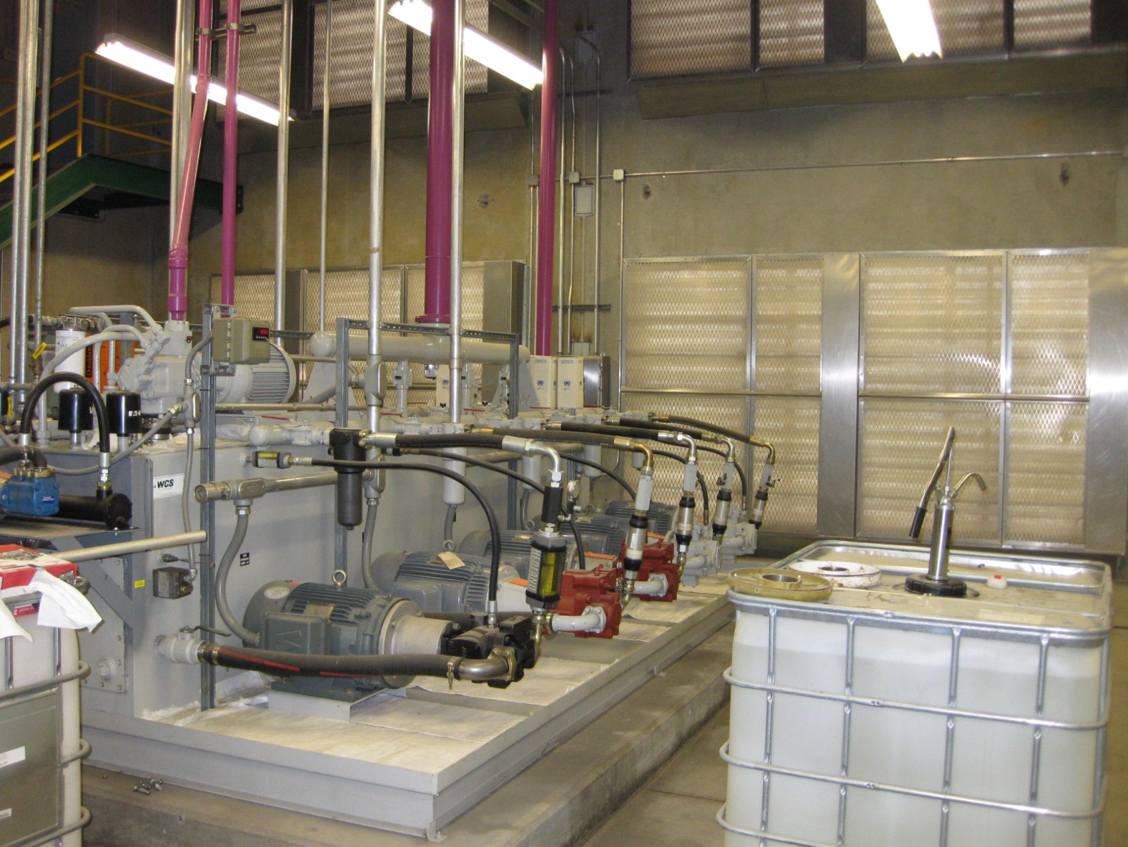
Hydraulics

Slide 15
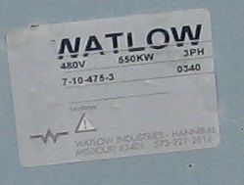
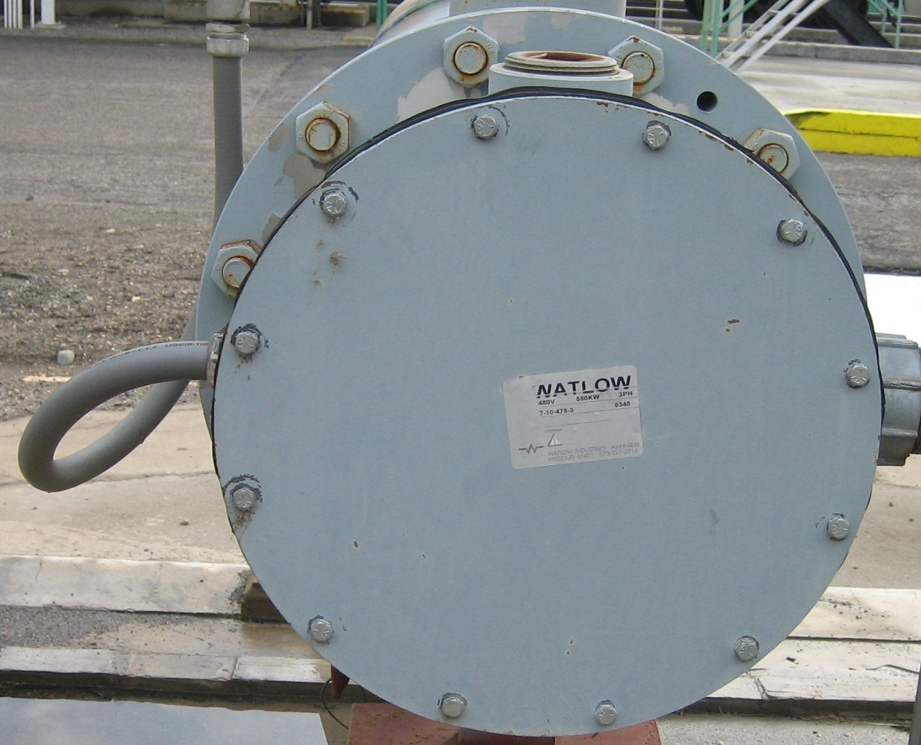
Electric Resistance

Slide 16
Things to Remember….
Motors are not the focus
What matters is:
  What is driven by the motor?
  What parameters impact the driven load?
  How is capacity of driven load varied?
  How long is the load driven?

Slide 17
Common Industrial Projects
VFDs
Control Upgrades
More Efficient Equipment
System Configuration Upgrades
Fundamental Process Improvement
Energy Management
  EPM/RCM
  O&M
  Coaching/Behavior/CEI

Slide 18
Regional Industrial DSM Programs
Avista: Site-Specific Incentives
BPA: Energy Smart Industrial
ETO: Production Efficiency
Idaho Power: Custom Efficiency
PacifiCorp: FinAnswer
PSE: Business Energy Mgmt.
Common Themes
Goals are energy savings (kWh or MWa)
Incentives of 8 to 30¢/kWh, up to 50% to 70%+ of project cost
Retrofit & new construction
Various levels of deemed or prescriptive technologies
Subject to cost-effectiveness criteria

Slide 19
DSM Program Characteristics
Highly technical
Relationship-driven
Mostly custom assessment
Substantial on-site activity
  “Boots on the ground”

Slide 20
Energy vs. Demand
Region is currently focused on energy
Competitive incentives may be required for DR to compete or collaborate
  What is best for end user?
  What is best for utility?
  What is best for region?

Slide 21
Council’s 6PP Definition of DR
“A voluntary and temporary change in consumers’ use of electricity when the power system is stressed. The change in use is usually a reduction, although there are situations in which an increase in use would relieve stress on the power system and would qualify as DR.”

Slide 22
Industrial DR Simplified
Rescheduling
Not Doing
Store, Slow or Accelerate
  Batch Processing
Firing Up Resources (e.g., generators)

Slide 23
Cascade’s Exposure to DR
We are the corporate energy management firm for:
  Sysco
  SuperValu
  Ben E. Keith
Total of approximately 150 refrigerated warehouses
Refrigerated warehouses are the #1 target for DR
  Payments for signing up
  Payments for answering the call

Slide 24
Example of DR Episode

Slide 25
Hurdles for DR
May increase energy use
  Non-linear systems such as VFDs
Some equipment cannot be easily started or stopped
  Compressor anti-recycle
  Manual intervention required
Refrigerated warehouse product liability insurance revisions
May push energy use into peak TOU periods
May increase utility-recognized peak demand
Interactive equipment, systems or processes
Potential market actor confusion, lack of alignment
Knowing when to pursue kWh vs. kW

Slide 26
Questions or Discussion?
Marcus H. Wilcox, President, P.E.
Cascade Energy, Inc.
Marcus.Wilcox@CascadeEnergy.com

