Slide 1
Realizing DR in California:
Enhancing Industry’s Relationship with the Electric Grid
Aimee McKane
Sasank Goli
Lawrence Berkeley National Laboratory (LBNL)
PNDRP
Feb 23, 2012 : Portland, OR

Slide 2
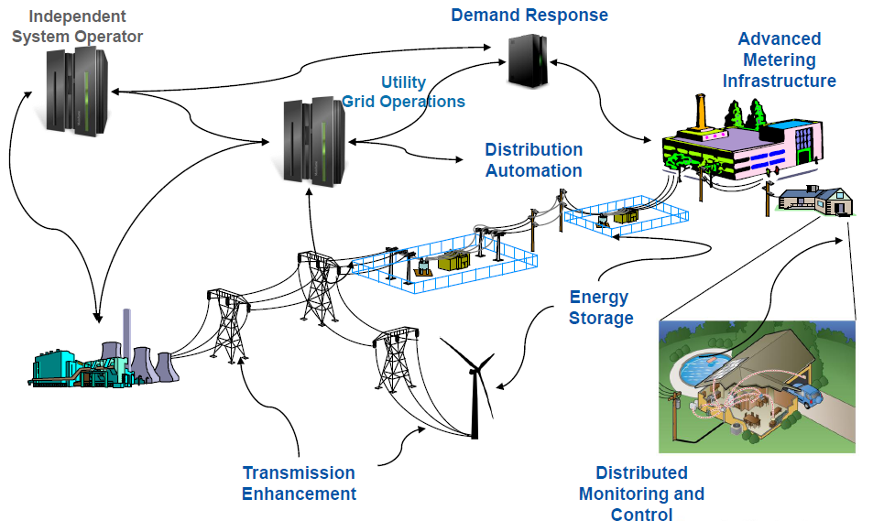
DR in the “Smart” Electric Grid
Source: Charles River Associates www.crai.com

Slide 3
What is the DRRC?
Demand Response Research Center (DRRC) was formed within LBNL in 2004, primary funding from California Energy Commission (CEC) Public Interest Energy Research (PIER) program – Plans and conducts multi-disciplinary research to advance DR within Smart Grid infrastructure to reduce environmental impact, increase reliability of the electricity grid and reduce costs in California, the nation, and abroad.
1. Electric Systems and Strategic Issues
  Valuing Demand Response
  Dynamic Tariffs, Rate Design, Ancillary Services
  Communications and Telemetry
  2. Buildings
  Automation, Communications and Control
  End-Use Control Strategies and Models
  Behavior–response to dynamic tariffs
  3. Industry
  Automation and Controls
  Sector-specific End Use Strategies
  Relationship to Energy Management Systems
Notes:
3

Slide 4
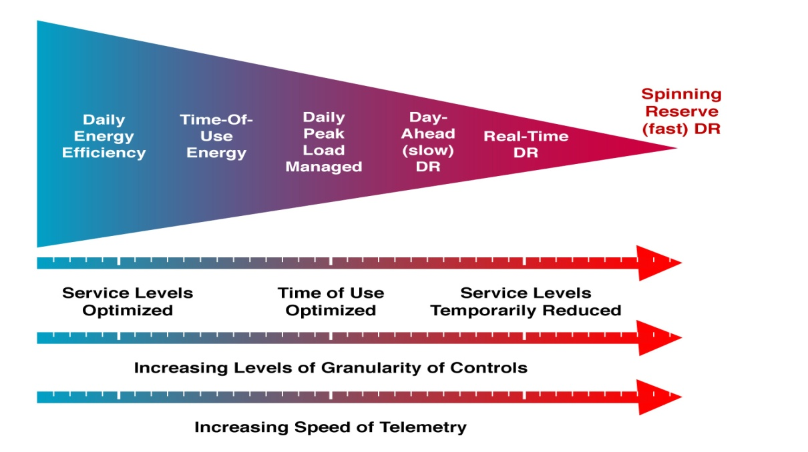
Demand Side Management and OpenADR
OpenADR

Slide 5
OpenADR:
Automated DR Communication Standard
Key Features
Complete Data Model – Describes model and architecture to communicate price, reliability, and other DR activation signals.
Translation - Translates DR events into continuous internet signals
Continuous and Reliable - Provides continuous, secure, and reliable 2-way IP based communications infrastructure.
Supports Real Time Pricing (RTP) - Supports policies to promote price response.
Opt-Out – Provides opt-out or override function
Scalable – Provides scalable architecture scalable
No stranded technology assets – Interoperable
*OpenADR v2.0: http://openadr.lbl.gov/

Slide 6
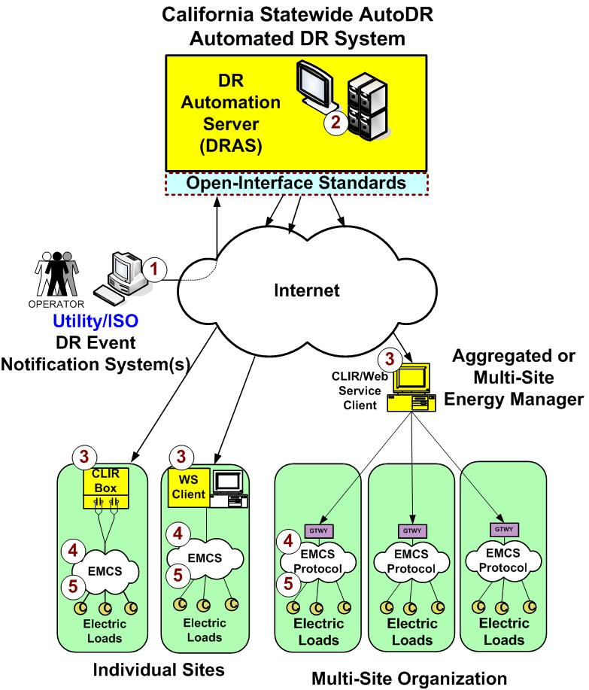


OpenADR Control – Viewed from Grid Level
Electricity
Usage
Electricity
Usage
Electric Grid

Slide 7
Current Areas of Industrial DR Research
Refrigerated Warehouses
Data Centers
Agricultural Irrigation
Wastewater Treatment
Cement
Industrial Control Systems Survey
DR and ISO 50001 Energy Management Standard
More information and reports on drrc.lbl.gov

Slide 8
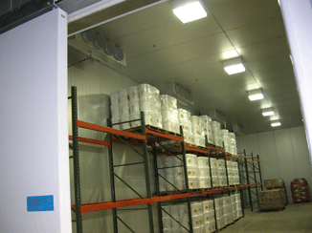
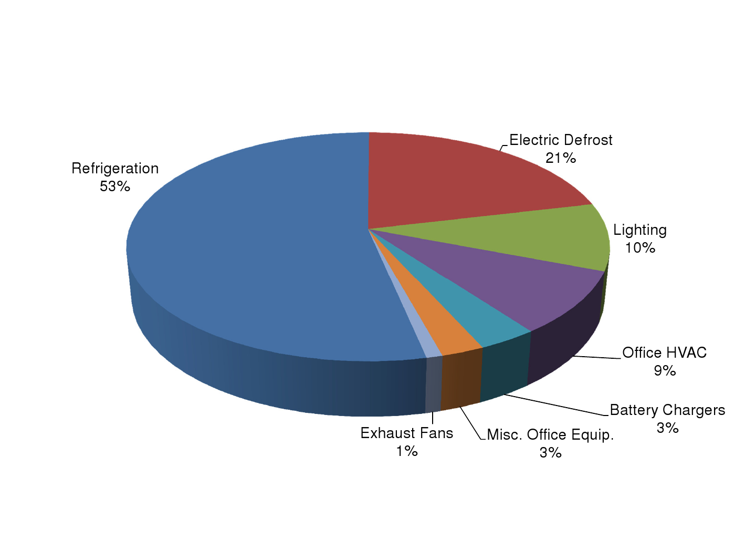
DR in Refrigerated Warehouses in California
360 MW of load in CA
45-90MW theoretical peak load DR potential
  20% participation rate would yield peak load reduction of 9-18 MW
  Not being achieved- room to improve
Demand coincides with utility peak
Processes are limited, well understood
  Thermal mass of building envelope and stored products
  Synergies with Buildings/HVAC DR research
Completed DRRC Research:
Opportunities for EE and Auto-DR in Industrial Refrigerated Warehouses in CA: Report published May 2009
Conducted Auto-DR field studies in 2 facilities; Published case studies
Analysis of Manual-DR at several facilities
National Grid: Shared DR Sample Audit 2004

Slide 9
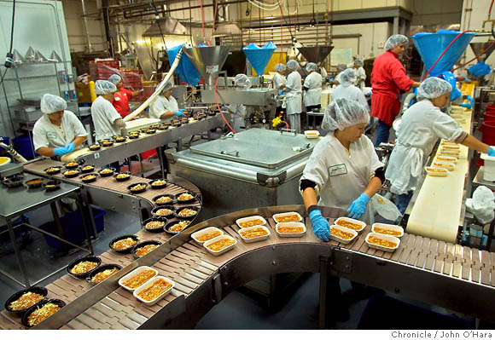
Auto-DR Case Study 1 – Amy’s Kitchen
Several end-use loads, in refrigeration, production and office areas
Electric demand:
  Average of 1,600 kW
  Peak demand of 1,900 kW
History of Several EE initiatives:
  Freezers and cool rooms well insulated
  Entire facility being re-roofed with cool roof foam insulation
  CFL bulbs and occupancy sensors in administrative offices
Past participation in PG&E's manual DR programs
Recently undertook a controls system upgrade to enable it for AutoDR

Slide 10
Auto-DR Case Study 1 – Amy’s Kitchen
Control system and Auto-DR for this facility achieved:
Better than expected results in these initial Auto-DR tests with no product loss or production delays
Peak period DR of 580 kW, viz. 36% load shed from baseline. This was 162 kW more than had been estimated before the tests
$139,200 in incentive payments resulted in payback period of less than one year, with potential additional incentives for future events

Slide 11
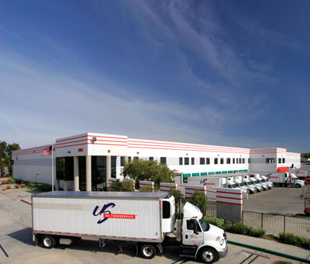
Auto-DR Case Study 2 – US Foodservice
Large frozen food storage center of 345,000 sq. ft.
Site electricity demand average of 700-900 kW, with the freezer accounting for 30-40%.
History of being proactive in electric EE measures
Results of AutoDR tests at this facility:
Normalized shed up to 385 kW during a DR event.
Entire equipment installation cost was covered by a one-time incentive payment of $71,000 based on the estimated load shed. Future participation in AutoDR events would enable them to receive additional incentives.

Slide 12
Analysis of Manual DR at selected facilities
Electricity usage data was analyzed from 9 refrigerated warehouses in PG&E territory that did manual or semi-automated DR in 2009
It confirmed the DR abilities inherent to Refrigerated Warehouses, but showed considerable variations across the different facilities likely due to Manual controls.

Slide 13
Conclusions
Refrigerated Warehouses is a promising sector for DR over a range of time scales, and there is sizeable potential to improve participation rates.
Work in Progress:
DR Strategy Guide
  Phase 1 complete, focuses on how DR potential is influenced by Control System capabilities
  Phase 2 underway, focuses on how DR potential is influenced by process, technical, organizational and other characteristics
DR “Quick Assessment Tool”: Built on EnergyPlus platform for quantitative estimation of DR potential
  Refrigerated Warehouses module is almost complete – Open to working with partners for further refinement and data to test

Slide 14
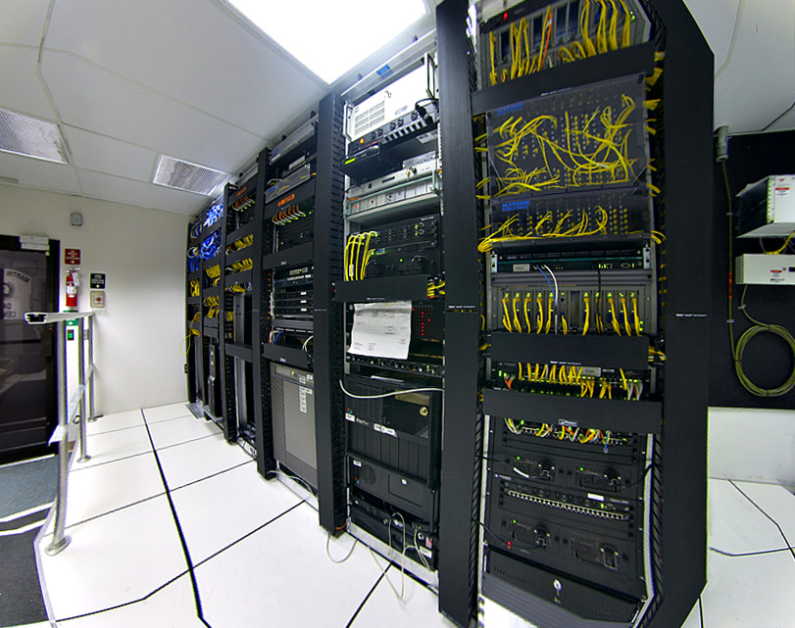
DR in Data Centers in California
500 MW peak load in California
Largest opportunity is in the use of virtualization to reduce IT equipment energy use, which correspondingly reduces facility-cooling loads
DRRC Research:
Phase 1 scoping study on EE and Auto-DR potential completed and published
Phase 2 research on field and additional testing of DR strategies underway

Slide 15
Phase 1 Research: Scoping Study
Objectives: Examine data center characteristics, loads, control systems, and technologies to identify demand response (DR) and open automated DR (“Open Auto-DR”) opportunities and challenges.
Methods: Collaborated with technology experts, industry partners, facility managers and collated existing research on commercial and industrial DR.

Slide 16
Data Center End Use Equipment
(11%)
(35%)
(50%)
(4%)
  Support services :
  DR opportunities in Cooling, Power Delivery, and Lighting
  Well studied but lesser potential
  Core service:
  DR opportunities in Virtualization, Power management
  Lesser studies but greater potential
Notes:
Study examined energy-use characteristics of data centers and potential for demand response

Slide 17
Key Conclusions from Scoping Study
Data centers have significant DR potential.
“Non-mission-critical” data centers (research and labs) are likely to be early adopters.
Site infrastructure DR strategies (cooling and lighting) are well studied; DR strategies for IT infrastructure need research.
Largest opportunity is in the use of IT equipment virtualization – also reduces supporting site loads.
Studies and demos are needed to quantify benefits for data centers to participate in DR.
Demand Response and Open Automated Demand Response Opportunities for Data Centers, published January 2010

Slide 18
Phase 2 Research: Field Tests
Objective: Improve understanding of DR opportunities and automation in data centers, so as to accelerate adoption through study of:
  Feasibility and adoption of DR in data centers exploring practical barriers and opportunities, as well as perceived versus actual risks and methods to overcome risks.
  Potential DR strategies for site infrastructure (HVAC) and IT infrastructure (servers, storage) loads for data centers.
  Potential virtualization and control technologies, methods and strategies to deploy OpenADR for Automated DR.
Methods: Field tests and Collaboration with technology experts, industry partners and facility managers
Non-mission critical standalone data centers (R&D and labs) including mixed use with minimum loads of 1000kW.
  LBNL B50, NetApp, UCSD-SDSC

Slide 19
Emerging Results from ongoing Field Tests
Promising results from the 3 data centers currently under study.
DR potential and strategies vary by types and IT/Site equipment and comfort level of each customer.
Enabling technologies are important
  Both temperature and IT equipment monitoring
Largest opportunity in IT equipment, load migration.
LBNL is conducting further tests at these data centers to better understand the findings.

Slide 20
LBNL B50- Infrastructure vs IT loads DR
Total Data Center kW →
Date and time →
Date and time →
CRAC and CRAH set points increased 2ºF at a time.
6% CRAC and Fan Power demand reduction
IT shutdown
50% demand shed
Large IT load drop
Smaller HVAC load drop
Notes:
Computer room air conditioner and Computer room air handler units

Slide 21
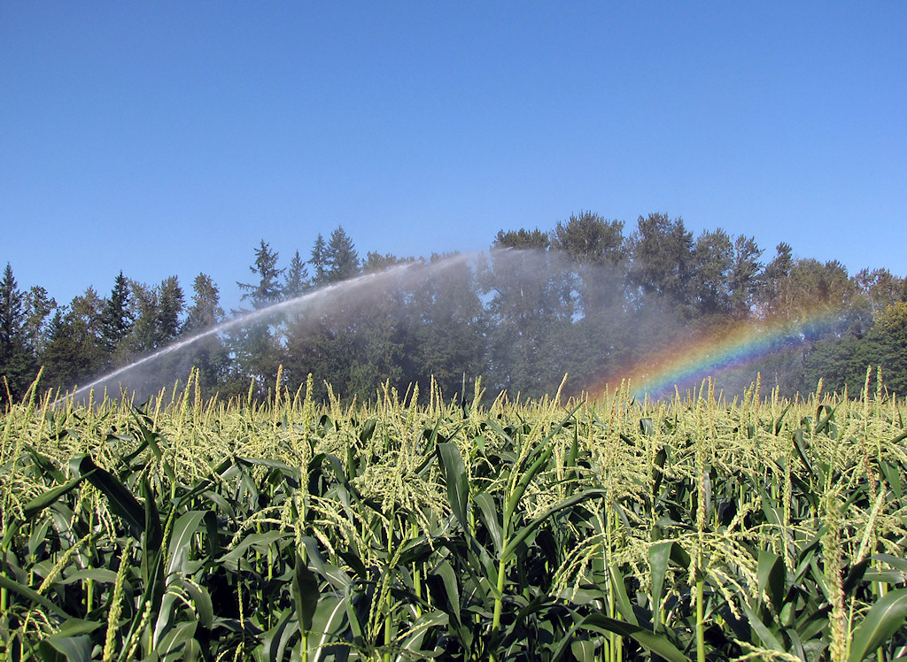
DR in Agricultural Irrigation
10 billion kWh annually in US
Large potential:
  Intrinsically flexible schedule
  Peak demand coincident with grid peak
  Low penetration of Auto-DR
Utility incentives: TOU rates and Auto-DR incentives
DRRC’s Research:
Responding to an identified potential, developed innovative Ag Pumping DR estimation model.
  Phase 1 completed and tested, seeking collaborations to expand further
Scoping study underway for improved identification of target markets and quantification of opportunities

Slide 22
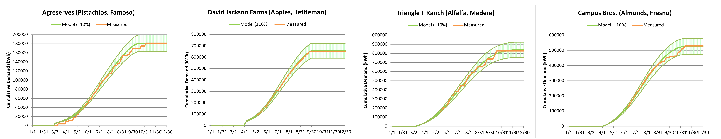
DR Estimation Model Inputs/Outputs
Location
Model
ƒ(w,x,y,z)
Water Requirement
Crop
Load Prediction
Field size
Irrigation System Details
Shift Potential
Modeled demand vs. actual shows good agreement
Seeking larger data set for analysis

Slide 23
Factors that influence achievable DR
Inherent DR potential of a farm is dictated by the crop’s evapo-transpiration rate (water requirement under given weather and soil characteristics) vs. maximum irrigation rate.
  There is more potential for load shifts at the beginning and end of the season when the crops require less water.
Apart from inherent DR potential, the extent to which DR is likely to be sustained depends on factors such as:
  Technology: e.g. Control systems; Type of pumps
  Water scheduling flexibility: e.g. Water source; Labor issues
  Grower participation: e.g. Level of awareness; Financial incentives
Notes:
These are some of the factors we are looking to integrate into the phase 1 model we have developed. Its something we have discussed internally and look forward to collaborating and working together with outside stakeholders to develop specific deliverables.
It could even be part of a comprehensive water management tool. But as a next step we are looking to develop a tool that can be used either by the public or by an agency that sponsors this research.

Slide 24
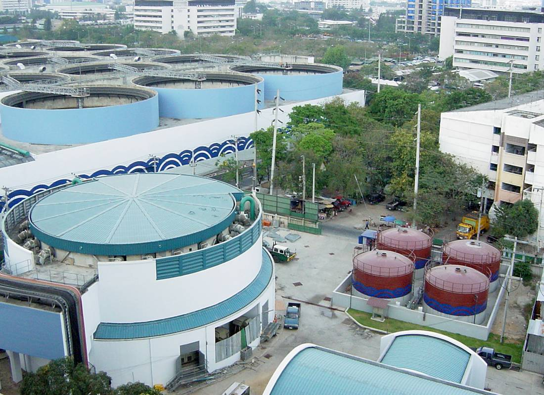
DR in Wastewater Treatment in California
5% of California’s energy use
2 billion kWh annually in CA (75- 100 billion kWh annually in US)
20% increase in next 15 years
Significant cogeneration potential
DRRC’s Research:
Auto-DR Opportunities in Wastewater Treatment Facilities: Report published in Nov 2008
Two case studies completed at San Diego (published) and San Francisco plant (in pre-publication review)
More case studies are planned
Tested end uses: Pumps; Centrifuges; Aeration blowers

Slide 25


San Luis Rey Wastewater Treatment Facility:
Case Study 1
Located in Oceanside, CA.
Processes average of 9.5 million gallons of wastewater per day.
Typically draws 900 – 1,100 kW from grid, and uses an additional 600 – 700 kW from cogeneration unit.
Little load variability.

Slide 26
San Luis Rey Wastewater DR Summary
Equipment | Average Peak Period Demand (kW) | Average Baseline Demand (kW) | Instantaneous Demand Reduction | Average Demand Reduction*
Pumps | 280 | 483 | 300 kW | 204 kW (36%)
Centrifuges | 25 | 35 | 40 kW | 10 kW (30%)
Blowers | 177 | 255 | 250 kW | 78 kW (31%)
*Averaged over entire peak period.

Slide 27
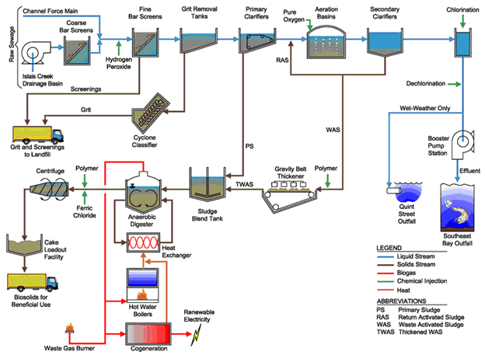
SF SE Wastewater Treatment Facility:
Case Study 2
Located in San Francisco, CA.
Normal throughput of 85-142 million gallons of wastewater per day.
Typically draws 4000 kW from grid, with cogeneration 0-2000 kW sold directly back to grid.
Little load variability.

Slide 28
SF SE Wastewater DR Summary
Date | Time | Baseline Demand (kW) | Actual Demand (kW) | Average Demand Reduction kW (%)
7/23/10 | 10:45-15:30 | 3719 | 2574 | 1145 (31%)
8/12/10 | 05:00-11:45 | 3760 | 2902 | 858 (23%)
8/30/10 | 03:15-10:30 | 3780 | 2828 | 951 (25%)
9/29/10 | 4:45-14:30 | 3753 | 2733 | 1020 (27%)
Average | Average | 3756 | 2771 | 985 (26%)
*Averaged over entire peak period.

Slide 29
Conclusions from Current Research
Municipal wastewater treatment is highly energy-intensive, and key end-use equipment such as pumps and centrifuges can provide significant demand reduction during the peak period.
Blowers can also provide instantaneous demand reduction, but it resulted in peaks in turbidity of effluent at San Luis Rey, making it potentially an unsuitable demand response strategy.
Anaerobic processes produce digester gas that results in significant cogeneration potential which reduces power draw from the grid.

Slide 30
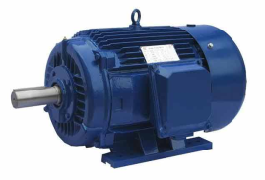
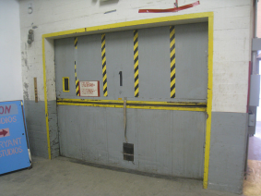
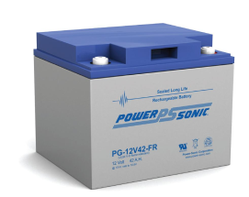
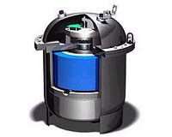
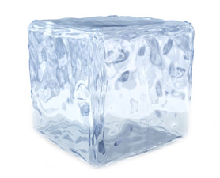
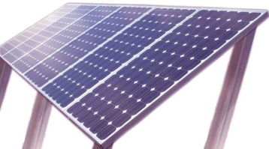
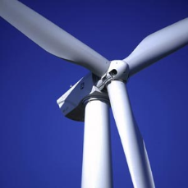
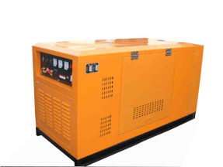
Emerging Area: Microgrids
Smart Grid Extending into Industrial Facility
Industrial Facility Boundary
Loads
Energy Management
and Control System
Storage
Generation
Secure External Communications
Intra-Facility Communications
Electrical Flows

Slide 31
Questions?
Aimee McKane : atmckane@lbl.gov
Sasank Goli : sgoli@lbl.gov
drrc.lbl.gov

Slide 32
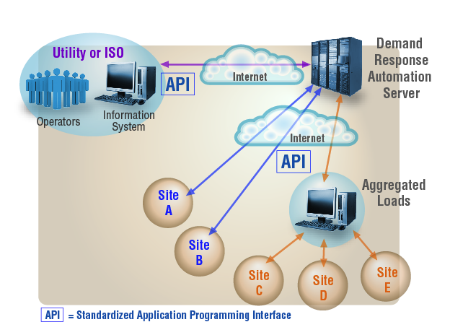
Some sites opting out of participation

Slide 33
Case Study 1 – Amy’s Kitchen (AutoDR)
.
Event
DR test, December 3, 2008

Slide 34
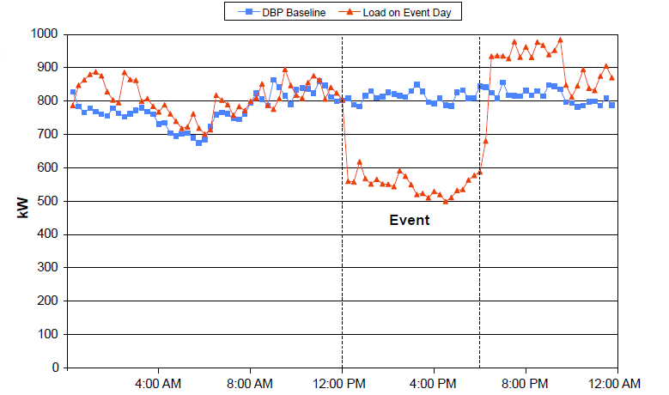
Case Study 2 – US Foodservice (AutoDR)
.
DR test, April 22, 2008

Slide 35
Analysis of ManualDR at selected facilities
Site 1
Peak Period
Peak Period
Site 6

Slide 36
Summary: DR Strategies
Data Center Infrastructure | DR Strategy | Advantages | Cautions
IT Infrastructure | 1. Virtualization technologies: A. Consolidate servers B. Consolidate storage C: Improve network systems efficiency | – Enabling technology tested (A & B) – Enabling technology maturing (C) – Could integrate with Open Auto-DR – Vendors and facilities interested | – Need to quantify value/scalability – Not well tested for DR. – Increased utilization rates for servers may require increased cooling (A). – Some are still research concepts for DR (B & C)
 | 2. Load shifting IT or back-up job processing | – Enabling technology in use – Could be used as shed or shift | – Research concept for DR – Not suited to production data centers
 | 3. Built-in equipment power management | – Built-in power management presents in most equipment already – Energy savings higher in newer systems. – Could integrate with Open Auto-DR | – Minimal energy savings for most current equipment – Need to be combined with virtualization and load shifting of IT or back-up job strategies - Research concepts for DR
 | 4. Emerging load migration technologies | – Enabling technology available for some – Perennial strategy (“anytime DR”) | – Infrastructure available in only a few data centers – Used primarily for disaster recovery – Research concept for DR
IT and Site Infrastructure Synergy | 1. Integrating virtualization, HVAC, lighting controls, etc. | – Intelligent strategies with higher potential energy savings – Vendors interested in enabling technology | – No enabling technologies available currently – IT and site infrastructure technology disconnect – Research concept for DR

Slide 37
IT Virtualization Strategy
Server load consolidation w/ virtualization (+storage, network).
Need research for details and sequence of operations.
Framework from previous DRRC strategy guide.
Definition | Automatically limit or adjust server processor utilization rate as conditions permit by using virtualization technologies in response to a DR signal. The resulting higher utilization rates would free redundant servers, which could be shut down.
Applicability | IT Infrastructure
End-Use type | Server, hardware
Target loads | Server processor load
Category | Load shed
Development Status | Proof–of-concept studies, demonstrations, and research.
Summary of Potential Strategy | Option 1: Set absolute server processor utilization rate Selectively adjust (increase) server processor utilization rate to a pre-set absolute value (e.g., 70% processor utilization rate). We designate this absolute value SE_{au}%, server absolute utilization rate. Gracefully consolidate and shut down* redundant applications and servers that are not needed.
 | Option 2: Set relative processor utilization rate Select high-limit server processor utilization rate (e.g., 70% processor utilization rate). We designate this high-limit value SE_{hu}%, server high-limit utilization rate. Selectively adjust (increase) server processor utilization rate by certain X % from pre-DR mode operation (e.g., increase processor utilization rate by 15-30%). We designate this percent change from pre-DR operation SE_{ru}%, server relative utilization rate. Limit sum of pre-DR mode and SE_{ru}% to less than or equal to SE_{hu}%. Gracefully consolidate and shut down redundant applications and servers that are not needed.
Rebound | Rebound avoidance strategy required to gracefully restart software applications and servers.
Caution | Higher processor utilization rates may lead to marginally higher energy use and subsequent cooling. Impact on energy savings and scalability needs to be quantified. Not well-tested Auto-DR strategy.

Slide 38
IT Migration Strategy
Temporary work load migration (need infrastructure).
Definition | Data centers with fully networked infrastructure within different electrical grids, zones, or geographic locations, can shift loads temporarily to other locations in response to DR event.
Applicability | IT and Site Infrastructure
End-Use type | Server, storage, and networking devices
Target loads | Potentially all loads
Category | Load shed
Development Status | Research
Summary of Potential Strategy | Temporarily shift IT load to redundant networked location: Use fully remote networked redundant infrastructure and automation capabilities to selectively or completely shift IT equipment load in response to a DR event. We designate this percent shift LM _{it}%, IT load migration. The unused IT equipment could be shut down. A percentage of the load of supporting site infrastructure services could be minimized. We designate this percent (LM _{st}%), site load migration. The resulting lowered energy use could be significant.
Rebound | Rebound avoidance strategy required to restore local operations.
Caution | Emerging technology. Used primarily for disaster recovery. Advance notification may be required. Impact on energy savings and scalability needs to be quantified.

Slide 39
Data Center Load Characteristics
Flat Load (Load Factor >=90%)
Mixed Use (Load Factor <90%)
39

