Slide 1
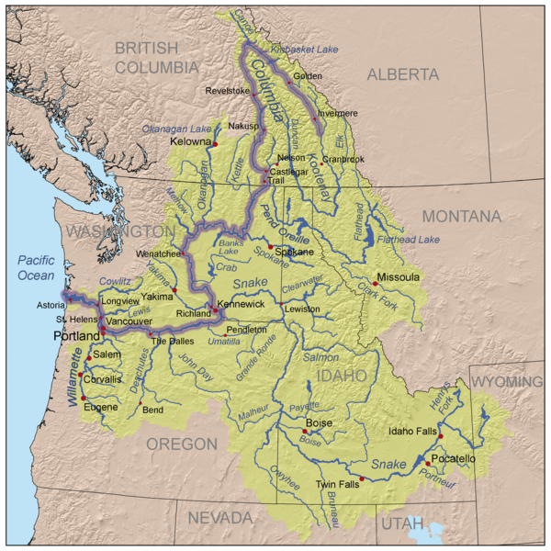
Columbia Basin Coordinated Anadromous Monitoring Strategy Workshop
Mid Columbia
Sub-Basin
October 20 & 21, 2009
Stevenson, WA

Slide 2
Outline
Background Information, e.g.:
Number of MPGs
Number of Populations
Other
Factors that Affect the Strategy
(e.g., landscape description, infrastructural opportunities, etc.)
Existing Work
(Brief narrative describing overall level of effort)
Overall Strategy
VSP
BiOp Requirements
Habitat Effectiveness
Hatchery Effectiveness
Gaps and Adjustments

Slide 3
1. Background Information
Only steelhead listed – Mid-C steelhead DPS
4 MPGs: John Day (5 subpops); East Cascades – 5; Umatilla/WW (3); Yakima MPG (4)
Also 10 spring chinook pops; 5 fall chinook; 2 coho; and 2 sockeye (extirpated)

Slide 4
2. Factors that Affect the Strategy

Slide 5
3. Existing Work

Slide 6
4. Overall Strategy
VSP: Maintain moderate to high precision estimation monitoring approaches that are currently in place for abundance, productivity, spatial structure and diversity. Strengthen salmonid status and trend monitoring in the DPS, improve effectiveness monitoring, and facilitate the implementation of a regionally standardized monitoring and evaluation program.
BiOp:
Habitat Effectiveness:
Hatchery Effectiveness:

Slide 7
4. Overall Strategy
VSP:
BiOp:
Habitat Effectiveness: Implement habitat monitoring to adequately assess status and trends and evaluate overall habitat actions.
Determine effectiveness of specific habitat actions to address key limiting factors.
Determine the effectiveness of habitat restoration actions and to detect fish response in the IMWs (fish in/fish out).
Hatchery Effectiveness:

Slide 8
4. Overall Strategy
VSP:
BiOp:
Habitat Effectiveness:
Hatchery Effectiveness: Continue to evaluate the benefits and risks of supplementation by monitoring natural origin abundance, productivity, life history, and make comparisons of hatchery and natural origin fish. Develop better understanding of origin and abundance of hatchery strays.

Slide 9
5. Gaps and Adjustments
Yakima – GSI approach to identify populations from adult/juv samples at Prosser for VSP
Further evaluate PIT arrays for population specific VSP
Understanding resident / anadromous dynamics
Where to do smolt abundance estimates and tie with habitat effectiveness
Refine redd surveys to identify critical distribution estimates

Slide 10
5. Gaps and Adjustments
Umatilla – implement IMW for fish in/ fish out and Habitat effectiveness
John Day – expand adult abundance, fish in / fish out monitoring, and hatchery spawner estimates
15 mile Cr – implement fish in/ fish out VSP monitoring
Deschutes - implement R/S and stray impact proposal in east side pop; conduct steelhead fall back and hatchery spawner distribution study

