Slide 1

Presentation of the PTAGIS Database
NPCC’s Fish Tagging Forum
John Tenney PTAGIS Software Engineer
March 22, 2012
Notes:
Presentation: overview of PTAGIS data and how database works

Slide 2
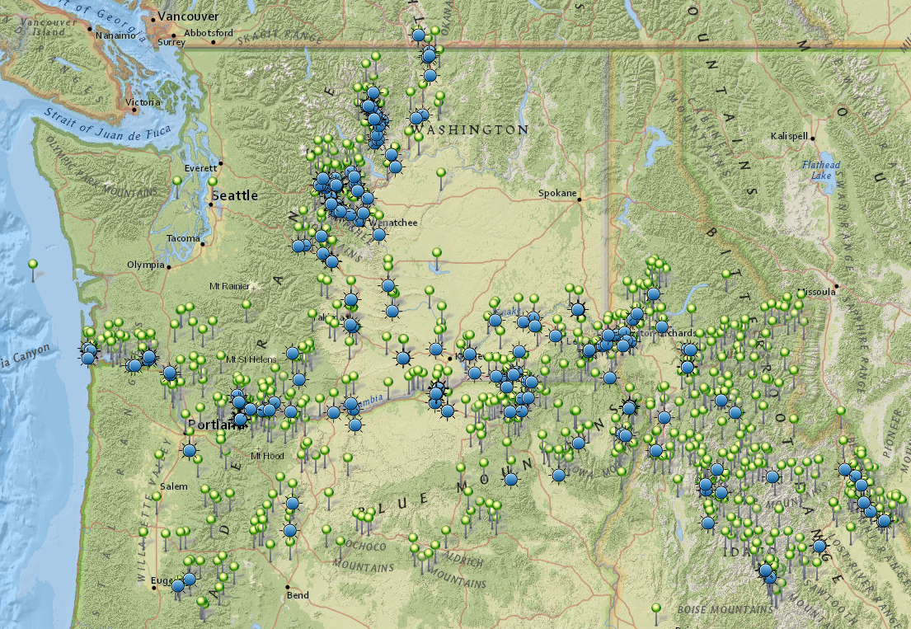
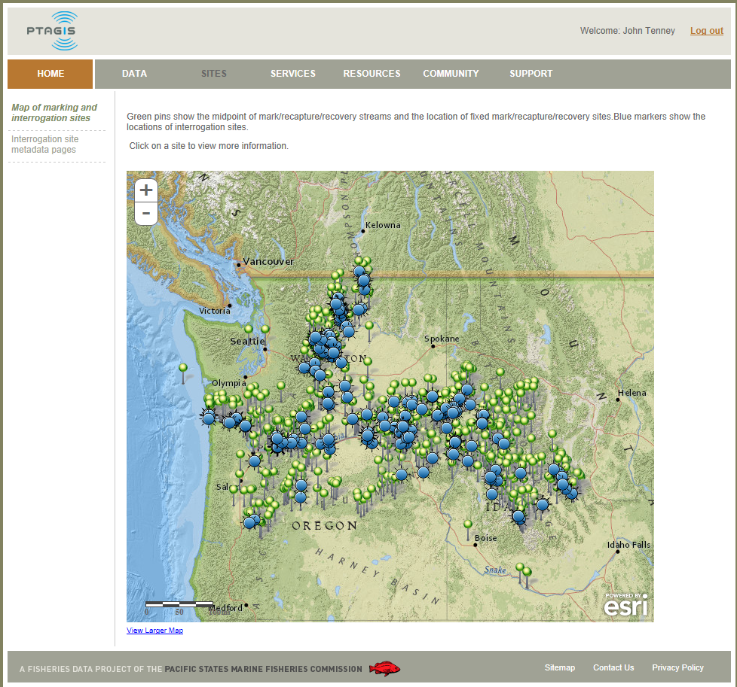
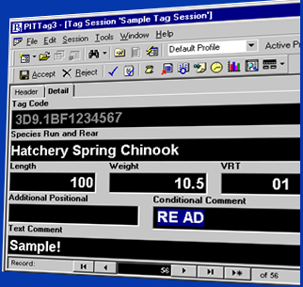
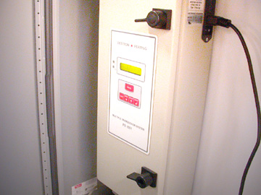
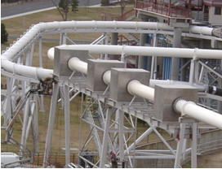
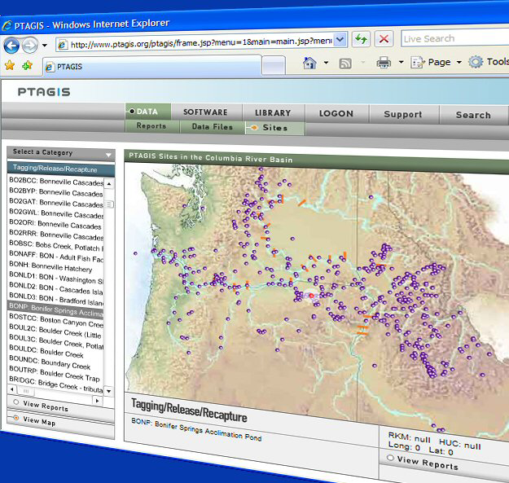
PTAGIS Program Overview
Mark/Recapture/Recovery Sites
Interrogation Sites
Data Collection
Technical Operations
Fish Monitoring
Online Data Access
Notes:
I was asked to present brief overview of PTAGIS, focusing on data management.
PTAGIS is a regional database of fish marked with PIT tags by various fisheries management agencies and research organizations.
There are hundreds of MRR and Interrogation sites submitting data to PTAGIS throughout the CRB
(CLICK) Data Collection: we develop custom software to capture this data
(CLICK) Fish Monitoring: every time a fish marked with a PIT tag passes a detection site, a computer records this information and automatically uploads this data to PTAGIS database.
(CLICK) Technical Operations: PTAGIS installs, operates and maintains most of the equipment and software needed for this automated PIT Tag detection.
(CLICK) Online Data Access: and PTAGIS publishes all of the PIT tag data to our website to make it accessible for researchers and the general public..

Slide 3
Summary of the PIT Tag Data Event Model
Notes:
We use a simple model to describe the various PIT tag events reported in the Columbia Basin.
It is in the tag and release event that a unique PIT tag is permanently associate with a specific fish.

Slide 4
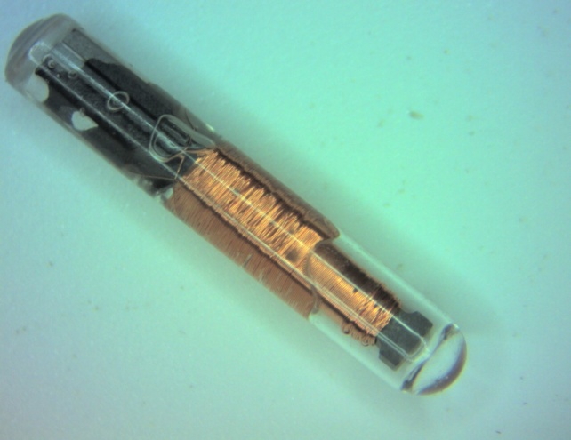
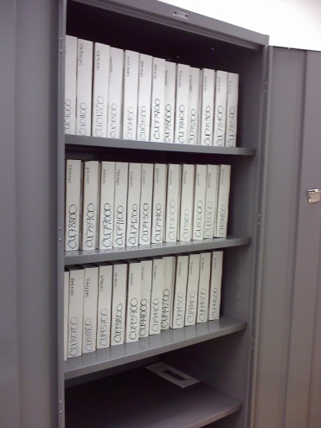
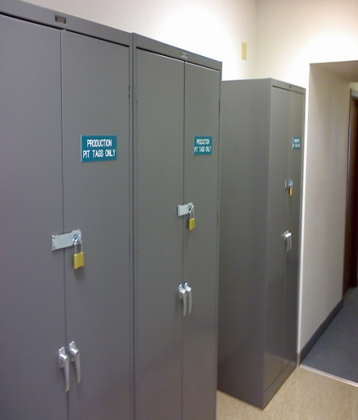
PTAGIS: PIT Tag Distribution
Approximately 1.2 million of the two million PIT tags used annually in the Columbia Basin are distributed to BPA approved projects.
Opportunity for Additional Metadata from Distribution Event
  Tag Type
  Fish and Wildlife Project Number
Notes:
PTAGIS inventories and, in cooperation with BPA, distributes more than a half of the 2 million tags used for research in the CRB by various FWP. The distribution event is the first event in our data lifecycle of a PIT Tag and provides additional metadata such as Tag Type and FWP number.

Slide 5
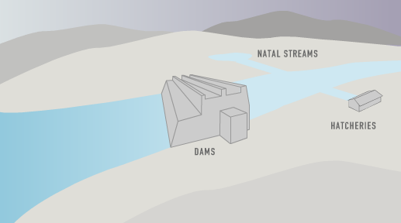
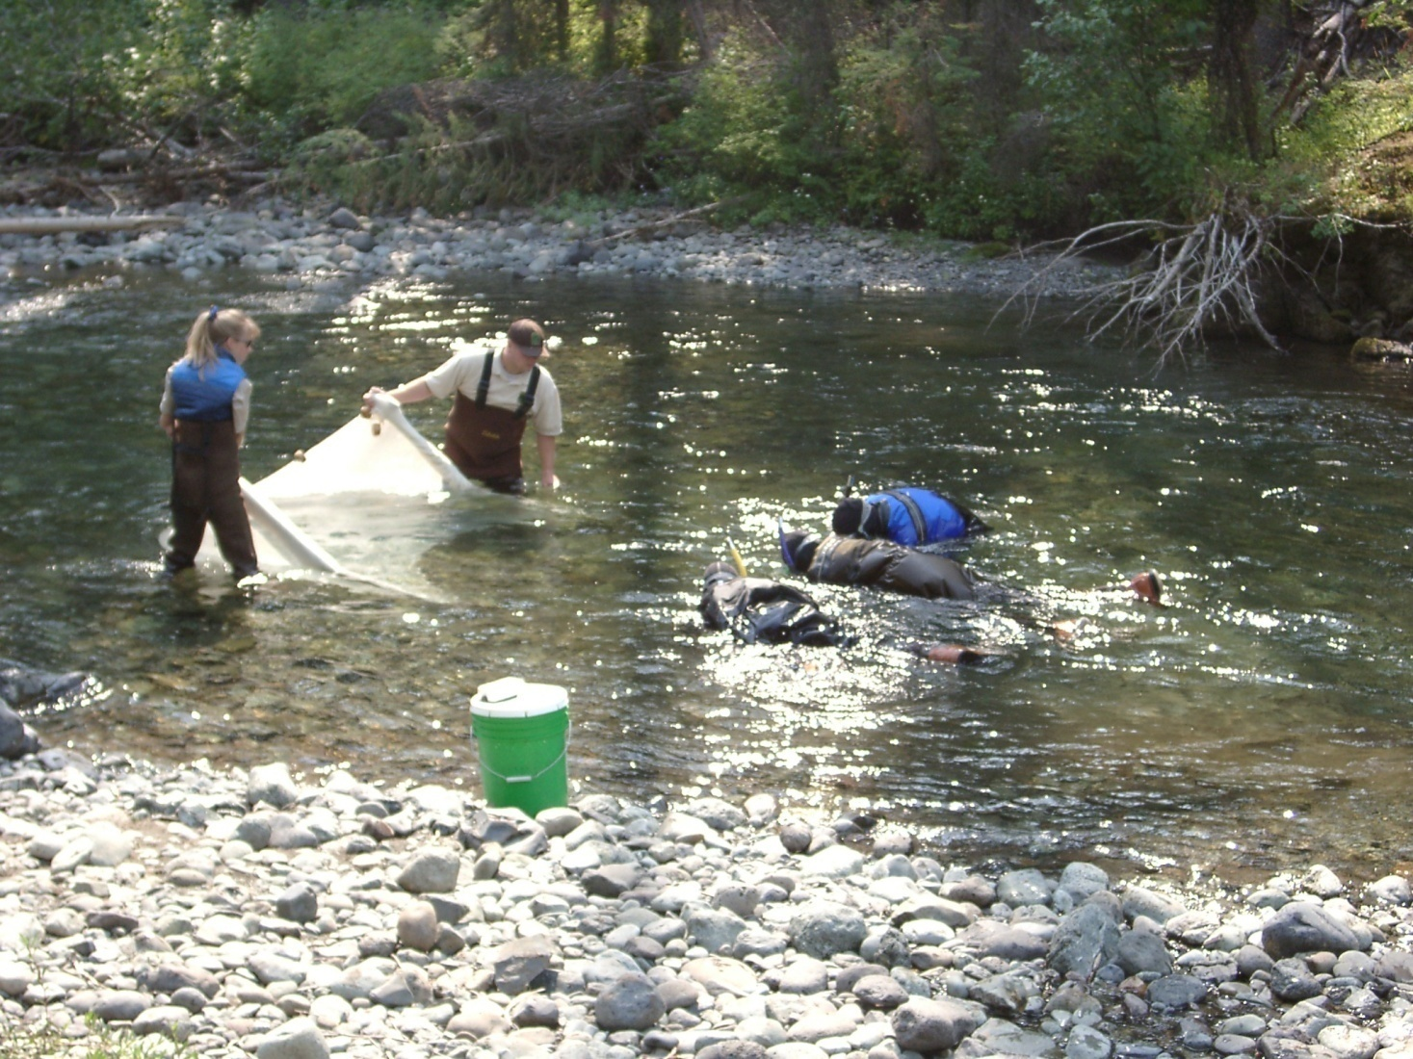
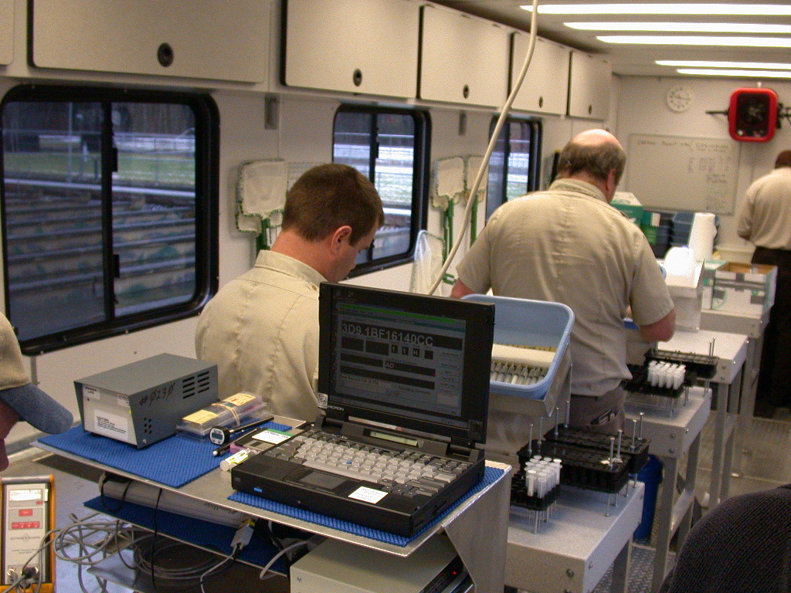
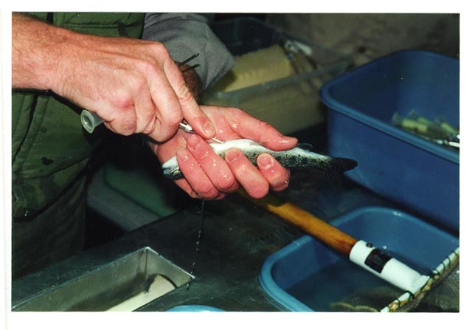
PTAGIS Data Event: Tagging
Tagging
Notes:
What do we mean by data?
(CLICK) we capture the Initial Tagging Event
(CLICK) this can range from 20,000 tagged fish per day at Mass Marking operations located at hatcheries or Juvenile Bypass Facilities.
(CLICK) To tagging much fewer wild fish in very remote regions.

Slide 6
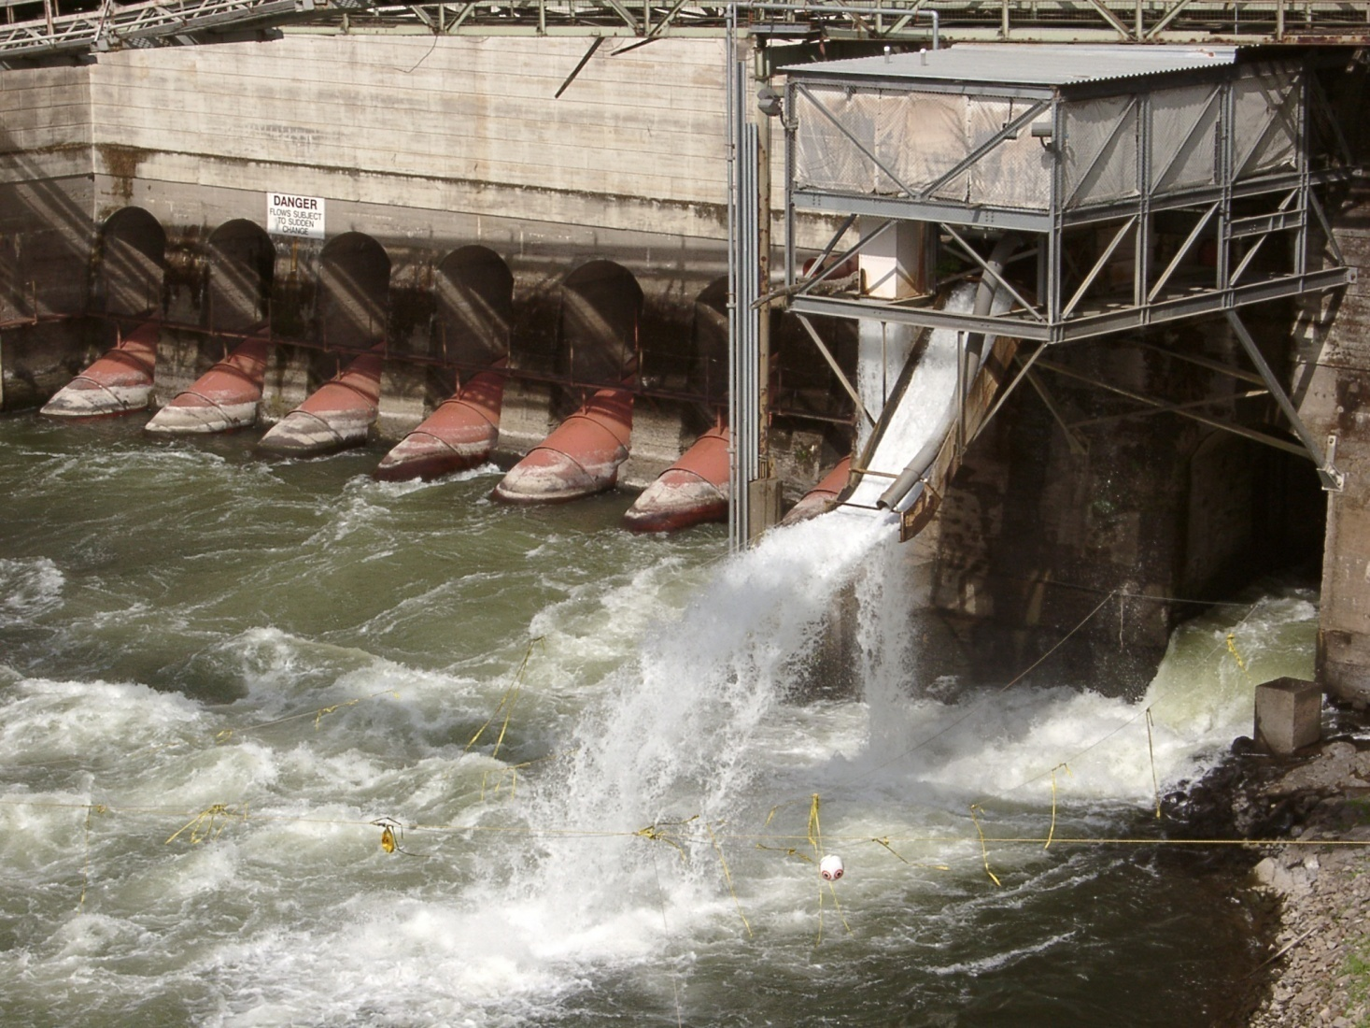
PTAGIS Data Event: Release
Tagging
Release
Notes:
Release Information tells us Where and When a group of tagged fish are released into the wild.

Slide 7
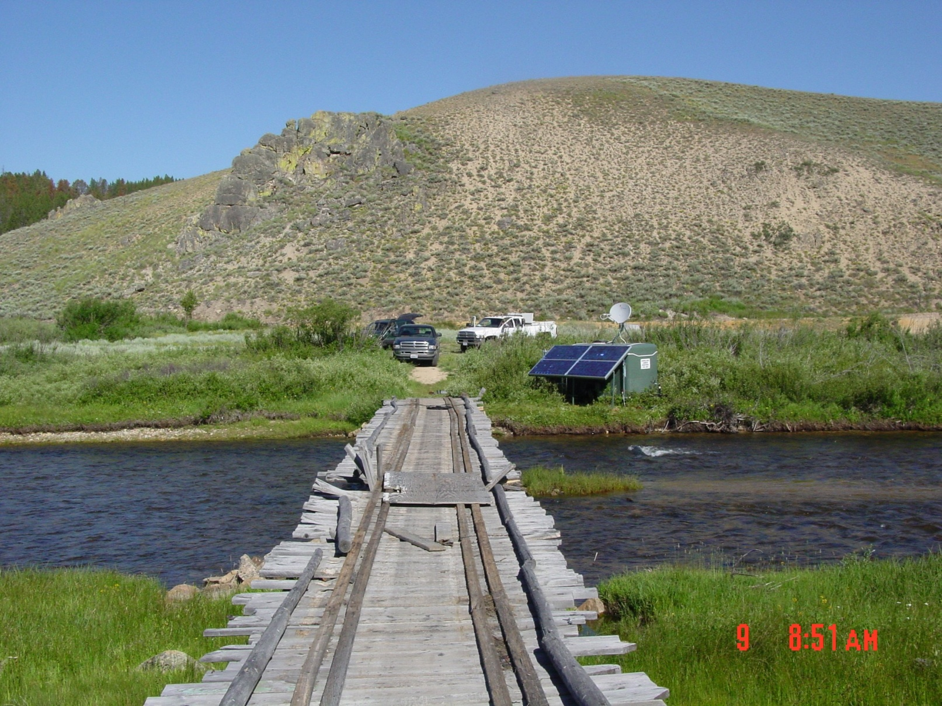
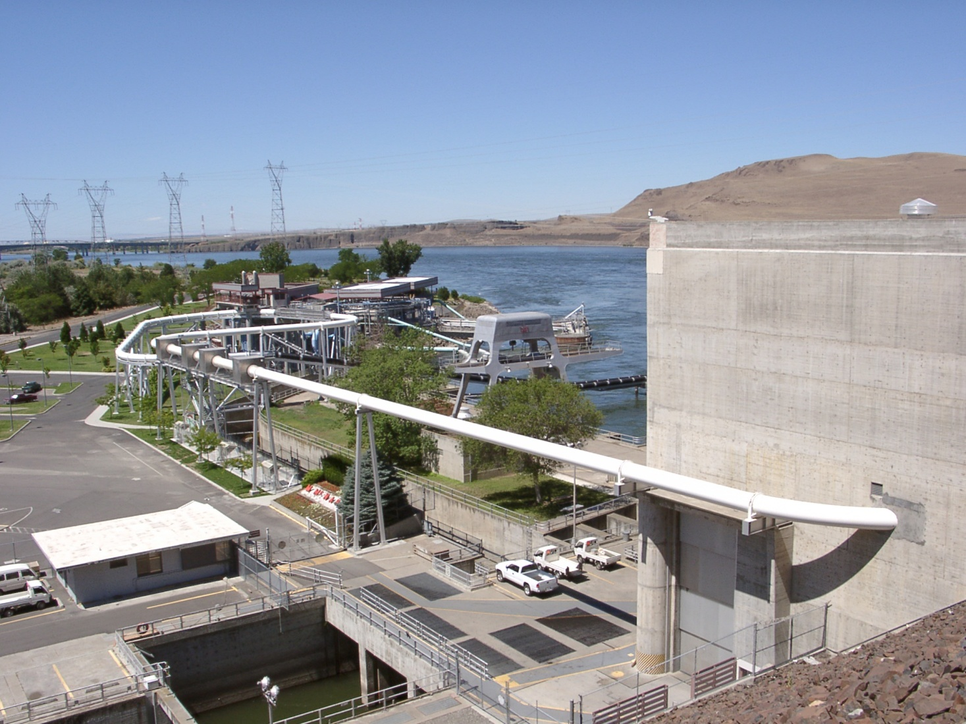
PTAGIS Data Event: Juvenile Fish Passage
Release
Tagging
Juvenile Fish Passage
Notes:
When juvenile fish marked with a PIT Tag migrate downstream, they pass by automated PIT Tag interrogation equipment that record this event at larger sites situated at hydro-facilities as well as smaller in-stream sites

Slide 8
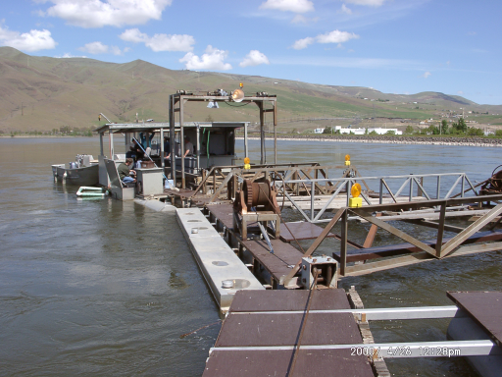
PTAGIS Data Event: Recapture and Re-Release
Release
Tagging
Recapture
Juvenile Fish Passage
Notes:
Fish traps such as this may recapture a previously tagged fish. This event is recorded and appended to the life history of that fish.

Slide 9
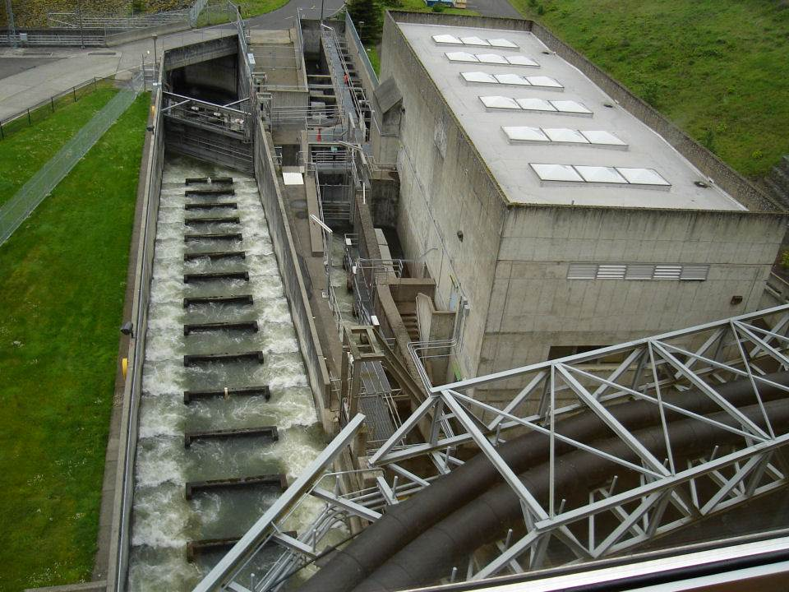
PTAGIS Data Event: Adult Fish Passage
Release
Tagging
Recapture
Adult Fish Passage
Juvenile Fish Passage
Notes:
When adult fish marked with a PIT TAG return from the ocean they pass through Fish Ladders and Weirs instrumented with PIT Tag detection equipment that automatically record this event. And of course we record adult detections at numerous in-stream sites as well.

Slide 10
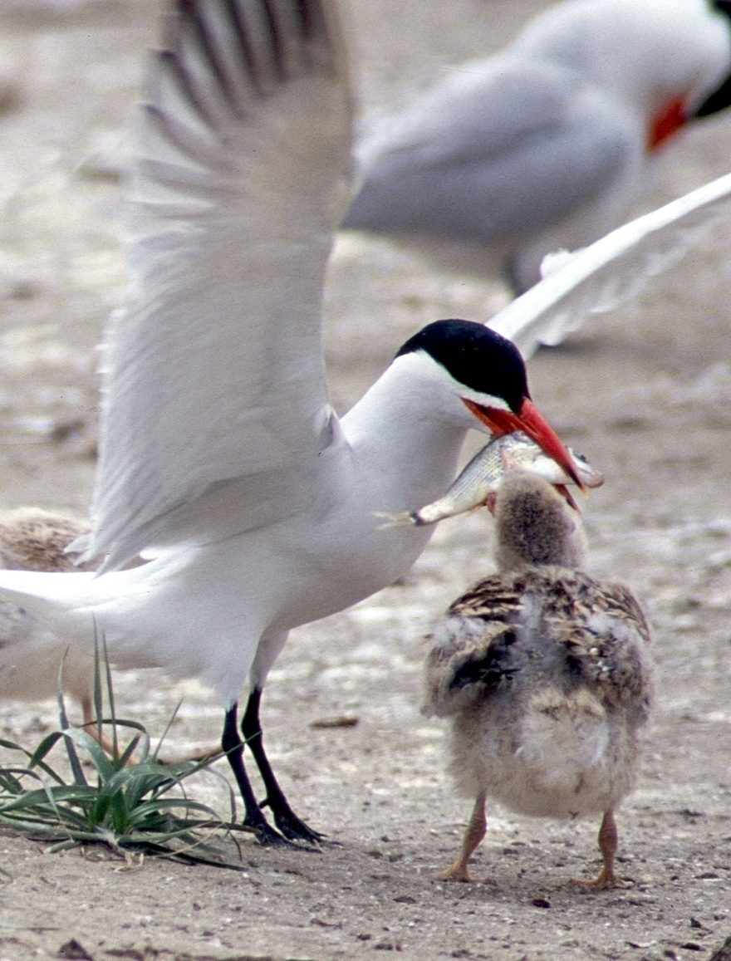
PTAGIS Data Event: Mortality
Release
Tagging
Adult Fish Passage
Recapture
Mortality
Juvenile Fish Passage
Photo Credit: Lynn Ketchum, OSU
Used with Permission
Notes:
We record various types of Mortality Events such as:
When adult fish return to hatcheries to spawn
From various Predation studies
And Sport Recoveries
As well as unintentional mortalities caused by Sampling and Handling

Slide 11
Summary of the PIT Tag Data Event Model
Notes:
We use a simple model to describe the various PIT tag events reported in the Columbia Basin.
It is in the tag and release event that a unique PIT tag is permanently associate with a specific fish.

Slide 12
Notes:
There has been a steady and dramatic growth in PIT tag use in the last 20 years.
25,000 fish were tagged during the spring migration in 1987
Over 2.5 million fish were marked during the 2011 Migration Year.
Total number of marked fish in the database currently exceeds 31 million

Slide 13
Notes:
This graph shows the number of individual fish detected, by year, (BLUE)
as well as cumulative number of individual antenna interrogations events (136 M). (LINE)
Many of these fish were detected at two or more sites as they migrated down- or back up-stream. (RED)

Slide 14
Notes:
The annual and cumulative numbers of PIT tag recapture and mortality events reported to PTAGIS.
Avian predation, as indicated on graph, were reported starting in 1998 (vast majority >95%).
The spike in recaptures in 2005 are 60K fish released from Ringold Hatchery that were supposed to be a monitored release and instead were reported as recapture events due to equipment malfunction.

Slide 15
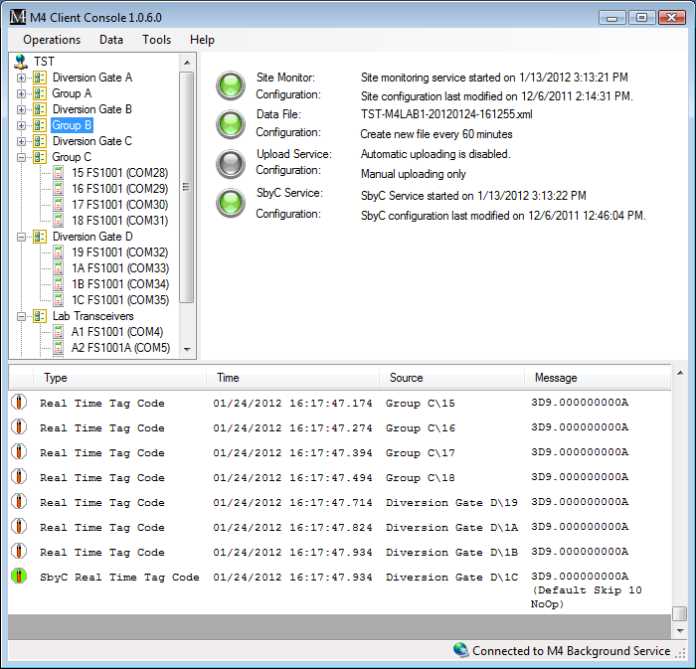
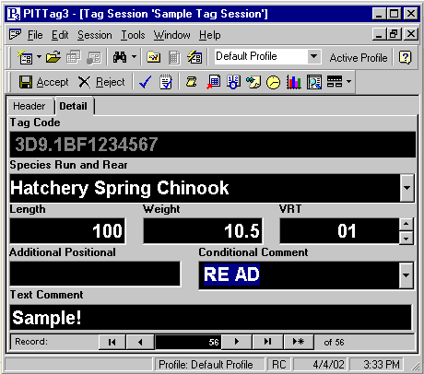
PTAGIS Data Collection Software
Interrogation Software
Tagging Software
Adult Fish Passage
Tagging
Juvenile Fish Passage
Recapture
Release
Mortality
Notes:
To collect this data, we have to principal types of field software applications that we develop and support:
(CLICK) Interrogation Software which runs unattended and automatically captures the passage of Juvenile and Adult fish marked with a PIT Tag.
(CLICK) And Tagging Software is used to capture all the other events which we sometimes refer to as mark and release or tagging data as a group.

Slide 16
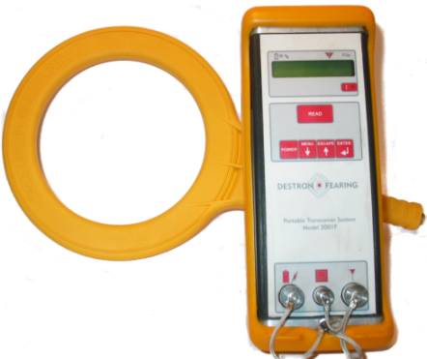
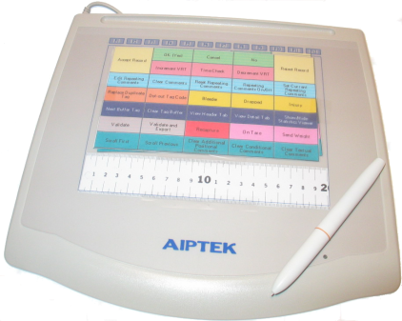
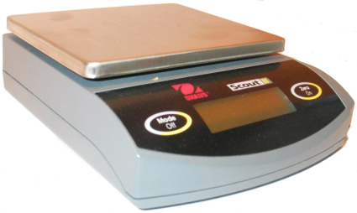
PTAGIS Tagging Software: P3
PIT Tag Reader
Tagging Software
Digitizer Tablet
Tagging
Digital Balance
Recapture
Release
Mortality
Notes:
This tagging software, called P3, was developed by PTAGIS over 10 years ago as a PC-Based application.
It presents a structured data entry environment for end users to rapidly and accurately input mark and release information.
Users can enter data with the traditional keyboard and mouse.
However, this application interfaces with peripheral devices such as:
(CLICK) Tag Readers to input a tag code
(CLICK) Digitizer Tablet to input length and codified comments
(CLICK) Electronic Balance to record weight.
The data is then submitted to the PTAGIS database and made available to the world-wide-web.

Slide 17
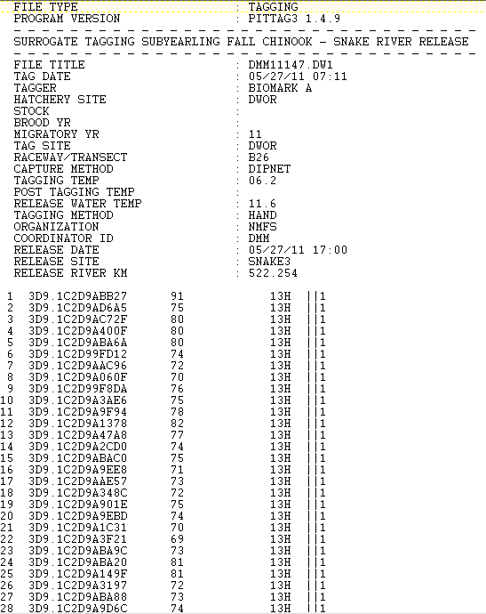
P3 Tagging File
Defined in the 2009 PIT Tag Specification Document
ASCII format, designed for DOS systems
Pros:
  Well-defined
  Compact
  Human readable
  Security through obscurity
Cons:
  Difficult/costly to extend
  Fragile formatting
  Non-standard: requires custom software to parse/validate
Notes:
An example of a P3 tagging file used to submit field data to PTAGIS
Top header provides metadata on who, when and where the fish were marked or recovered
Bottom provide detail for each fish marked with a PIT Tag
ASCII format developed years ago based upon an implementation running on DOS
The data is defined in the PIT Tag Spec Doc
Requires custom code to parse/validate and is difficult to extend

Slide 18
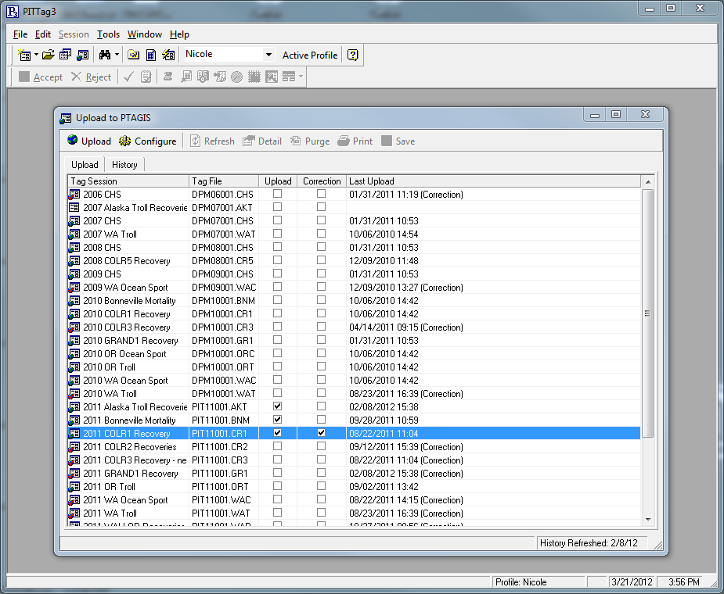
P3 Tagging Software Data Submission
Notes:
Tagging data is submitted on-demand by researchers in batches of tagging files. Files are validated and loaded into the database and the data is immediately available on the PTAGIS web site.

Slide 19

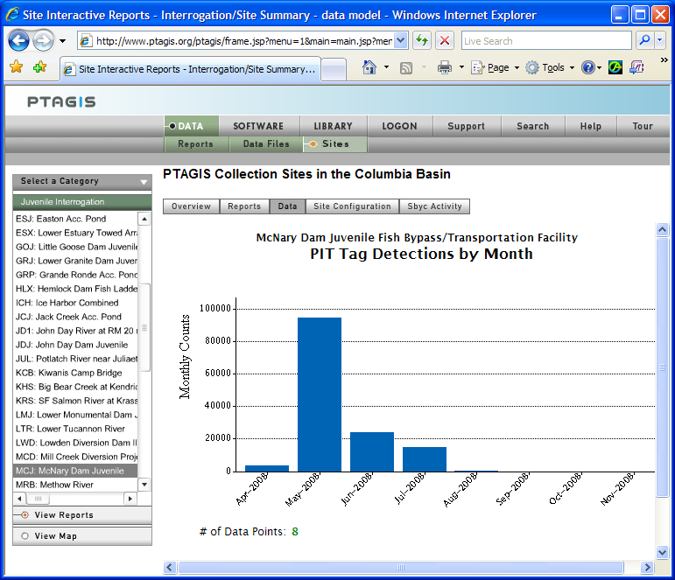
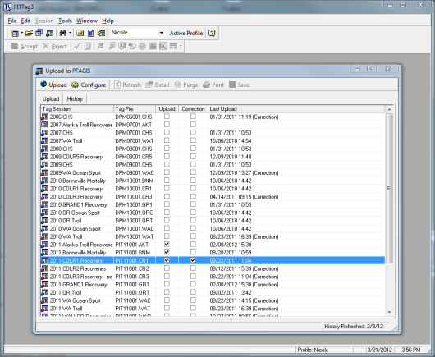


P3 Tagging Software Data Submission
PTAGIS Web Site
www.ptagis.org
PTAGIS
Database
Upload (FTP)
PTAGIS Server
Tagging Data Files
Notes:
Tagging data is submitted on-demand by researchers in batches of tagging files. Files are validated and loaded into the database and the data is immediately available on the PTAGIS web site.

Slide 20
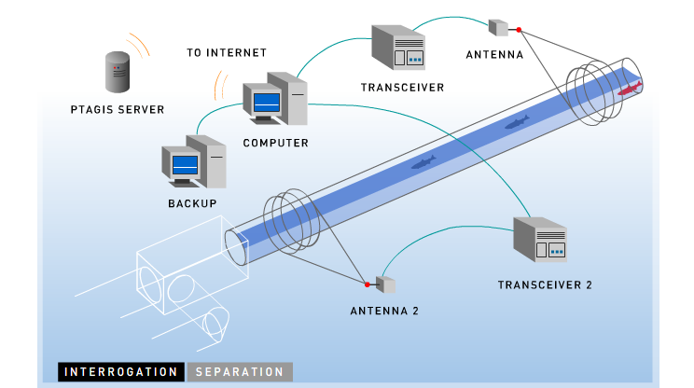
Interrogation Platform
Notes:
Interrogation Platofrm?
M4 is software that will operate on standard Windows PCs.
Designed to run unattended in a 24x7 lights-out environment
Simultaneously captures data from several transceivers and other devices
This data consists of
Site configuration and location information
Observation of fish marked with a PIT Tag at given time
Diagnostic data from the transceivers to report on the health of the entire data acquisition system
M4 can be run on two computers in a clustered failover environment to maintain continuous uptime.
Data captured by M4 is uploaded to the central PTAGIS server so that it can be reported upon in “near-real-time”
CLICK
M4 can be configured to identify individual PIT-tagged fish and instantly divert them into Examination Tanks, Transportation Vehicles or Back to the River using system called Separation-By-Code.
Once a marked fish is detected, M4 has a fraction of a second to lookup the tag code in a database (with records usually in the millions) and trigger the physical gate.
Downstream antennas are used by M4 to confirm diversion activities and compute and report efficiency.

Slide 21
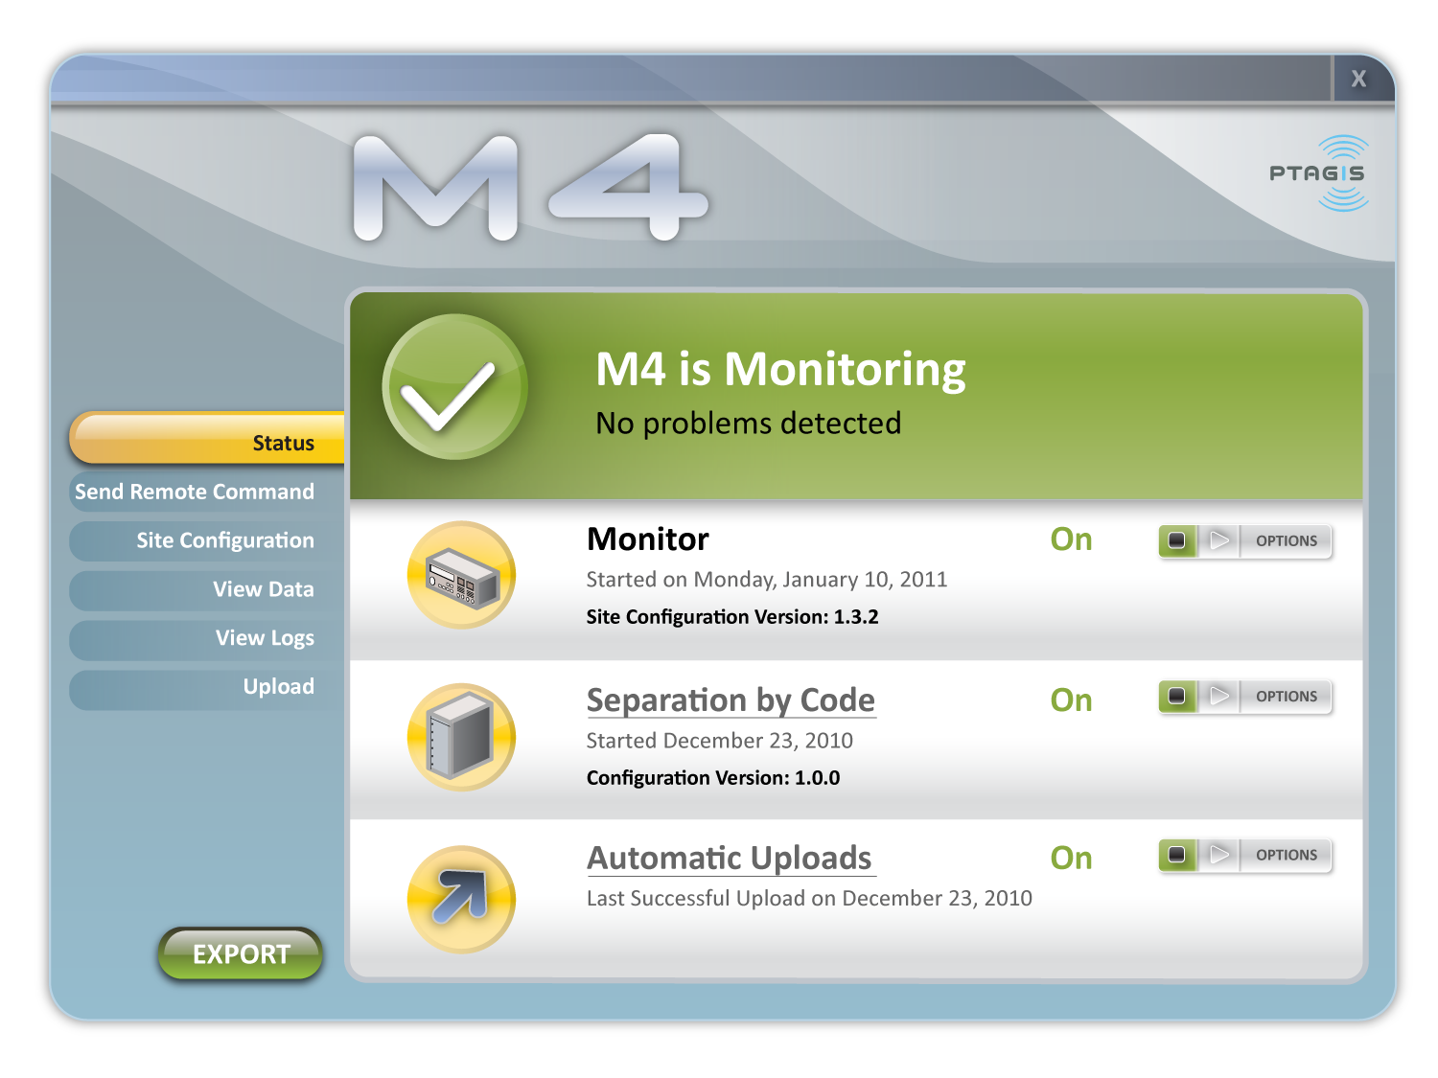
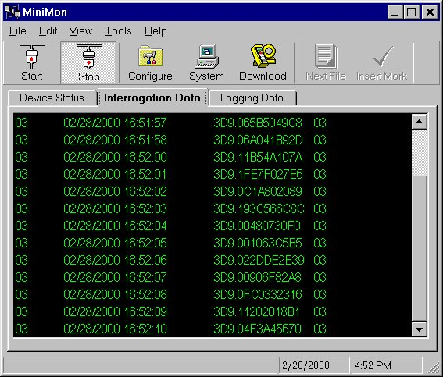
Field Interrogation Software
MultiMon
M4
MiniMon
M4 is a replacement for both MiniMon and MultiMon software
Notes:
The current field interrogation software are MultiMon and MiniMon
MultiMon, developed by NOAA, is a DOS-based application used at interrogation sites performing SbyC
MiniMon, developed by PTAGIS, replaced MultiMon at sites not performing SbyC
M4, next-gen software developed by PTAGIS to replace both MM’s
Deployed this year for evaluation at select sites

Slide 22
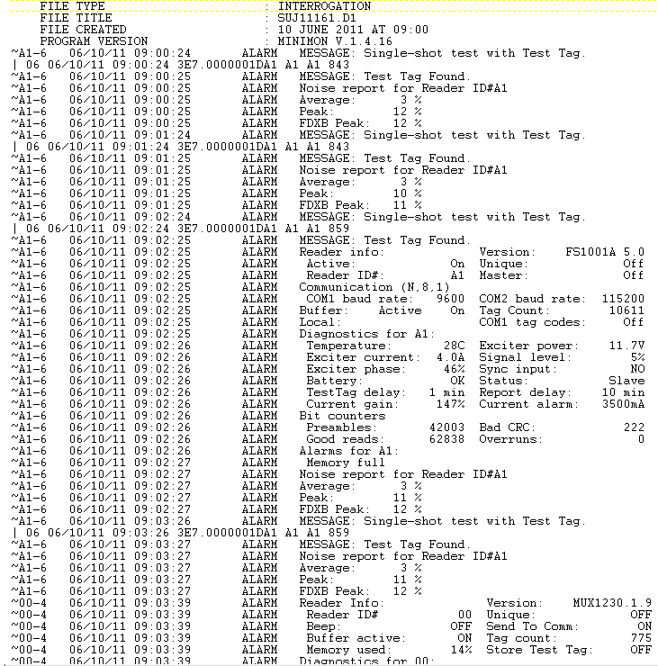
MiniMon Interrogation File
Defined in the 2009 PIT Tag Specification Document
ASCII format, designed for DOS systems
Pros:
  Well-defined
  Compact
  Human readable
  Security through obscurity
Cons:
  Difficult/costly to extend
  Fragile formatting
  Non-standard: requires custom software to parse/validate
Notes:
MiniMon (and MultiMon) generate ASCII text files containing data and transceiver diagnostics.
The data format are specified in the PIT Tag Spec Doc
Provides a compact, human-readable data format
This format require custom coding to parse and validate
It has fragile formatting (e.g. MIME) and somewhat rigid.

Slide 23
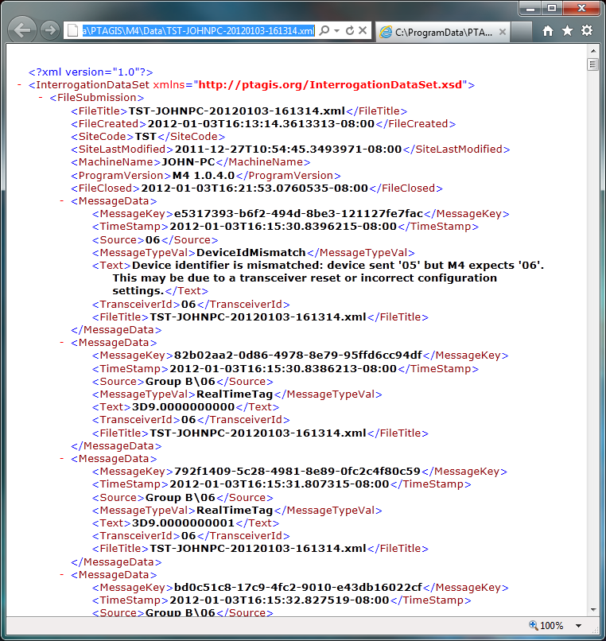
M4 Data File Format: XML
Extensible Markup Language
Publicly defined schema (structure/data types/relationships)
Common for data exchange (portable)
Pros:
  Industry Support/Standards
  Well-defined
  Flexible
  Efficient Parsing/Validation
Cons:
  Verbose/Complex
  Security: target for injections
Notes:
The next generation systems M4 (and P4) use file format common in the industry called XML
Efficient and portable for data exchange
Designed to be easily extendable
The specifications for data and relationships are available in a published schema allowing other entities to submit data to PTAGIS

Slide 24
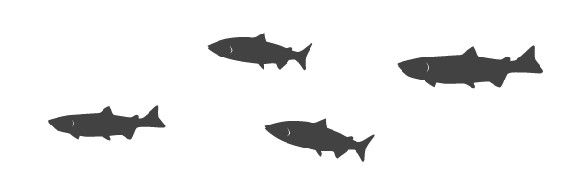
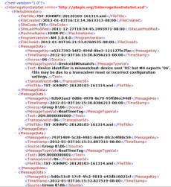
M4 Interrogation Data Capture
PC
M4 Background Service
Antenna
Transceiver
Interrogation Data Files
Notes:
M4 Data Capture
M4 Background service captures data and diagnostics from up to several dozen transceivers devices connected to antennas
M4 user interface separate application from service, promoting stability for long-running processes
M4 Service stores data in XML data files, partitioned over time, typically 4 to 6 files a day…

Slide 25
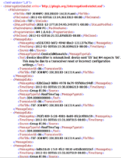
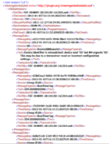

Interrogation Data Submission
PTAGIS Web Site
www.ptagis.org
M4 Background Service
PTAGIS
Database
Upload (FTP)
Interrogation Data Files
PTAGIS Server
Notes:
M4 Data Capture continued
Periodically, the data files are uploaded to the server …
and batch processed into the database, typically every 4 – 6 hour
The original data files are also archived on the server
The data is then immediately available for querying once it is processed.

Slide 26
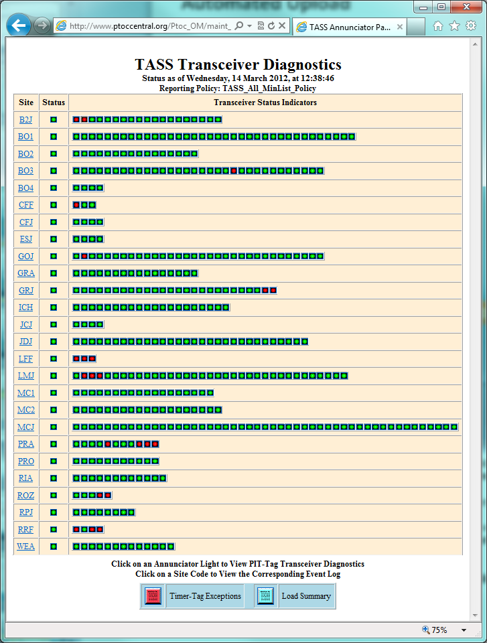
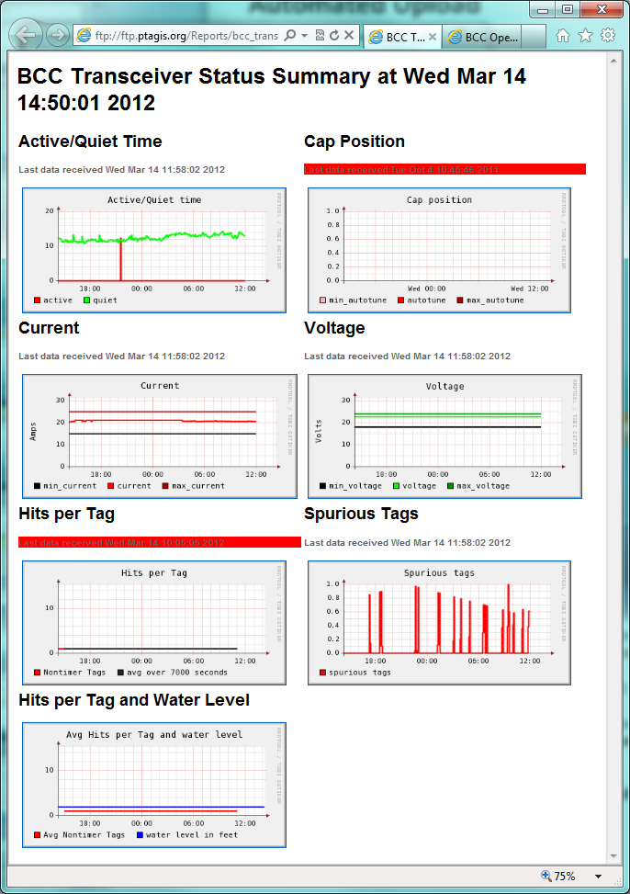
PTAGIS O&M Web Reports
Notes:
The interrogation software also captures transceiver diagnostic information and embeds them into the data stream
These diagnostics are used in our near-real-time operational reports to provide our field engineers with current status of all our detection components

Slide 27
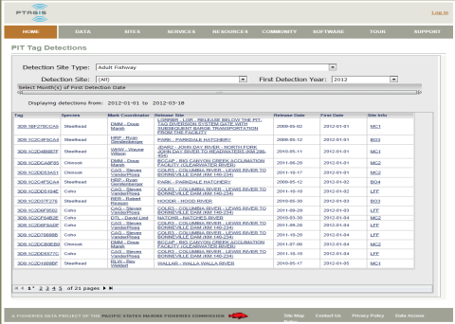
PTAGIS Systems Upgrade
PTAGIS4 Server
PTAGIS3 Server
Data Mart & Reporting Environment
Database
Database
Legacy Field Systems
New Field Systems
P4
Notes:
PTAGIS is in the middle of a major systems upgrade and continue to make progress while maintaining the current systems.
PTAGIS3 OLTP: database primarily tuned to receive data and not extract it
PTAGIS4: contains OLTP database to receive data, but uses industry-standard dedicated reporting environment (OLAP)
Much more efficient data analysis and report

Slide 28
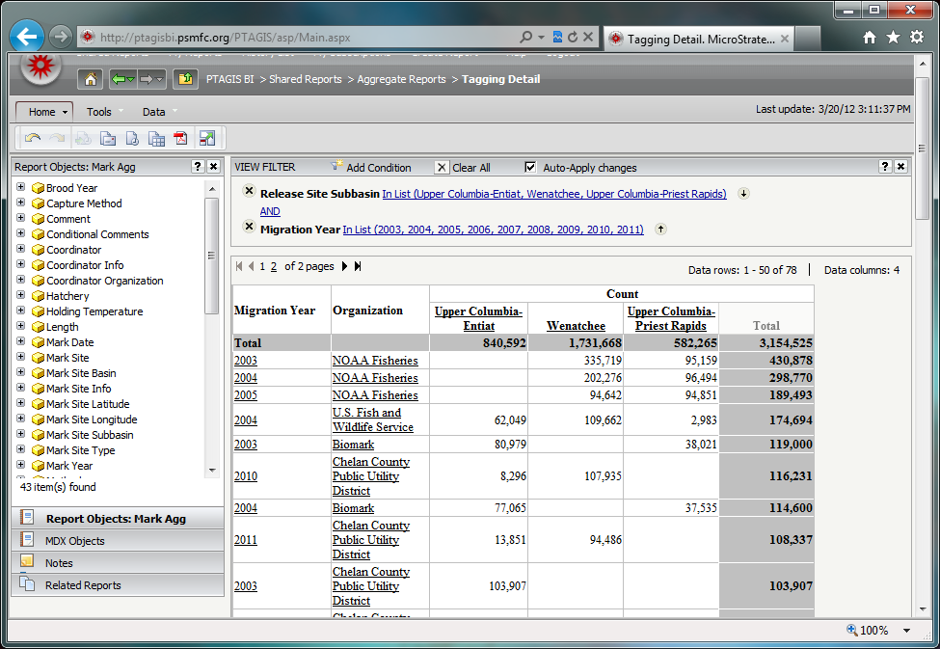
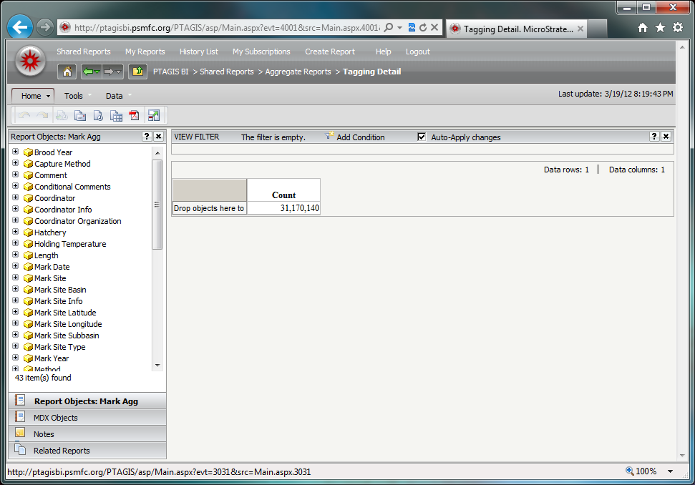
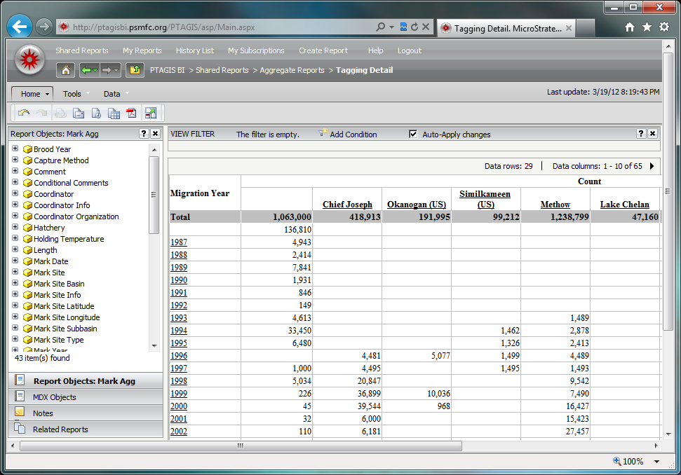
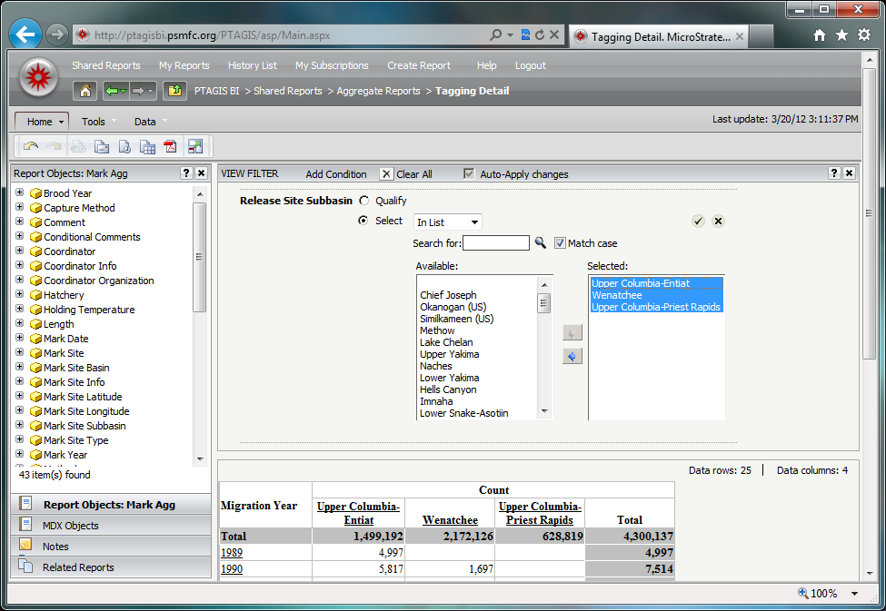
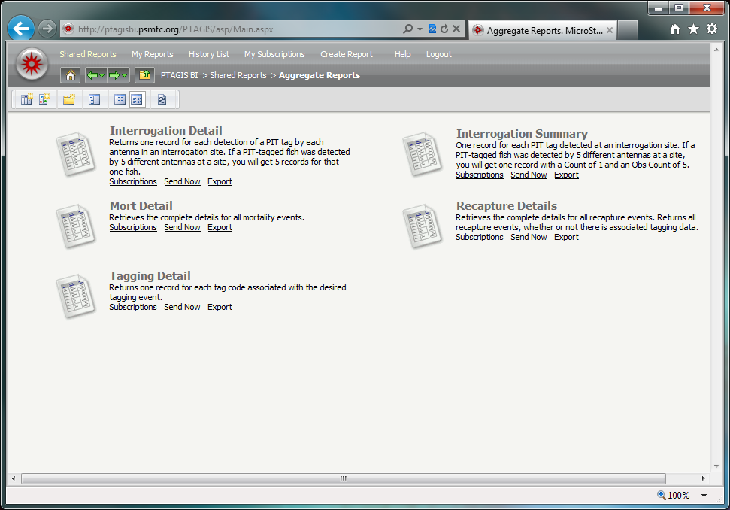
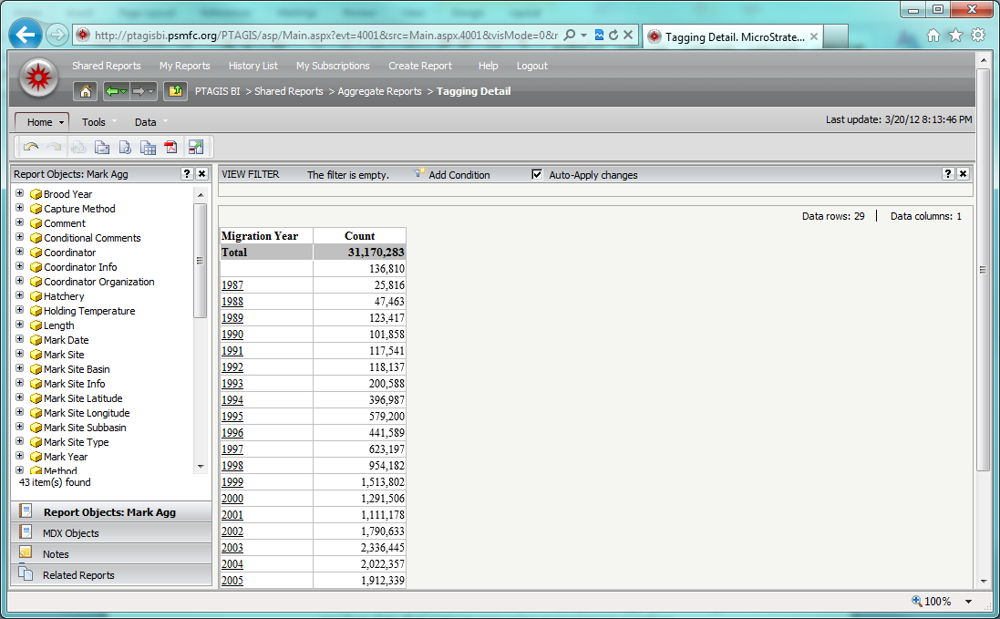
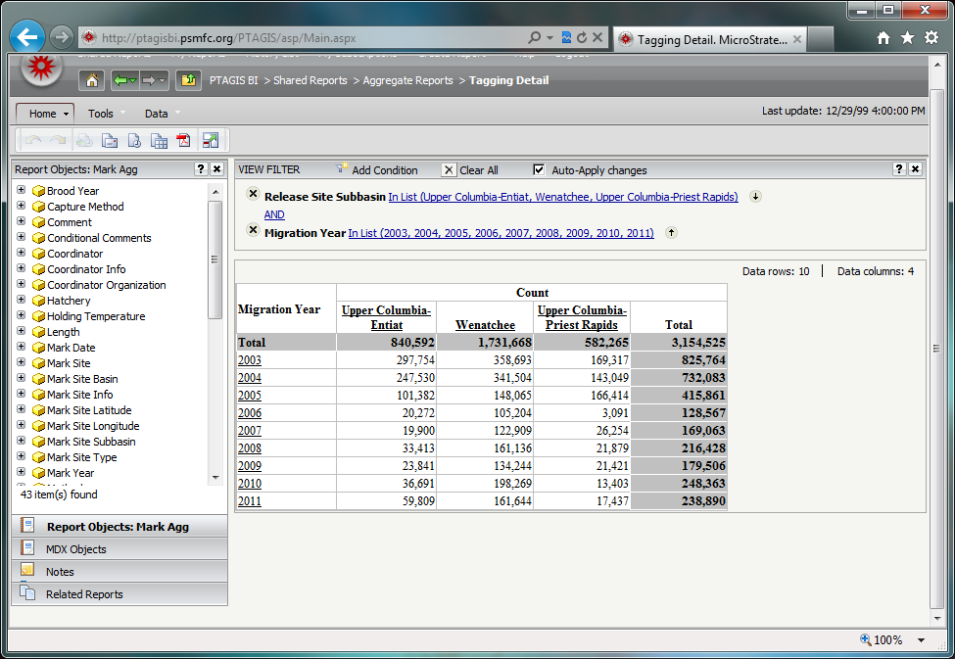
Example of Aggregate Reporting using PTAGIS Data
Notes:
Example of OLAP report using PTAGIS data and Microstrategy Web Reporting Tool
User selects one of the predefined aggregate report types from the new PTAGIS web portal
Tagging detail contains 31 million tags
Drag and drop Migration Year and slice the rows in less than a second
Drag drop Release Site Subbasin (HUC4) to the top and slice again
Filter on a few Sub Basins and migration years
Drag and drop Organization onto the data…

Slide 29
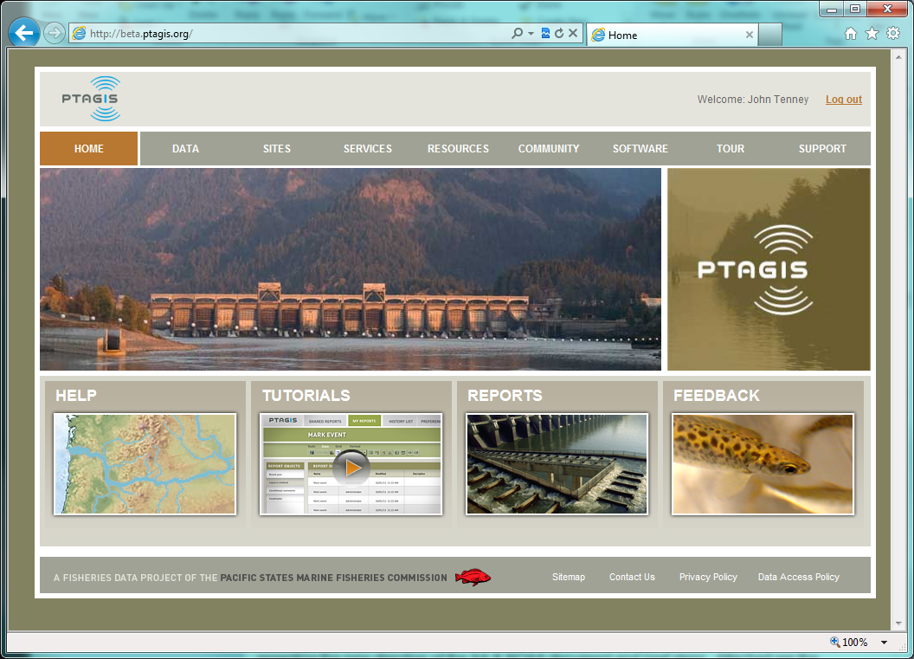
New PTAGIS Web Site (beta)
Notes:
A second beta of our new web site will be released very soon to a focus group for evaluation and feedback. This site incorporates the advanced reporting features discussed previously.

Slide 30
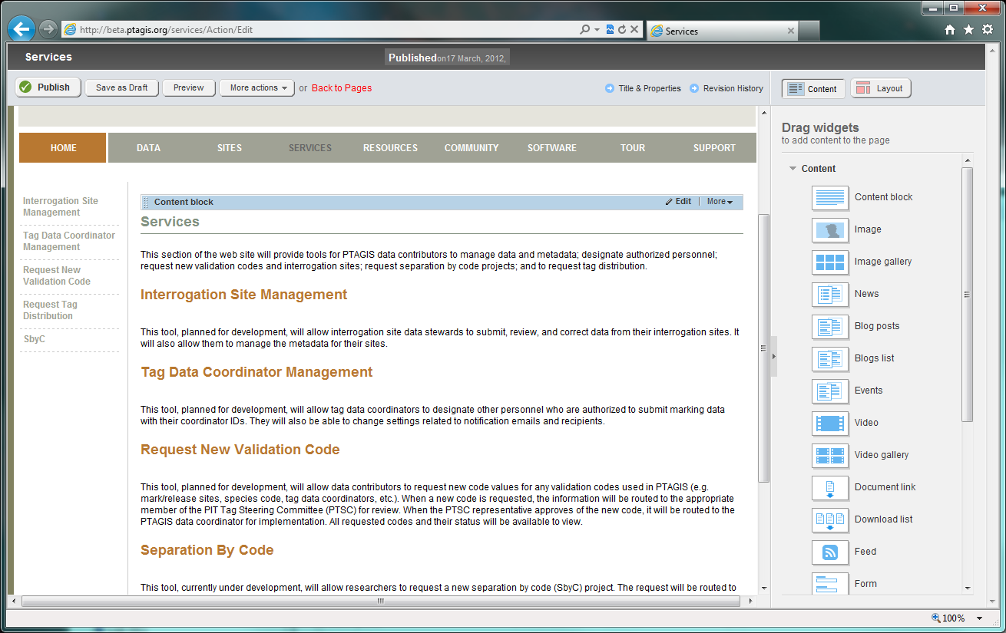
New PTAGIS Web Site: Content Management
Notes:
The new web site is built on top of a OTS content-management system, allowing us to easily manage and publish content such as news, documentation, photos and videos. It also provides system and user account management.

Slide 31
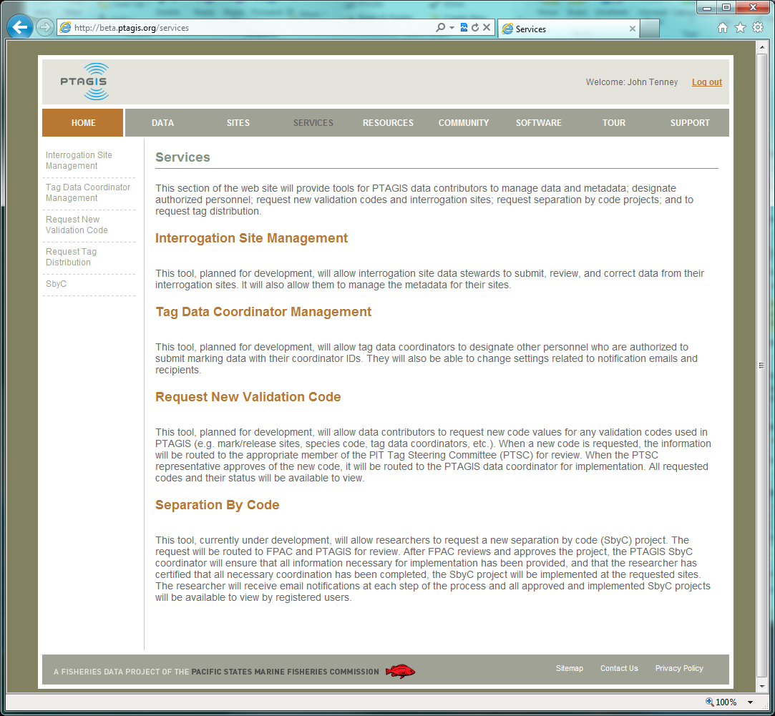
PTAGIS Web Site: Services
Notes:
There are a lot of new features on our new website we’re currently developing. The services section provides self-service governance of metadata by site stewards, PTSC and FPAC.

Slide 32

New PTAGIS Web Site: SbyC Project Requests
Notes:
For example, researchers will log into the site and complete an online form to request SbyC projects. FPAC will receive an email notification, review the request and promptly approve or deny.

Slide 33


PTAGIS Web Site: Interrogation Site Metadata Management
Notes:
Another service that is still in the design phase is allow researchers to request new interrogation sites. Similarly, PTSC will receive a notification and review the request metadata and promptly approve/deny the request. We’re working with an ad-hoc in-stream PIT Tag Steering group that includes ISEMP and others to define new set’s of metadata for in-stream sites to add to our database. Once defined, we’ll implement a portal to allow site stewards to maintain and version their metadata over time.

Slide 34



Evaluation of GIS Reporting Tools: Total Observations by Basin

