Slide 1
IEAB Cost-effectiveness
Evaluation Framework for Fish Tagging:
Building a (MIP) Programming Model
Bill Jaeger, IEAB
& Oregon State University
January 7, 2013

Slide 2
Outline of Presentation
Describe programming approach
Demo of simple model examples
More on specifics of approach
  Constraints, parameters, costs, objectives
  Versatility in how the model can be used
Practicality: we can’t include everything
Data/parameters needed (various dimensions)
Discussion – issues to explore?
  key attributes, dimensions, complementarities that should be included
A plan, a check-list, a sign-up sheet!

Slide 3
A programming model
A computer algorithm:
  to optimize an objective function (max profits; min costs; etc.)
  Subject to constraints (budget limit, required level of production, water balance, laws of physics, laws of supply and demand)
A way “to organize what we know” about a system, when there are many parts interacting simultaneously
  Example: what set of crops should a farmer grow to maximize profits.

Slide 4
An example:
Morocco fertilizer industry
Ingredients can arrive at one of several ports
Transported to one of several bagging stations
Shipped to markets in various cities
In quantities to satisfy market demand
Transportation can be by road, or rail (where lines exist), or a combination of the two
Model question: How to minimize the total cost of satisfying the demand for fertilizer in all market?

Slide 6
Fish tagging: similar to the fertilizer model in some ways
Fertilizer Fish Tagging
Market demand Detections “demanded” to generate indicators
Rail or road? PIT, CWT, Acoustic?
Ports Location of marking fish
Fertilizer type Species

Slide 9
So, there are sets of equations:
Objective function: {minimize costs}
Subject to: {detections <= markings}
{detections iff array in place}
Accounting {costs >= sum for tagging, detect.}
Accounting { costs <= budgets }
Accounting {index of priorities, summed up}
Other objectives: maximize priorities (given limited budget)
Other versions: maximize with all budgets, certain budgets only, maximize different versions of priority weights

Slide 11
More on general model description:

Slide 12
Costs and optimization:

Slide 13
The nuts and bolts:
Model structure and parameters need to reflect most dimensions of real world setting, but not all!
Define a set of (most important) nodes and reaches
Define detection/recovery requirements to answer most management questions
Define survival rates by reach, node
Estimate costs for each “activity” (tagging a fish, detecting a fish, installing an array, etc.)

Slide 14
So, now two demo models
A simple model in a spreadsheet WB:
  One species
  One technology
  A set of costs
  A set of detection requirements
A simple model in GAMS:
  Two species
  Two tag types
  A network of four downstream nodes; three upstream
  A set of detection requirements
  A set of costs

Slide 16
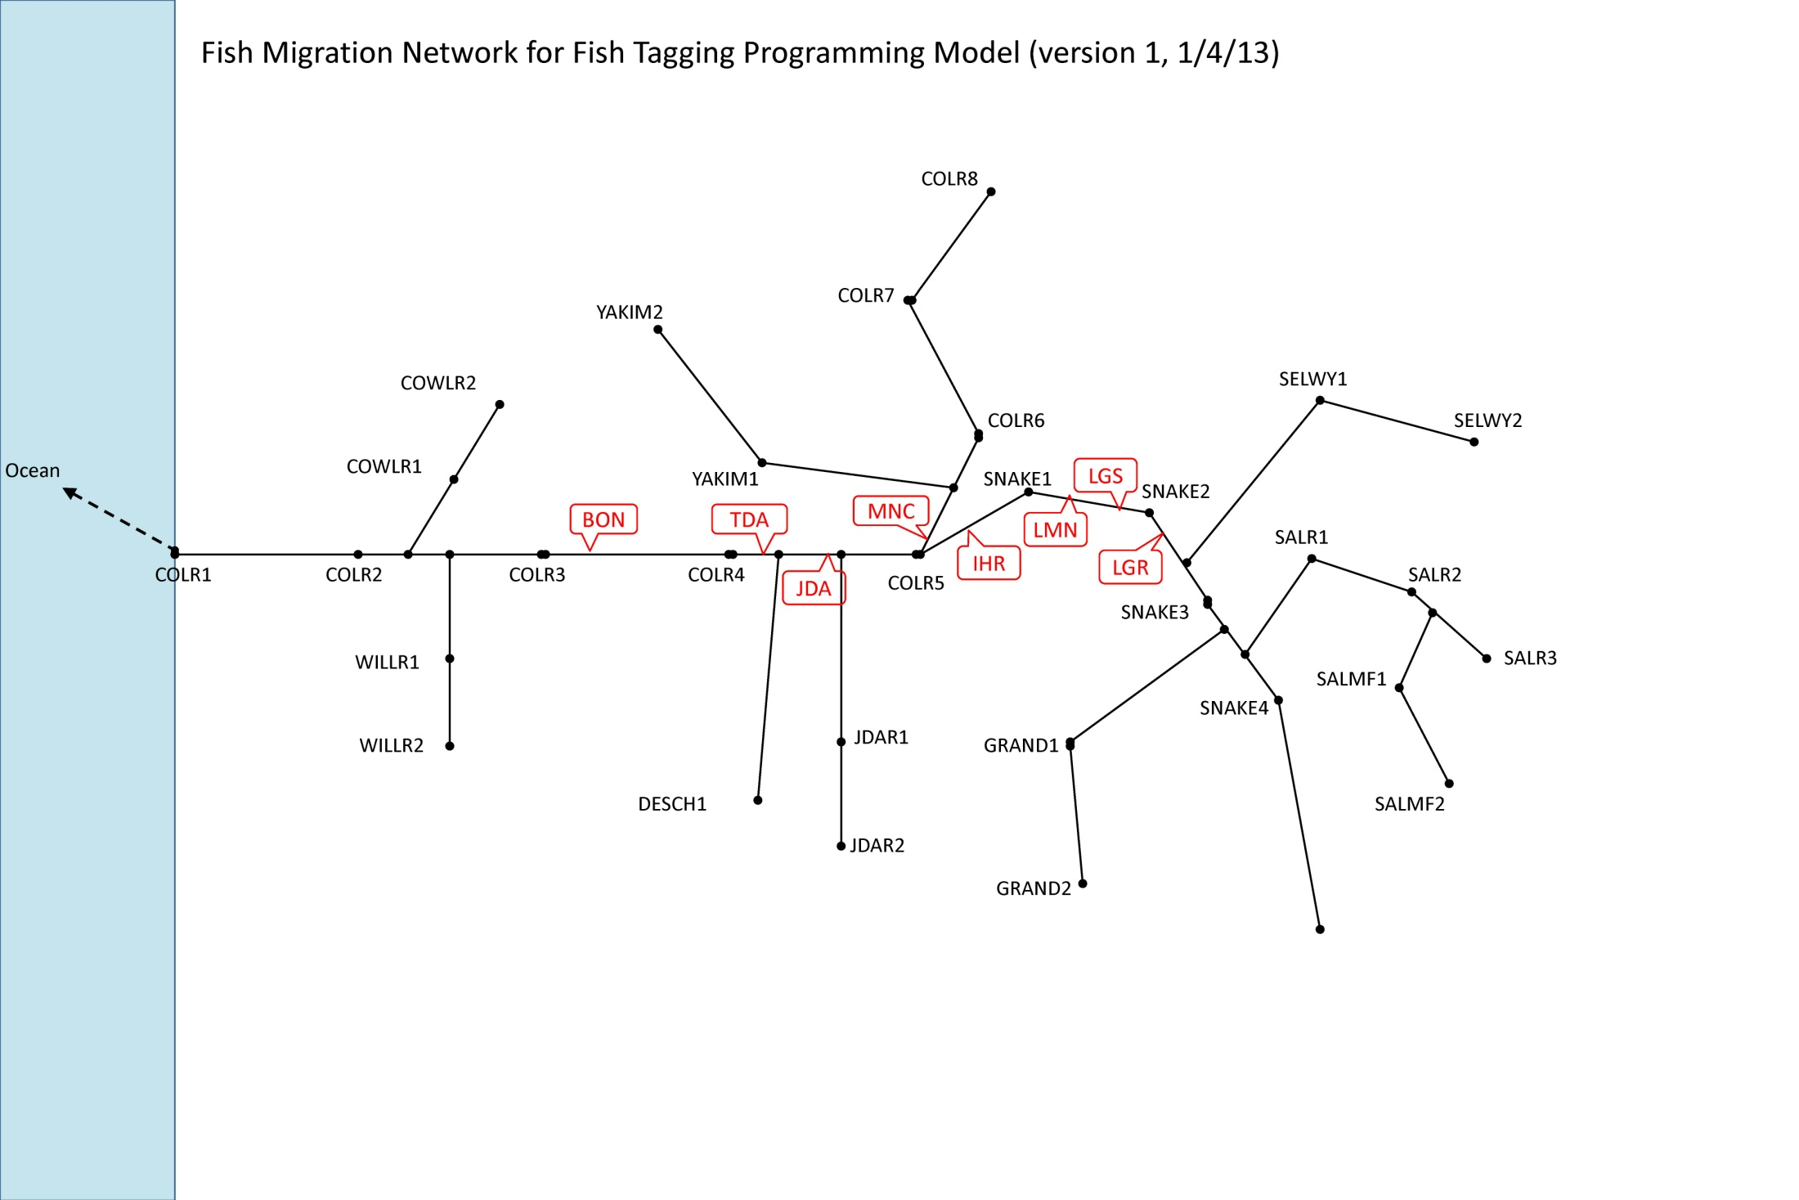

Slide 17
We need to make reasonable choices, to build a practical model – in terms of the network of nodes, reaches, hatcheries, release sites?
Aim for 80% coverage? 90%?
Start with ESA listed species?
Aggregate model sites for each ESU?
Issue: management questions/indicators in FTF spreadsheet are not species-specific

Slide 18
How to estimate # of “required” detections/recoveries?
Some possibilities:
CSS report has “smolts arriving” at MCN, MCA, BOA, JDA, LGR, but not other locations
Alternative: Look at data on “smolts tagged”, assume 3% SAR, and so multiply by 0.03 to estimate required “smolts arriving”
Other approaches?
Other sources of comprehensive data?

Slide 19
Other model elements to decide:
Reach/dam survival rates in river network – how to estimate?
Locations for detection to include?
Locations for tagging to include?
  E.g., top 40 hatcheries, release sites?
Cost data (template) – need to fill in template

Slide 20
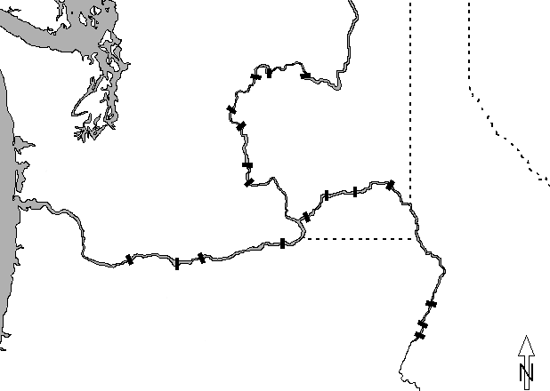

Yearling
Chinook salmon
reach survival
LGO
LGR
91.2
LMO
SRT
91.4
ICE
BON
TDA
JDA
MCN
2011
76.6 (87.5)
89.3
84.5
96.6
91.9
94.3
BON
JDA
MCN
LMO
LGO
LGR
SRT
Average
81.2 (89.8)
89.6
86.5
94.2
93.6
95.1
Standard errors not shown
Notes:
From Muir

Slide 21
Steelhead
reach survival
LGR
LMO
LGO
92.8
SRT
83.9
ICE
BON
TDA
JDA
MCN
2011
85.8 (92.6)
96.0
77.2
94.8
95.5
98.6
BON
JDA
MCN
LMO
LGO
LGR
SRT
Average
74.5 (86.0)
83.8
75.5
91.2
93.0
96.7
Standard errors not shown
Notes:
From Muir

Slide 22
A table of reach survival rates will be needed

Slide 24
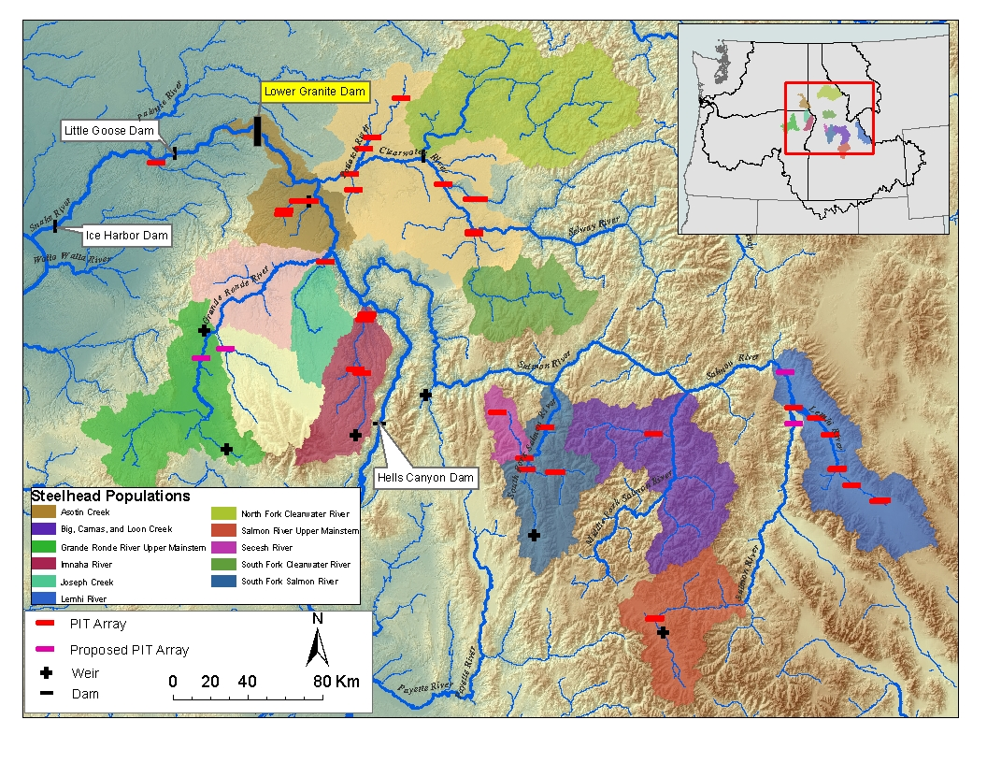
Notes:
From PIT tag presentation Hassemer 2012

Slide 25
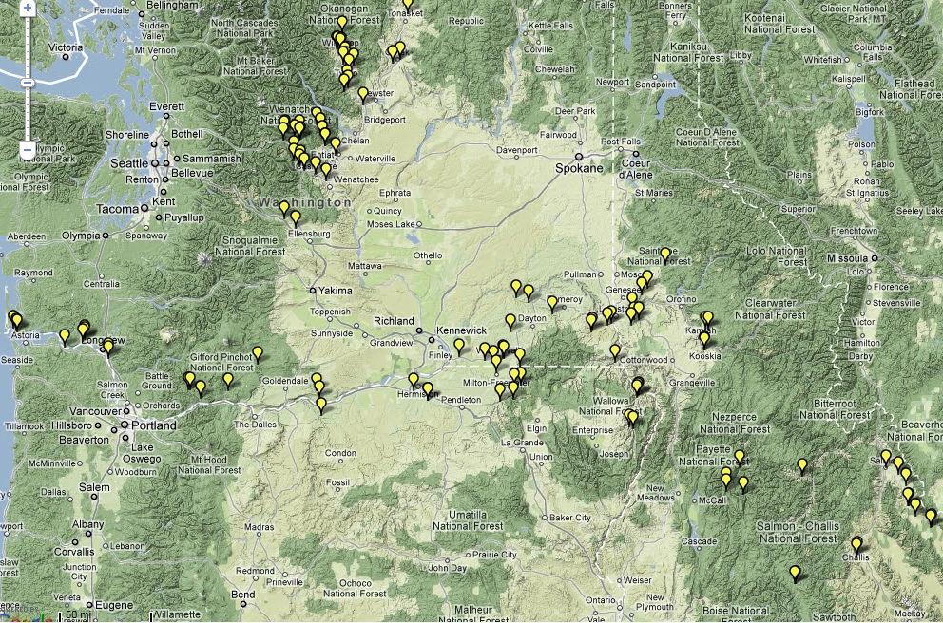
PIT tag instream arrays

Slide 27
Example of the kinds of “activity cost” information we need (From Dan Rawding):
Budget Increase
  2500 PIT tags for smolts & adults ($4K/year)
  2 Handheld readers ($6K) life 10 years
  Instream detector installation to replace abundance monitoring at Hemlock Dam ($55K)
  Instream detector O&M ($10K/yr)
  Parr survival as part of life cycle monitoring using 3000 PIT tags (5k/yr)
  Increase for database management, analysis, reporting ($10-20K/yr)

Slide 28
Checklist, sign-up sheets!
FTF work is a great resource for us;
but we need focused help from FTF participants:
  Choosing the dimensions of the model
  Estimating detection requirements by location, species, population, etc.
  Estimating variable and fixed costs for key “activities” (tagging, detecting)
  Survival rates
  Translating management questions into gross detection numbers between A and B, by species
  We need names, contact info, of individuals who can help with specific items; for intensive push during next three weeks

