Slide 1
Key Findings and Resource Strategy

Slide 2
The Council’s Power Plan
Goal - Ensure an adequate, efficient and affordable regional power system
Major Components
Forecast of regional electricity demand over the next 20 years
A “least cost with acceptable risk” Resource Strategy
Regional action plan to implement Resource Strategy
Use
By statute, plan guides Bonneville Power Administration’s resource decisions
By tradition, plan serves as an independent reference for all of the region’s utilities, regulatory commissions and policy-makers

Slide 3
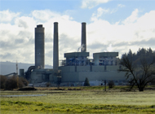
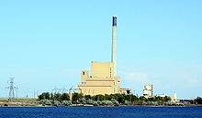
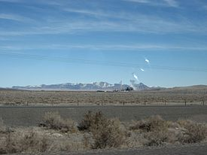
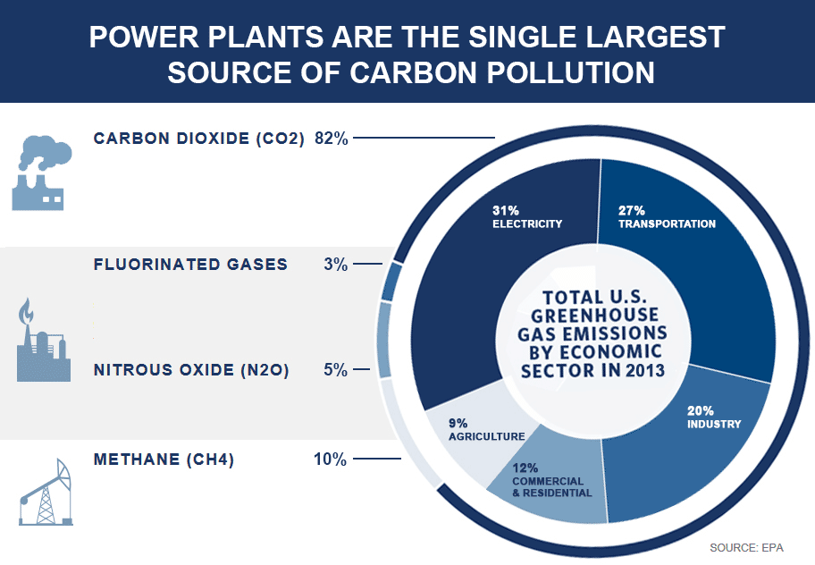
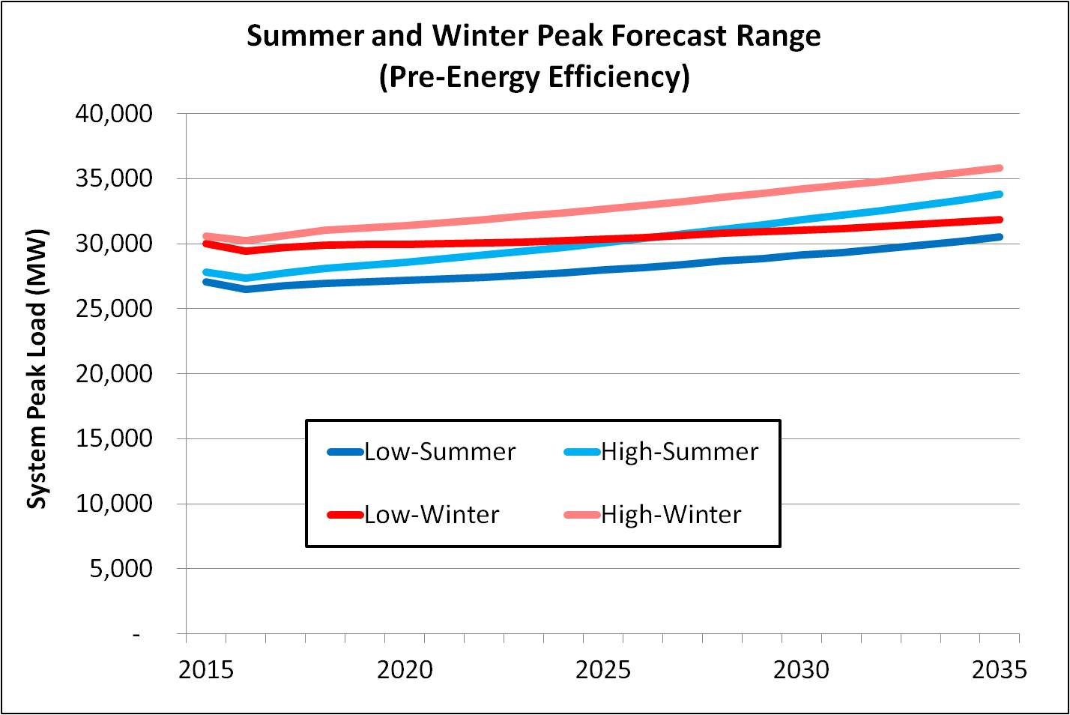
The Seventh Power Plan – Major Issues
Boardman – 550 MW
North Valmy – 522 MW
Centralia 1 & 2 – 1340 MW
Impact of announced coal-plant retirements on need for new resource development
Implications of and options for addressing EPA’s Clean Power Plan
How to best meet regional need for capacity (i.e., peaking) resources

Slide 4
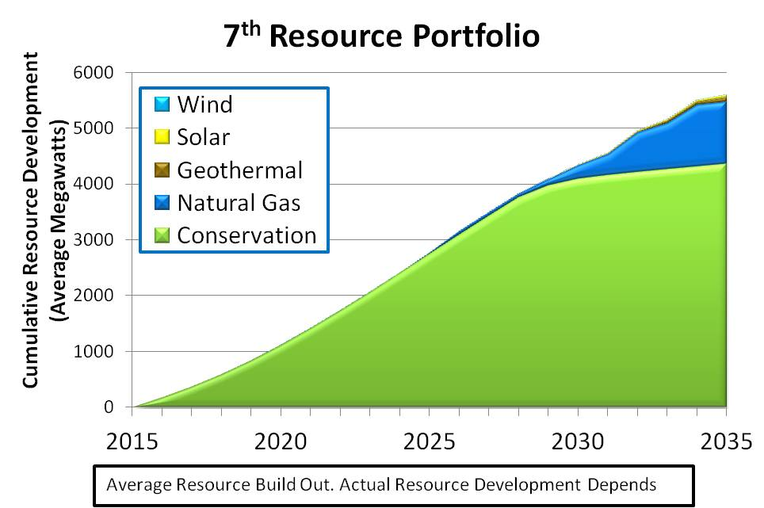
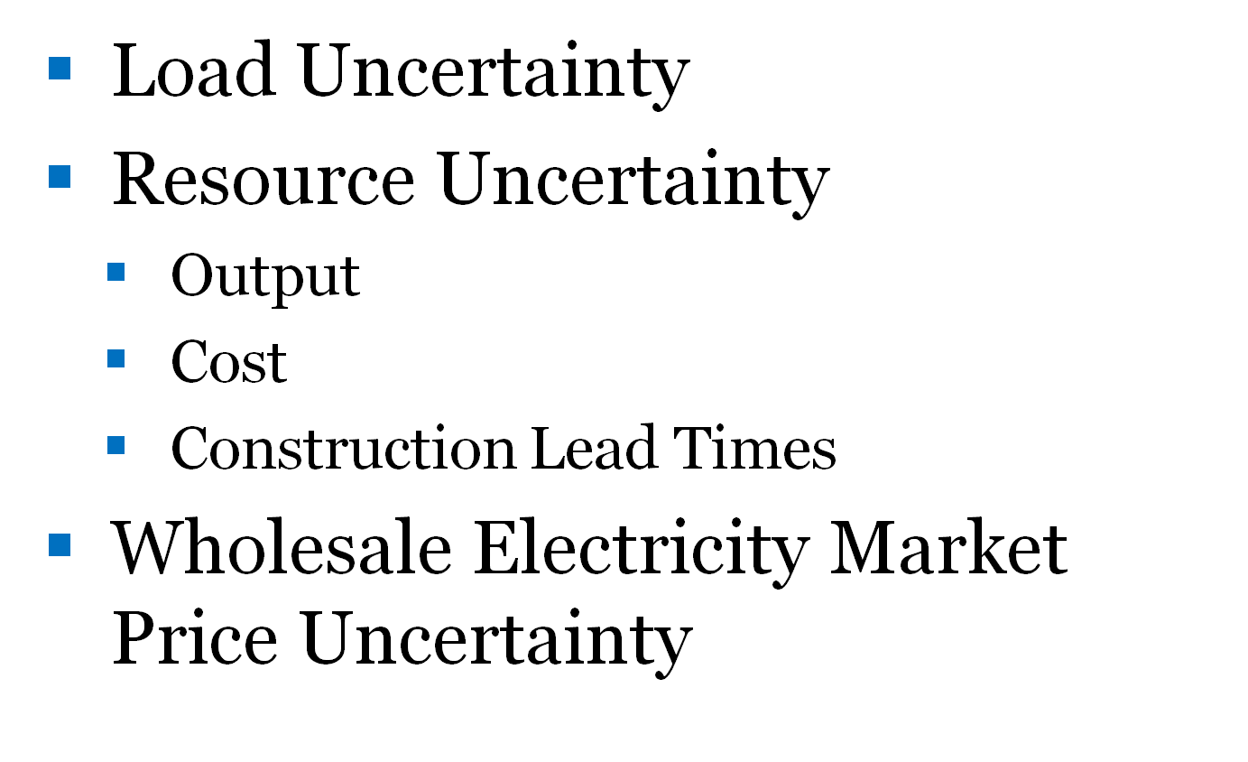
The Answers to These Issues Requires Planning for Uncertainty
Resource Strategies – actions and policies over which the decision maker has control that will affect the outcome of decisions
Futures – circumstances over which the decision maker has no control that will affect the outcome of decisions
Scenarios – Combinations of Resource Strategies and Futures used to “stress test” how well what we control performs in a world we don’t control

Slide 5
Council Follows the “Gump” Resource Strategy Testing Model
The Future’s Like A Box of Chocolates.
You Never Know What You’re Gonna Get.

Slide 6
Council Tested Over Two Dozen Different Scenarios
Existing Policy
Social Cost of Carbon
Retire Coal
Retire Coal and Inefficient Gas
Retire Coal & Impose Social Cost of Carbon
Retire Coal & Impose Social Cost of Carbon & No New Gas
Regional RPS @ 35%
No Demand Response
Increase Market Reliance
Lower Conservation

Slide 7
Key Findings

Slide 8
Key Finding
The region’s population and economy are forecast to grow

Slide 9
Regional Population and Economic Forecast

Slide 10
Key Finding
Energy Efficiency and Demand Response can meet nearly all growth in energy and capacity needs through 2035

Slide 11
Seventh Power Plan Least Cost Resource Strategies for Meeting Forecast Energy and Capacity Needs

Slide 12
Forecast Load Growth Over The Next Two Decades (Average Over 800 Futures)
Regional Load Growth Met with Energy Efficiency
Load Reduction from Federal Standards
Adopted Post-Sixth Power Plan
Regional Load Net of Energy Efficiency

Slide 13
Key Finding:
The Seventh Power Plan Relies on Energy Efficiency and Demand Response Resources To Meet Load Growth
Because they cost less!

Slide 14
All Resource Cost – Energy

Slide 15
All Resource Cost – Peak Capacity

Slide 16
Key Finding
A Minimum of 600 MW of Demand Response resources should be developed to meet regional peak demands

Slide 17
Demand Response Deployment By Scenario (Average Across 800 Futures)

Slide 18
Probability and Amount of Demand Response Deployment by Scenario
Minimum Probability of 600 MW DR Deployment by 2021 is 70%

Slide 19
Key Finding
Retiring coal plant generation can be replaced by greater reliance on existing natural gas plants

Slide 20
Existing Natural Gas Dispatch by Scenario (Average Across 800 Futures)

Slide 21
Key Finding
No immediate need to acquire or build new natural gas-fired generating resources
Unless, regional energy efficiency and demand response goals are not achieved
OR
Unless, additional coal plants are retired

Slide 22
Probability of Needing New Natural Gas Generation by 2021

Slide 23
Key Finding
Resource strategies that maximize the use of existing regional resources to satisfy the region’s resource adequacy standards require less resource development

Slide 24
Net Electricity Exports (Exports minus Imports) by Scenario (Average Across 800 Futures)

Slide 25
Key Finding
EPA carbon emission reduction regulations can be met regionally
However, some states, especially Montana, face significant challenges

Slide 26
Annual CO2 Emissions for Plants Covered by Clean Power Plan by Resource Strategy and Scenario (Average Across 800 Futures)

Slide 27
Key Finding
Carbon emission reduction policies that result in the significant renewable resource development without also retiring coal generation produce the least carbon emission reductions per dollar invested

Slide 28
Annual Regional Power System CO2 Emissions in 2035 by Scenario (Average Across 800 Futures)
70%

Slide 29
Present Value Cost of Reducing Regional Power System CO2 Emissions by Scenario (Average Across 800 Futures)

Slide 30
Why Increasing RPS (Alone) Isn’t an Effective Option for Reducing CO2 Emissions
RPS don’t reduce coal use
RPS don’t change the fact that the “wind doesn’t blow and the sun doesn’t shine all of the time”
RPS lower the amount of cost-effective energy efficiency

Slide 32
Seventh Plan Resource Strategy
Energy Efficiency Development
1400 aMW by 2021
3000 aMW by 2026
4300 aMW by 2035
Expand Use of Demand Response
Develop at least 600 MW of demand response resources by 2021
Natural Gas
Increase use of existing gas generation to offset coal plant retirements
While there is a very low probability of regional need for new gas-fired generation prior to 2021, individual utility circumstances and need for capacity and other ancillary services may dictate development

Slide 33
Resource Strategy
Renewable Resources
Develop local renewable alternatives that are cost-effective now
Develop solar PV systems to comply with existing renewable portfolio standards, especially in areas with increasing summer peak loads
Conduct research on and demonstration of renewable energy with a more consistent output like geothermal or wave energy
Carbon Policies
Support policies that cost effectively achieve state and federal carbon dioxide emissions reduction goals, while maintaining regional power system adequacy by:
Develop the energy efficiency and demand response
Replace retiring coal plants with increased use of existing gas-fired generation
Dispatch existing regional generation to meet adequacy standards for energy and capacity rather than to serve external markets
Do not increase the requirements of state renewable portfolio standards without also either retiring coal generation or imposing a cost on carbon

Slide 34
Resource Strategy
Regional Resource Use
Continue to improve system scheduling and operating procedures across the region’s balancing authorities to maximize cost-effectiveness and minimize the need for new resources to integrate renewable generation
Improve use of existing regional resource to meet regional adequacy standards
Expand Resource Alternatives
Energy efficiency
Renewable with less variable output (e.g., enhanced geothermal, wave)
Adaptive Management
Monitor regional economic conditions and market developments
Assess progress on 7th Power Plan energy efficiency and demand response goals

Slide 35
Questions?

Slide 36
Backup Slides

Slide 37
Carbon Dioxide Emission Reduction Policies
Council Tested Multiple Policy Options for Reducing Carbon Emissions
Non-Pricing Policies
Existing state and federal policies (RPS & CPP)
Retire Coal (all plants beyond those plants already announced)
Retire Coal and Inefficient Natural Gas (below 40% efficiency)
Increase Regional RPS to 35% of All Retail Sales
Pricing Policies
Assume carbon cost equivalent to Federal Government’s estimate of the Social Cost of Carbon (SCC)
Mid-Range SCC Estimate ($40/MT in 2016, escalating to $60/MT in 2035
95th Percentile SCC Estimate ($160/MT in 2016, escalating to $180/MT in 2035
Non-Pricing Combined with Pricing Policies
Retire Coal w/MidRange SCC
Retire Coal w/MidRange SCC and Restrict Development to Renewable Resources

Slide 38
Key Finding
The two carbon emission reduction policies that result in the significant renewable resource development mandate a minimum share of renewables or restrict development of new natural gas generation

Slide 39
Average Annual New Renewal Resource Generation Dispatch 2015-2035 Under Alternative Resource Strategies

Slide 40
Key Finding
Neither of the two carbon emission reduction policies that result in the significant renewable resource development significantly reduce coal use

Slide 41
Average Annual Coal Generation Dispatch 2015-2035 Under Alternative Resource Strategies

Slide 42
Key Finding
The two carbon emission reduction policies that result in the significant renewable resource development significantly reduce reliance on existing natural gas generation

Slide 43
Average Annual Existing Gas Generation Dispatch 2015-2035 Under Alternative Resource Strategies

Slide 44
Key Finding
The two carbon emission reduction policies that result in the significant renewable resource development significantly decrease new natural gas-fired generation development

Slide 45
Average Annual New Natural Gas Generation Dispatch 2015-2035 Under Alternative Resource Strategies

Slide 46
Key Finding
The two carbon emission reduction policies that result in the significant renewable resource development slightly decrease long term energy efficiency development

Slide 47
Cumulative Energy Efficiency Development 2016-2035 Under Alternative Resource Strategies

Slide 48
Average Annual Carbon Dioxide Emissions 2015-2035 Under Alternative Resource Strategies

Slide 49
Summary of Carbon Reduction Policy Costs and Impacts
CO2 Emissions - PNW System 2016 - 2035 (MMT) | Cumulative Present Value Average System Cost of Emission Reduction (2012$) | Cumulative CO2 Emission Reduction Over Existing Policy - Scenario (MMT) | Incremental Emission Reduction (MMT) | Incremental Average System Cost (billion 2012$) | Incremental Cost of CO2 Emission Reduction (2012$/MT)
Existing Policy | $82 | 0 | 0 | $0 | $0
Retire Coal | $98 | 197 | 197 | $16 | $81
SCC - Mid-Range | $78 | 351 | 154 | ($20) | ($130)
Retire Coal w/SCC_MidRange | $91 | 377 | 26 | $13 | $500
Retire Coal w/SCC_MidRange & No New Gas | $126 | 430 | 53 | $35 | $660

Slide 50
Carbon Pricing Policies Drive Cumulative Emissions Reduction and System Cost

Slide 51
Forecast Load Growth Over The Next Two Decades (Average Over 800 Futures)

Slide 52
Northwest Actual and Forecast Loads After Accounting for Energy Efficiency 2000- 2035

